Slide 1
Community Advisory Board Questionnaire Outline
September 7, 2017

Slide 2
What is the CAB Questionnaire and Why?
New form developed this past July; replaces the old Cultural Competence Report
Cultural Competence had stopped requiring submission of CC Report as of 2015
Purpose of the form:
Emphasize OCC’s focus on CAB development within CBOs and Civil Service Clinics
Scale down the amount of questions and time needed on the form, from 11 pages to 2
Removes some of the staff demographic questions
Attempts to take a more qualitative look at the status of CABs
As of now, form is meant to only be a temporary measure

Slide 3
Question Breakdown 1
How many CABs does your agency/program have? How are they organized (e.g. by agency, program, stakeholder)? Please also describe the recruitment/selection & retention strategies and membership types as applicable (e.g., cultural groups, expertise, etc.).
For multiple CABs within an agency, how are they divided?
Member types of the CAB/demographics
Via ethnic, racial, cultural backgrounds
Breakdown by relationship to the organizations (i.e. client, program staff, community member, etc.)
Recruitment and retention methods: application process? Word of mouth?
Incentives used to draw people to CAB sessions and have them come back

Slide 4
Question Breakdown 2
What is the general structure of the CAB(s)?
Frequency or number of CAB sessions in a given period
Quarterly, bi-annually, every third Wednesday of the month, etc.
How many core members does the CAB have?
Based on the number of registered members, what’s the participation rate

Slide 5
Question Breakdown 3
Which CLAS (Cultural Linguistic Appropriate Services) standard/module if any has your CAB(s) worked (is working) towards? How has the agency/program approached implementation of related goal(s) and what are some CAB activities/projects that reflect this? What do you foresee as the long-term result?
Each program is supposed to designate one area on which the CAB will focus on
Ex. Increased linguistic capabilities, recruitment of more diverse workforce and leadership, culturally appropriate management accountability infused in planning
The steps taken to initiate change towards the goals
New procedures or the establishment of new relationships, such as working with universities
What will the future look like?

Slide 6
Question Breakdown 4
How are the ideas /information generated by the CAB(s) shared within the program/agency? To whom do they go (e.g. Agency/Program Director, Board of Directors)?
Who takes the meeting minutes and where are they recorded?
Transparency at all levels or is there discretion?
Are the ideas generated from the CAB given any weight in the program’s decision-making?
The extent to which those ideas allowed to make their way up the organization

Slide 7
Question Breakdown 5
What positive contributions has the CAB made to the agency/program?
Self-explanatory
Extent to which CAB has developed from year to year
A list of some of the ideas that have been put into action
Any observations on what those actions have yielded:
Increased client participation rates
Improved staff moral
Stronger data collection
More thoughtful levels of engagement with clients

Slide 8
Question Breakdown 6
What are some challenges or barriers to operating the CAB?
Inadequate monetary and time resources, staff shortages
Inability to dedicate time for outreach and retention efforts
Unable to offer non-service related incentives
General client disinterest or reluctance to join the CAB
Questions of its usefulness
What’s in it for them
The challenges they face to attending CAB events (childcare, work obligations)
Organizational/structural attitudes that inherently look inward and not out (at the greater community) when developing strategies

Slide 9
Question Breakdown 7
Is there any other valuable information to share about your agency/program’s CAB(s)?
Anything can be included here such as:
Discontinuation of the CAB
Developments, tips or resources that could be shared with other agencies in order to improve the effectiveness of CABs
Changes in leadership
A new approach that your agency is taking to (re)form a CAB

Slide 10
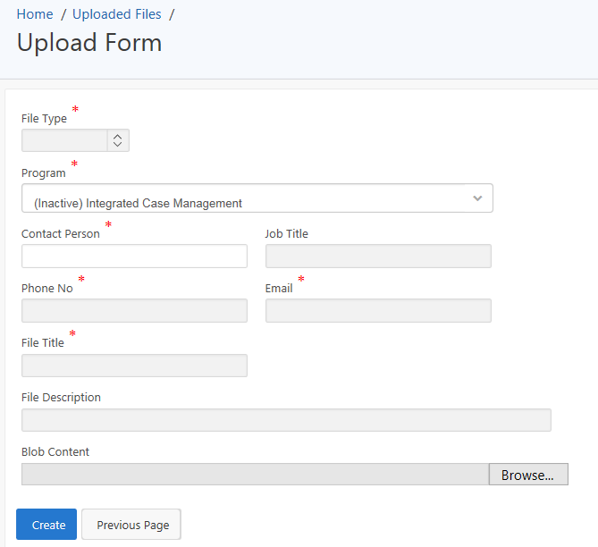
Submission
CAB Report can be submitted in two ways:
Scanned PDF or MS Word versions can be emailed to me
Digital copies can also be uploaded onto the Cultural Competence Tracking System (Homepage>File Upload>Create)
Deadline: September 30th, 2017

Slide 11
Questions?
For any further questions, please email me at michael.rojas@sfdph.org or call 415-255-3426
Thank you

