Slide 1
How to Access Trainings in the SF Employee Portal A Quick Guide for DPH Employees

Slide 2
In this guide, you will learn:
How to log into the SF Employee Portal
How to launch the Learning application to view your available classes and learning modules

Slide 3
After you launch the Learning app, the instructions in this guide will walk you through the steps to navigate to the Compliance and Privacy online course.
If you have issues, please refer to slide 23 for contact information.

Slide 4
Use only Chrome or Firefox to access the training
Do not use Internet Explorer Be sure to enable pop-ups. Note, by default, Google Chrome blocks pop-ups from showing up on your screen. When a pop-up is blocked, the address bar will be marked Pop-Up blocked. Select “Always allow pop-ups and redirects” from the site.

Slide 5
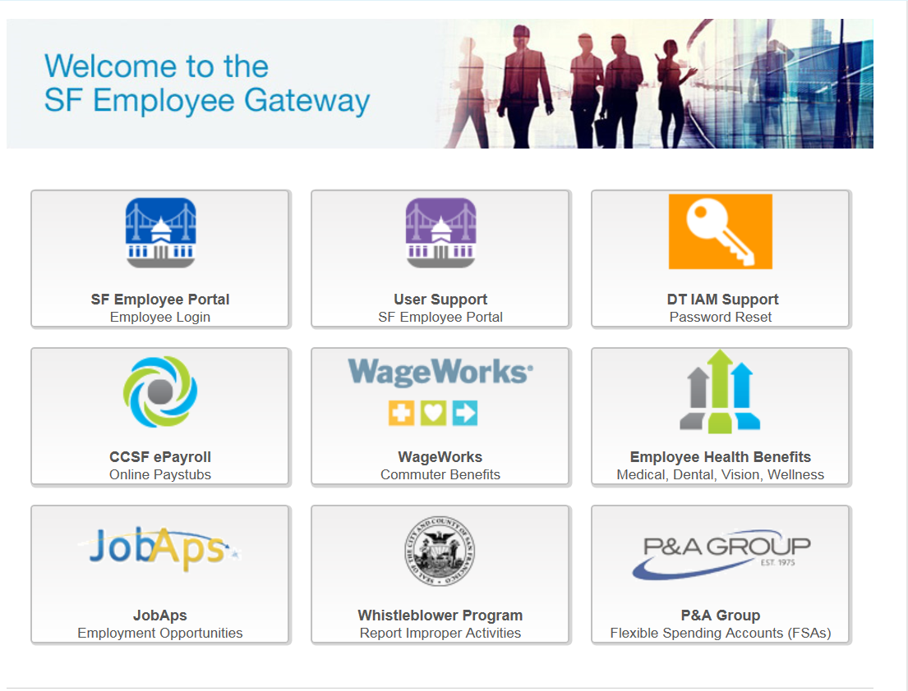
Go to SF Employee Portal to access the training. Go to https://sfgov.org/sfc/employee-gateway

Slide 6
STEP 1
Click “SF Employee Portal”
Click “SF Employee Portal”

Slide 7
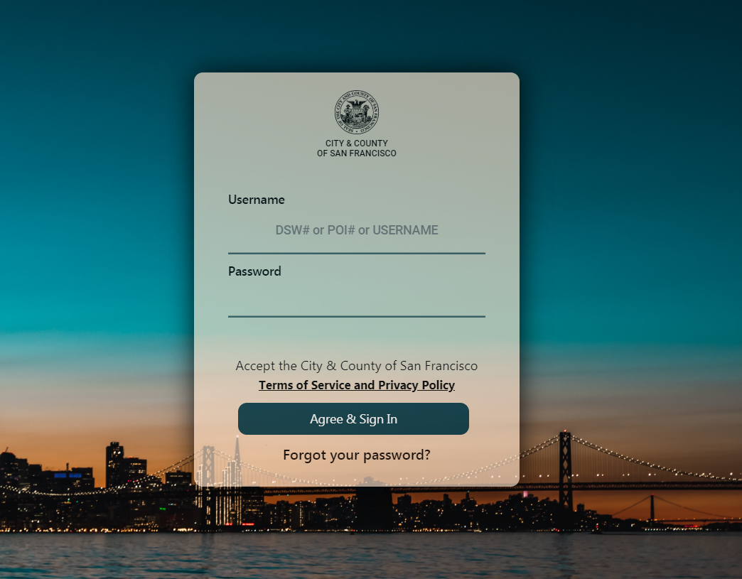
STEP 2
Enter your DSW Number and password.
Then click “Agree & Sign In”

Slide 8
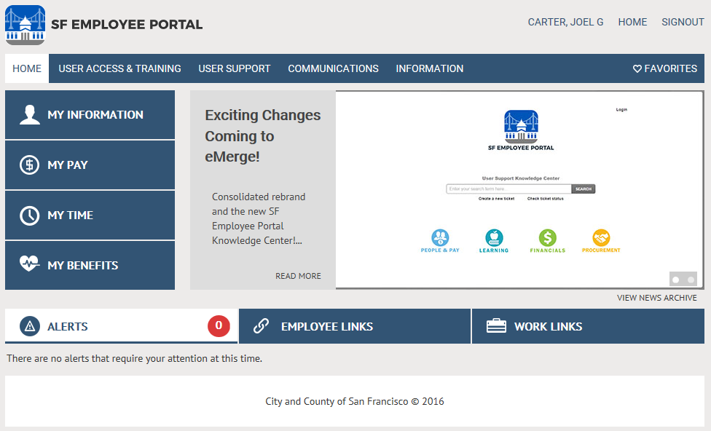
STEP 3
Click “WORK LINKS”

Slide 9
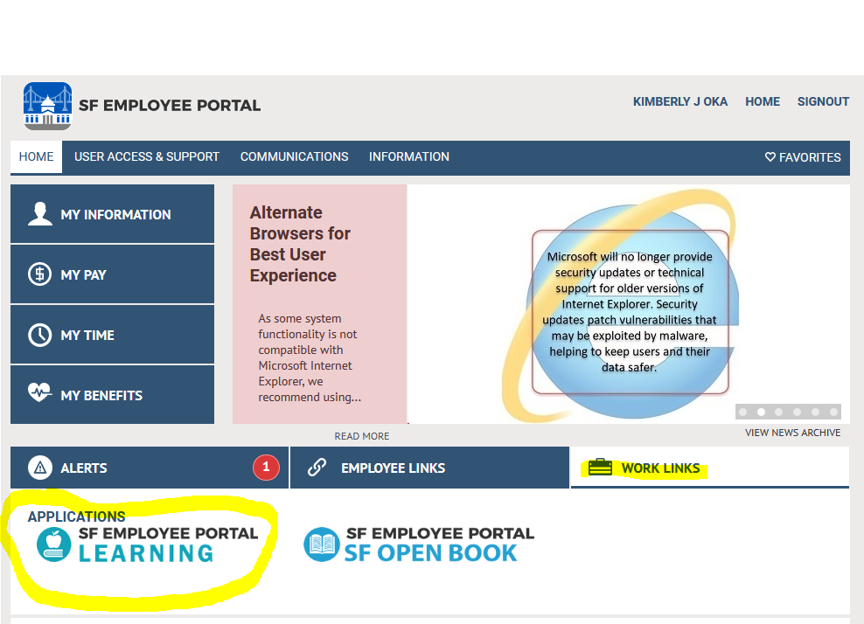
STEP 4
You will see a screen similar to this. Click on
SF Employee Portal Learning to enter the training.

Slide 10
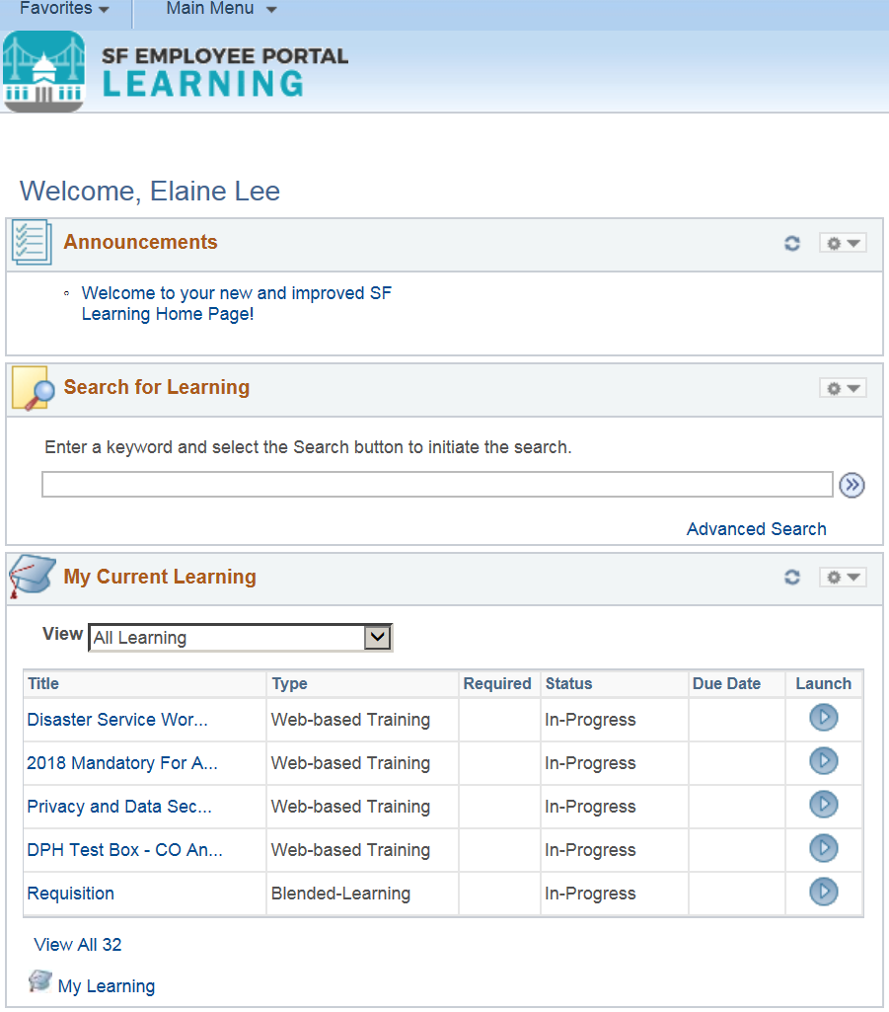
STEP 5
A list of your available trainings will appear, as seen here. Click on the “My Learning “ icon on the lower left hand side to move to step 6.

Slide 11
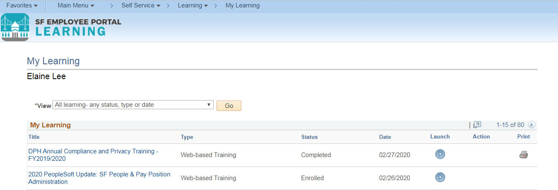
STEP 6
Locate the training

Slide 12
STEP 7
Click “Launch”

Slide 13
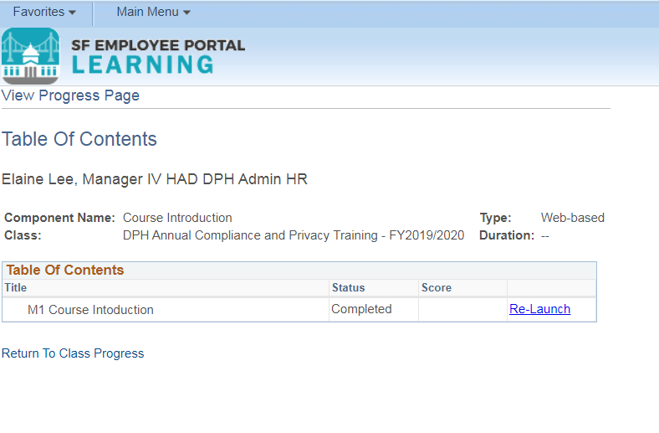
If the course does not appear, look for the pop-up blocker notification. Allow for the pop-up blocker and launch the course.
Click “Launch” to begin or “Re-Launch” to continue.

Slide 14
The course will appear in a new tab. Click “Start” to begin the course.

Slide 15
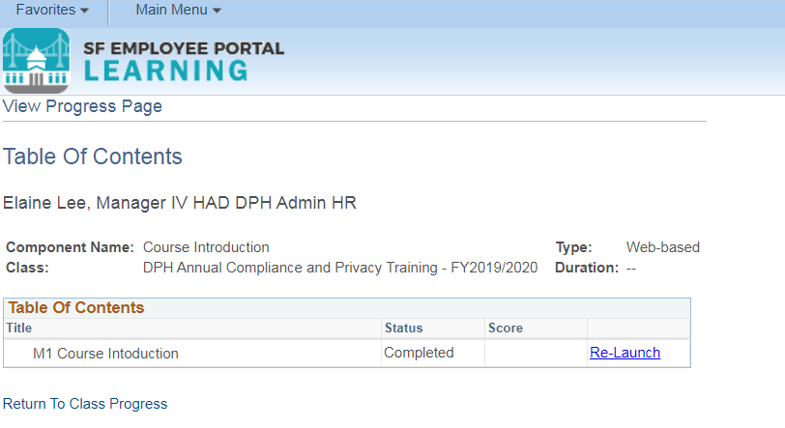
After you complete each module, the final slide will direct you to close the tab and return to the Class Progress page.

Slide 16
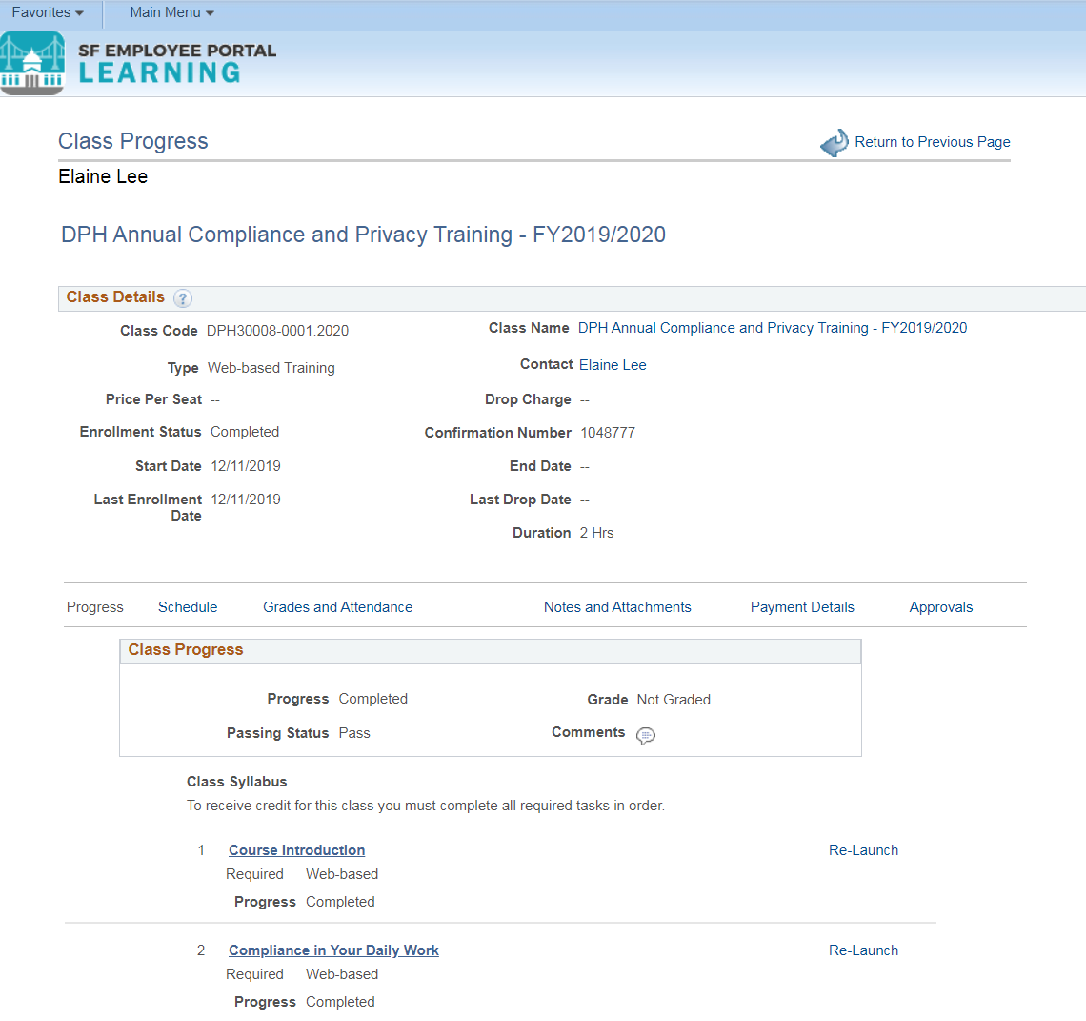
Click on the next module to proceed.

Slide 17
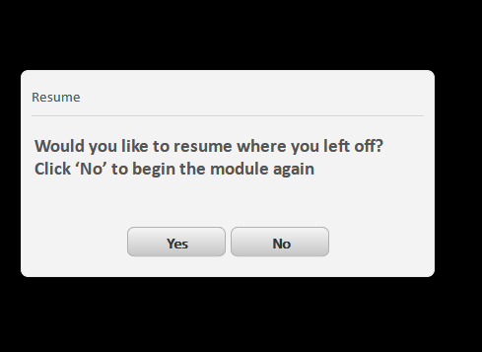
Please note that all modules can be bookmarked except for Module 3 Compliance Guidelines.
Bookmarking means that you can stop during a module and return to the last slide you were viewing at a later time.

Slide 18
Always remember to sign out when you are finished using the SF Employee Portal.
Click

Slide 19
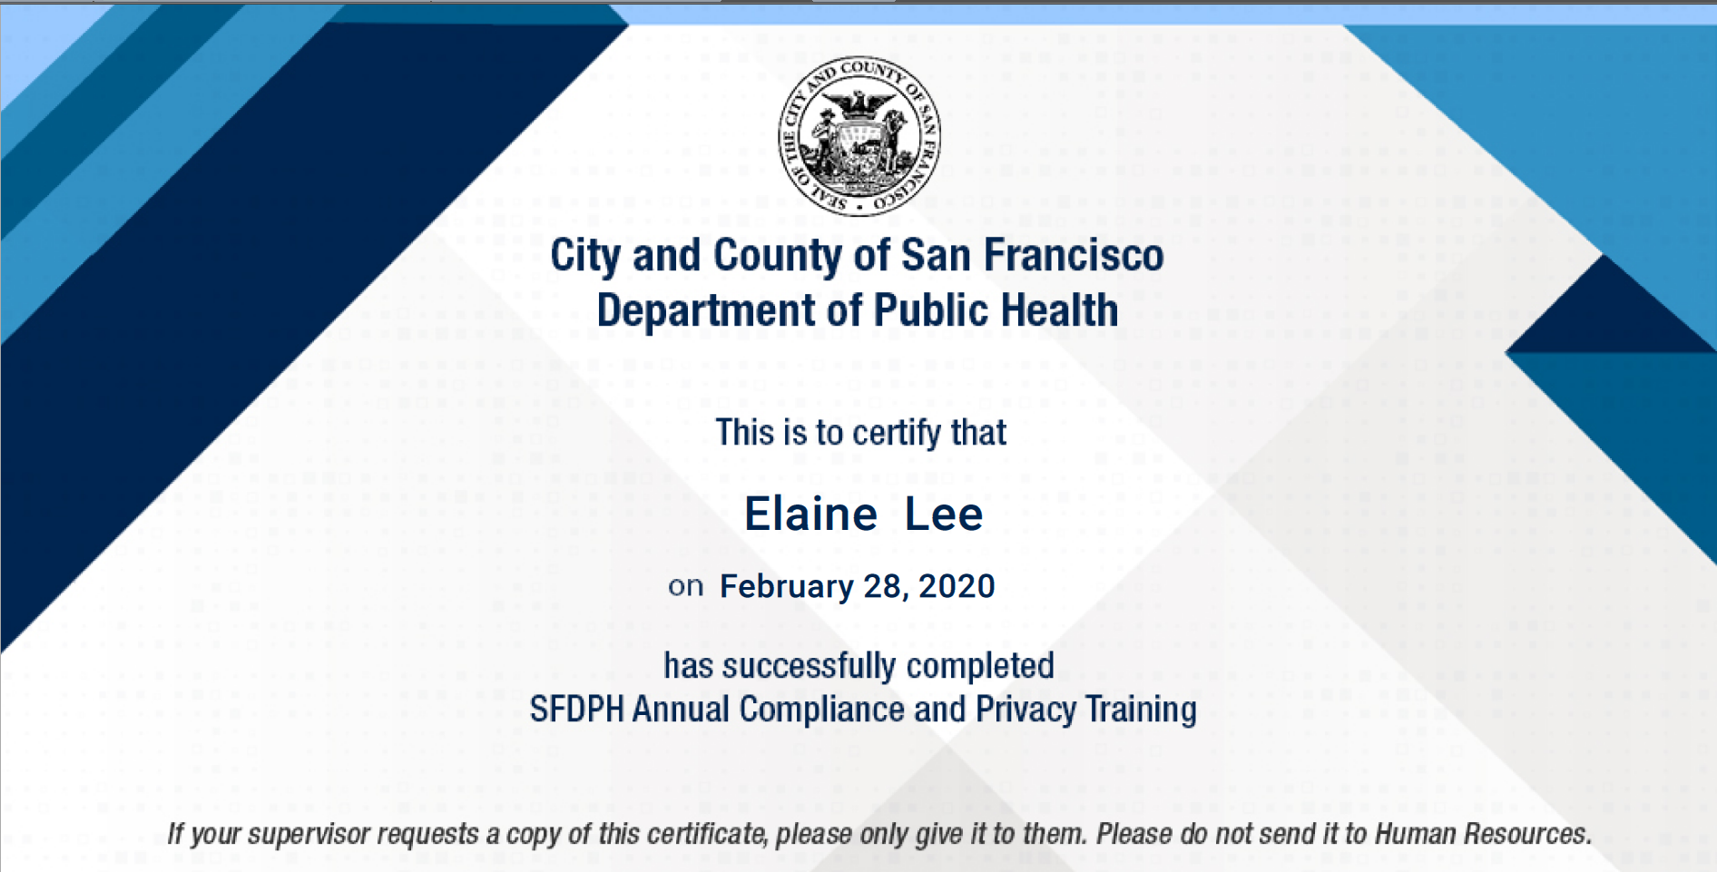
When you have completed the entire course, you will receive your Certificate of Completion.

Slide 20
Congratulations!
You have successfully logged into the SF Employee Portal, launched the Learning application, and completed the Annual Compliance and Privacy training!

Slide 21
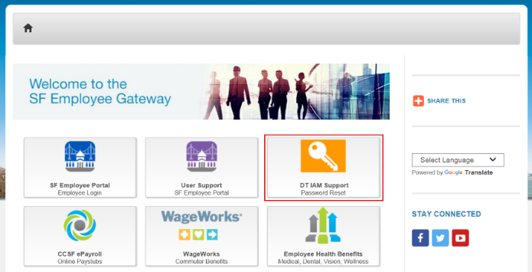
If you would like to change your password visit www.sfgov.org/sfemployee, select the DT IAM Support Password Request tile and follow the prompts.
.

Slide 22
For assistance regarding locked accounts or technical issues, please contact the Department of Public Health Service Desk at (628) 206-7378 or dph.helpdesk@sfdph.org.
If the SF Employee Portal Learning is not visible – contact the SF Employee Portal Support at (415) 944-2442 or sfemployeeportalsupport@sfgov.org.

Slide 23
For all other questions, please contact one of the following based on your work location. If you are sending an email, please include your DSW ID number and the nature of the issue.
Laguna Honda Hospital
DPH-LHHDET@sfdph.org
ZSFG
ZSFG.ELM@sfdph.org
Maternal Child and Adolescent Health (MCAH)
David Bell – David.Bell@sfdph.org
Population Health
Marise Rodriguez – Marise.Rodriguez@sfdph.org
Jail Health
Margaret Erickson – Margaret.Erickson@sfdph.org
If you do not see your area listed above, email the Office of Compliance and Privacy Affairs
Compliance.privacy@sfdph.org (faster service) or call (855) 729-6040.

