Slide 1
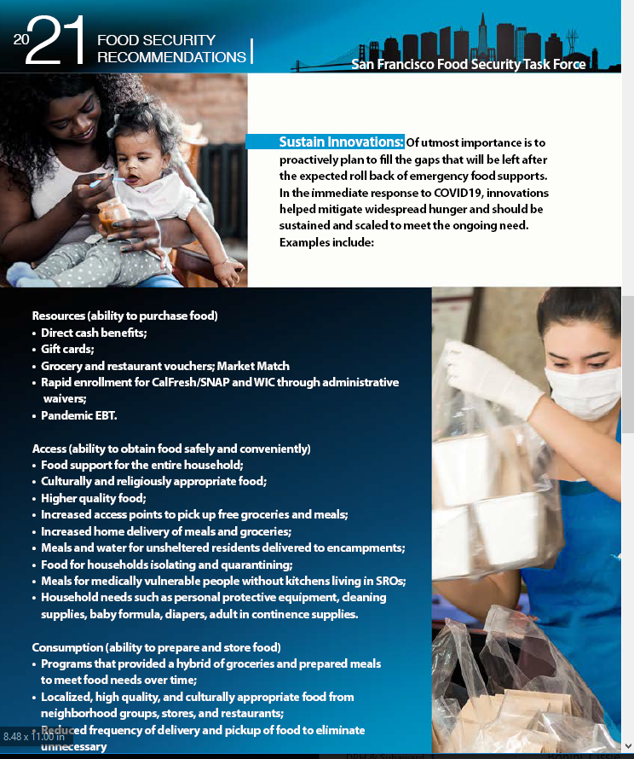
Innovations (& Flexibility)
Neighborhood Hubs
Flexibility (esp. public sector requirements)
Delivery
Culturally Relevant Meals + Groceries
Community Groups + Food
Business + Food
(restaurant meals, local business, etc.)
Grocery & Meal Vouchers
Housing + Food
San Francisco Food Security Task Force
March 2021
Notes:
Cissie: Huge range of innovations and increased infrastructure
New systems and connections that didn't previously exist
City wide – IQ network
**Highlight examples in specific districts
D1 -
D2 -
Neighborhood/Cultural
SFAAFBC, Latinx Taskforce ,Mission Food Hub, Mother Browns/Glide/St. Anthony's, EatSF grocery vouchers for Halal foods, Latinx families with young children, Black/AA, Recent – RFP for Latinx foods from COVID Command
Business + Food (economic stimulus/support)
SF New Deal, Great Plates, Feed + Fuel Chinatown, SF Produce Market, EatSF grocery vouchers
Delivery (particularly important for SIP)
Meals in Place (unsheltered), SFMFB, Mother Browns, Isolation & Quarantine (IQ )
Housing + Food
SF Housing Authority, TNDC + Farming Hope, DISH + LaCocina, Conard House, ECS, etc.
Grocery & Meal Vouchers
Feed & Fuel Chinatown, EatSF grocery vouchers, Clinic By the Bay,

Slide 2
Innovations (& Flexibility)
BRIEF sharing (no big lift for orgs/groups - does not need to be a powerpoint)
Set aside 10 – 15 minutes on monthly agenda
Answer a few questions such as:
Brief description of the food intervention
What, who are the beneficiaries
What makes it new/innovative
Key (3-5) benefits
Key (3-5) challenges
Who to contact for more information
Q&A
Flexibilities – agenda item to gather “what worked” or share (like above)
San Francisco Food Security Task Force
August 2021
Local community-based & faith-based organizations are the first responders for food but often not included in planning

Slide 3
Future Agenda Items
Identifying Opportunities & “Pushing” Solutions
Food As Medicine
Housing & Food
Affordability Measures (supplemental poverty, self sufficiency, etc.)
How are food policies informed and lead by communities impacted by them
How to do it
What has worked
What hasn’t worked/what to avoid
How much does it cost
How is community feedback aligned with funding allocations
San Francisco Food Security Task Force
August 2021
Notes:
Cissie: Huge range of innovations and increased infrastructure
New systems and connections that didn't previously exist
City wide – IQ network
**Highlight examples in specific districts
D1 -
D2 -
Neighborhood/Cultural
SFAAFBC, Latinx Taskforce ,Mission Food Hub, Mother Browns/Glide/St. Anthony's, EatSF grocery vouchers for Halal foods, Latinx families with young children, Black/AA, Recent – RFP for Latinx foods from COVID Command
Business + Food (economic stimulus/support)
SF New Deal, Great Plates, Feed + Fuel Chinatown, SF Produce Market, EatSF grocery vouchers
Delivery (particularly important for SIP)
Meals in Place (unsheltered), SFMFB, Mother Browns, Isolation & Quarantine (IQ )
Housing + Food
SF Housing Authority, TNDC + Farming Hope, DISH + LaCocina, Conard House, ECS, etc.
Grocery & Meal Vouchers
Feed & Fuel Chinatown, EatSF grocery vouchers, Clinic By the Bay,

