Slide 1
What is the White House Conference all about?
A quick overview
Notes:
It’s been more than 50 years since the first and only White House Conference on Food, Nutrition, and Health was held in 1969. That pivotal event influenced the country’s food policy agenda for the next 50 years.
Half a century later, the 2022 White House Conference will catalyze the public and private sectors around a coordinated strategy to accelerate progress and drive transformative change in the U.S. to end hunger, improve nutrition and physical activity, and close the disparities surrounding them.

Slide 2
5 Pillars shape the Conference
I.
Improve Food Access & Affordability
II.
Integrate Nutrition & Health
III.
Empower consumers to make healthy choices
IV.
Support physical activity for all
V.
Enhance nutrition and food security research
Notes:
White House Conference Pillars
Improve food access and affordability: End hunger by making it easier for everyone — including urban, suburban, rural, and Tribal communities — to access and afford food. For example, expand eligibility for and increase participation in food assistance programs and improve transportation to places where food is available.
Integrate nutrition and health: Prioritize the role of nutrition and food security in overall health, including disease prevention and management, and ensure that our health care system addresses the nutrition needs of all people.
Empower all consumers to make and have access to healthy choices: Foster environments that enable all people to easily make informed healthy choices, increase access to healthy food, encourage healthy workplace and school policies, and invest in public messaging and education campaigns that are culturally appropriate and resonate with specific communities.
Support physical activity for all: Make it easier for people to be more physically active (in part by ensuring that everyone has access to safe places to be active), increase awareness of the benefits of physical activity, and conduct research on and measure physical activity.
Enhance nutrition and food security research: Improve nutrition metrics, data collection, and research to inform nutrition and food security policy, particularly on issues of equity, access, and disparities.

Slide 3
The White House’s Goal:
End hunger and increase healthy eating and physical activity by 2030, so that fewer Americans experience diet-related diseases like diabetes, obesity, and hypertension.

Slide 4
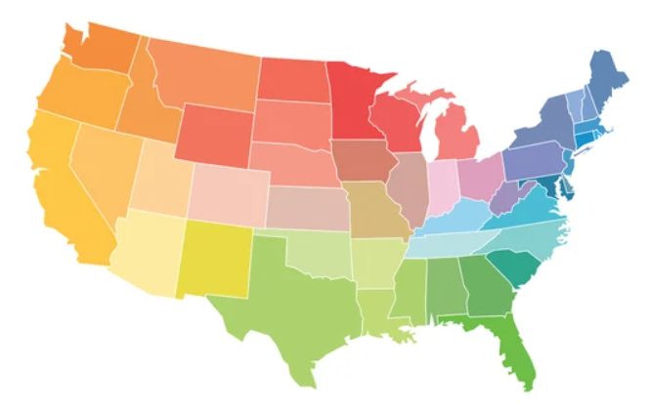
Listening sessions are happening across the entire country
Notes:
I want to share that this session you’re participating in is one of over a hundred listening sessions taking place across the country. SFMFB is a member of the Feeding America network of 200 food banks and 60,000 partner food pantries and meal programs across the country coordinating these listening sessions.

Slide 5
When is this all happening?
May
June-July
July-Aug
September
White House Announced Conference
Listening Sessions Nationwide
WH & Team Analyzes Inputs and creates recommendations
Conference is Held and Recommendations are proposed
Notes:
It’s a very short window!

Slide 6
This is where you come in!
Your voice is key to informing federal policy change.

