Slide 1
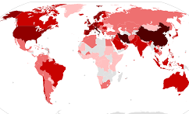
AGENDA
Response Overview
Roles/Responsibilities
Accomplishments
Call to Action
San Francisco
COVID Command Center (C3)
Presentation to the San Francisco Food Security Task Force
July 15, 2020
Andrea Jorgensen, CEM
Feeding Group Supervisor
COVID-19 Feeding Group Response

Slide 2
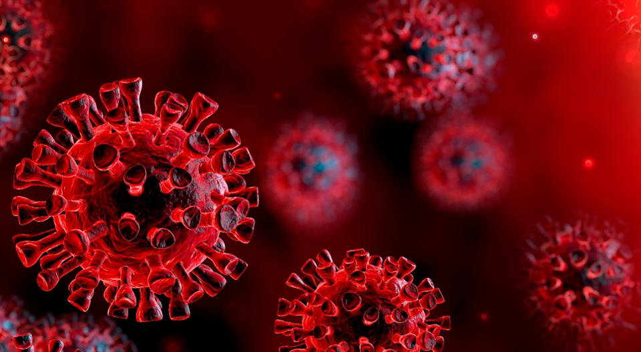
Unified Command
Leadership
Equity
Operations
Planning
Logistics
Human Services Branch
Finance/Admin
Joint Information
Feeding Group
Response Overview
COVID Command Center Structure (Incident Command System/ICS) and Emergency Management Approach
COVID-19 Feeding Group Response

Slide 3
Response Overview
Response Timeline
• Emergency Response (early January to July 6th)
• Phased Reopening (thru January 2021 - TBD)
• Sustained Response (thru July 2021 (CCC))
• Long Term Recovery (thru January 2022?)
Incident Highlights Daily Food Insecurities
Critical Community Response/Neighborhood Level
COVID-19 Feeding Group Response

Slide 4
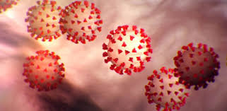
Mitigate the Spread of COVID-19 by Supporting Isolation/Quarantine and Shelter in Place
Information Coordination
Feeding Task Force
Neighborhood Workgroups
Prioritize/Connect Resources
Supporting Existing Food Service Efforts
Disaster Service Workers (DSW)
Street Closures/Power Washing
Roles & Responsibilities
COVID-19 Feeding Group Response

Slide 5
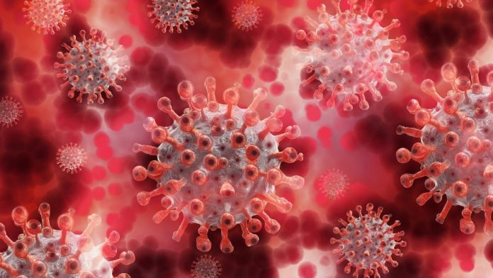
Staffing, Delivery Support, Safety Assessments and Coordination with CBOs
Local Food Resources Webpage (sf.gov)
Go to Services, COVID-19/Get help/Get food resources
3-1-1 Call Center and IQ Helpline (Food Program)
Public Food Data Reporting (data.sfgov.org)
https://data.sfgov.org/stories/s/9tff-97vx
Gaps Analysis (in progress)
Accomplishments
COVID-19 Feeding Group Response

Slide 6
Surge Planning
Revisit Feeding Task Force Functions
Policy Group Recommendations
Transition to New Normal
Call to Action
COVID-19 Feeding Group Response

