Slide 1


Medi-Cal Medically Tailored Meals Pilot Program
Kim Madsen, MEd, RD- Director, Nutrition Services
Adrian Nunez – Project Manager, Medi-Cal Medically Tailored Meal Pilot Program
for CA FIMC internal use only

Slide 2
Agenda
What is FIMC and CA FIMC
MTM Pilot Program Background
The Intervention
Referral Process: Creating the Process for connection
Successes and challenges

Slide 3
California Food is Medicine Coalition
FIMC is a an association of nonprofits across the nation that provide a complete, evidence-based, medical food and nutrition intervention to critically and chronically ill people in their communities
Cal FIMC includes the FIMC members in California
Cal FIMC Agencies include
  Project Open Hand in SF and Oakland
  Ceres in Sonoma and Marin,
  The Health Trust in Santa Clara County
  Food for Thought in Sonoma,
  Mama’s Kitchen in San Diego,
  Project Angel Food in LA

Slide 4
FIMC Priorities
To Provide
  a complete, evidence-based, medical food and nutrition intervention to critically and chronically ill people in their communities
To advance publish policy
  that supports access to medically tailored food and nutrition services for people with severe and/or chronic illnesses
To Promote research
  on the efficacy of food and nutrition services on health outcomes and cost of care
To share best practices
  in the provision of medically tailored meals and of nutrition education and counseling

Slide 5
MTM Pilot Program Background
Three-year, $6 million pilot to evaluate the impact of a medically tailored meal intervention on the health outcomes and health care costs of seriously ill Medi-Cal patients.
The pilot will be conducted in seven counties in California – Alameda, Los Angeles, Marin, San Diego, San Francisco, Santa Clara, and Sonoma – by the following organizations: Project Open Hand, Project Angel Food, Food for Thought, Mama’s Kitchen, The Health Trust and Ceres Community Project.
The California Department of Health Care Services (DHCS) will have oversight over the program.
Think of MTM services as a Medi-Cal benefit being tried out…the policy goal is to make MTM a permanent Medi-Cal benefit for seriously ill persons .
for CA FIMC internal use only

Slide 6
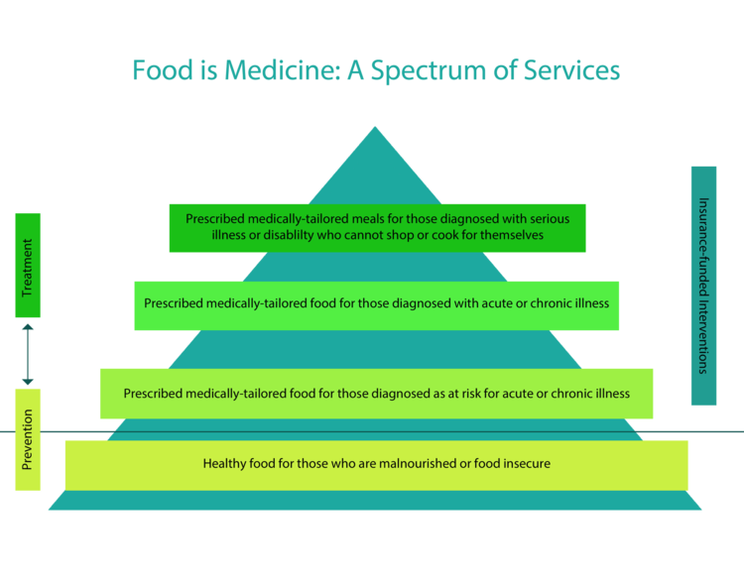
Source: http://www.fimcoalition.org/policy2/
for CA FIMC internal use only

Slide 7
What is the Medi-Cal MTM Program?
The Medi-Cal MTM Pilot Program is a medical nutrition intervention for high utilizing Medi-Cal beneficiaries with a diagnosis of congestive heart failure (CHF). The intervention is 12 weeks in duration.
Who: Discharged Medi-Cal patients who were admitted due to CHF and have a history of being a high utilizer of health care services and/or likely at risk for readmission within 30 days.
Intervention Goal: Reduce hospital and emergency department 30-day and 90-day readmissions.
Cost: No cost to patient. Must be on Medi-Cal.
for CA FIMC internal use only

Slide 8
What is the Intervention?
MTM Intervention
Medically Tailored Meals
Medical Nutrition Therapy
Information & Referral Services
Goal: Reduce hospital readmissions and ED visits!
for CA FIMC internal use only

Slide 9
Referral Process
A completed referral form is required. A clinician (MD, PA, NP, LCSW, RN, etc.) must make the referral.
Client Services will manage eligibility.
Meals should begin within 72 hours of discharge, but no later than 7 days
for CA FIMC internal use only

Slide 10
Successes and Challenges
Successes
Challenges
Collaboration within CA FIMC
Standardized approach statewide
Opportunity to build relationships with health networks and plans
2 CA FIMC agencies have started services
Building the connections between health care and food and nutrition services
Managing recruitment within eligibility criteria
CaRDS Study

Slide 11
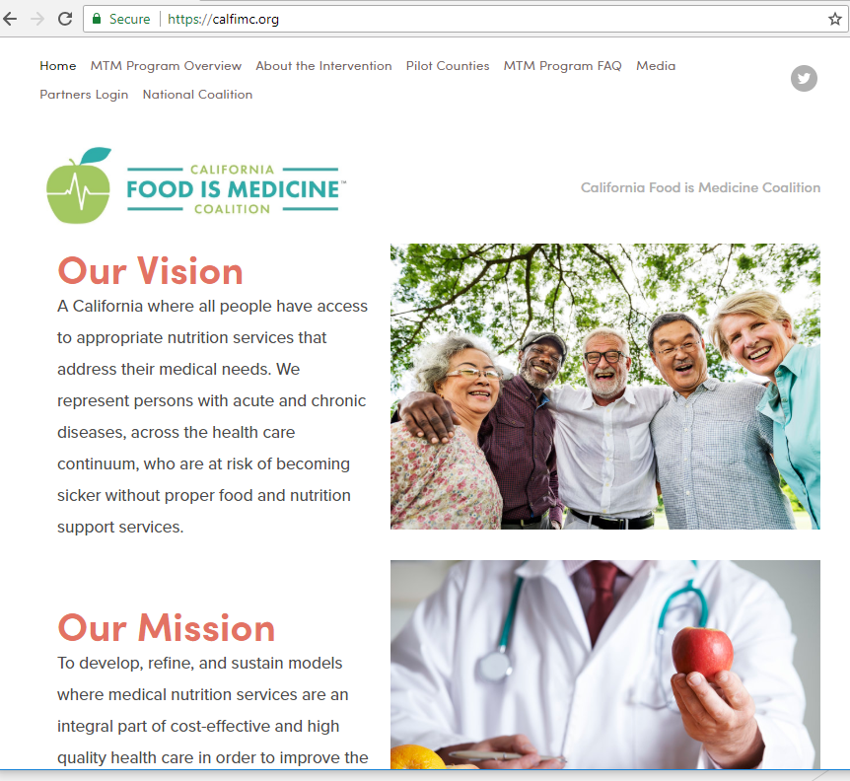
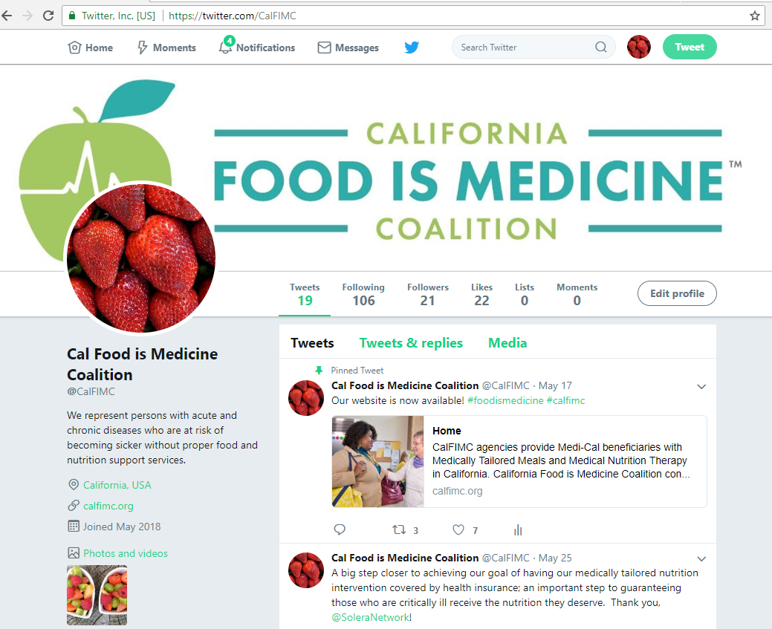
Website & Twitter
www.calfimc.org
https://twitter.com/CalFIMC
for CA FIMC internal use only

Slide 12
THANK YOU!

Slide 13
Medical Nutrition Therapy
Community-based
Four sessions in the course in 12 weeks
Two sessions at home or in community-setting
for CA FIMC internal use only

Slide 14
appendix

Slide 15
Medically Tailored Meals
All Meals for 12 Weeks
Medically tailored for CHF patients
Periodic wellness checks during delivery
for CA FIMC internal use only

Slide 16
Information & Referral Services
Program engagement case management by client services
Referral to community-based resources by client services
for CA FIMC internal use only

