Slide 1
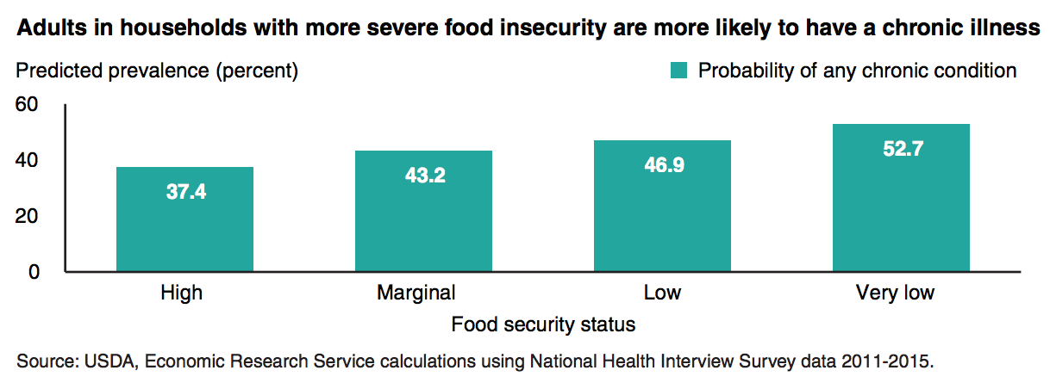
Food Insecurity and Health
Associated with increased risk of...
In children
Behavioral issues
Worse school performance
Poorer health
More hospitalizations
In adults
Obesity
Diabetes
Hypertension
Depression
Hospitalization
Kirkpatrick et al, JAMA Ped, 2010 ; Metallinos et al, J Acad Nutr Diet, 2012
Hager et al, Pediatrics, 2010 ; Slopen et al, J Am Acad Child Adol Psych, 2010
Seligman et al, J Nutrition, 2010 ; Seligman et al, Diabetes Care, 2012
Seligman et al, Arch Intern Med, 2011 ; Nelson et al, J Gen Int Med, 2001
Gregory and Coleman-Jensen. USDA, July 2017
Notes:
There is robust literature linking the association between food insecurity and health even after controlling for confounding factors like income, race, and education. It is not merely a phenomenon that can be attributed to poverty. Those at similar income levels with increased consistent access to healthy foods (whether that be because of access to food supports like SNAP (formerly “food stamps”), food pantries, or the ease and availability of nearby grocery stores) have better health than those who have less consistent access to healthy foods.
There is also a dose-dependent relationship with food insecurity and health whereby those who are more severely food insecure have higher likelihood of having a chronic disease.
Those who do have chronic disease also have a harder time managing it. Food insecure diabetics have worse control of their diabetes, are more likely to have hypoglycemic complications, and have 5 more physician encounters a year than those who are food secure.

Slide 2
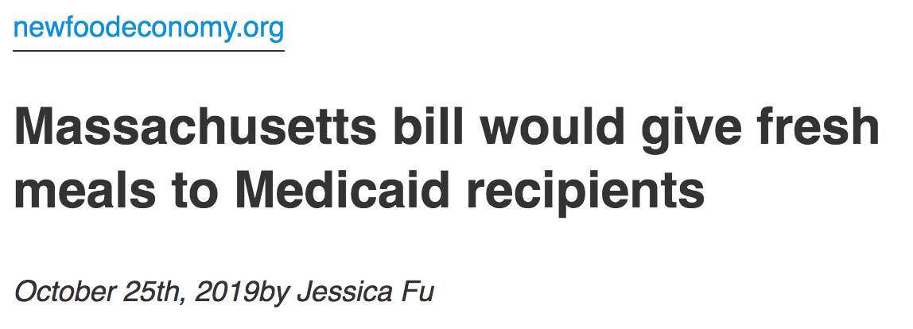
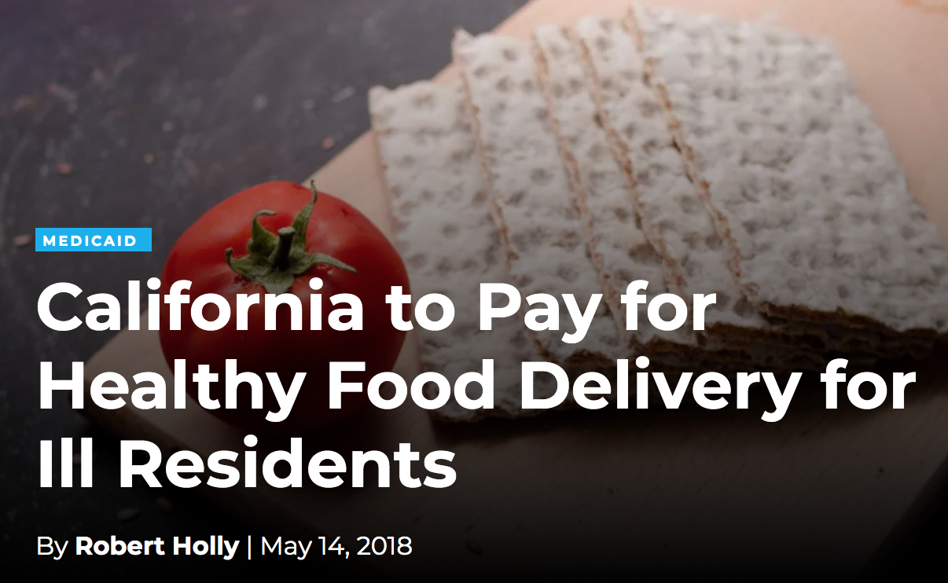
Food as Medicine: Policy and Systems Change in Healthcare to Support Healthy Eating
Notes:
Food insecurity impacts health and investing in food will improve health, reduce healthcare use, and reduce healthcare cost
North Carolina, Oregon, and Massachusetts have set a precedent by including a provision in their Medicaid waivers that allows for Medicaid dollars to be used to pay for food support. Massachusetts has taken this a step further with an introduction of a bill in October that would expand Medicaid’s ability to fund food for Medicaid recipients. Medicaid in California is currently in the midst of a 3 year, $6 million pilot to assess the impact of medically tailored meals on health and healthcare costs in 7 counties across the state.
These pilots have been implemented with different funding structures. In Massachusetts, the pilot was paid for through an incentive program funded by a tax levied on hospitals by hospitals. In Oregon the pilot was structured to use cost savings to fund services.

Slide 3
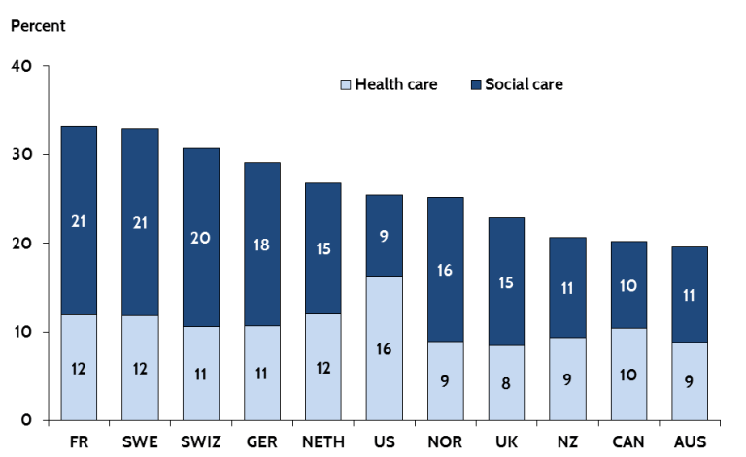
Butler et al. Brookings Institution. 2017
Notes:
It is well known that the U.S. spends a disproportionately large percentage of its GDP on healthcare when compared to other developed nations. But when added with what we spend on social care (including welfare, SNAP/food stamps, and other anti-poverty measures), we are on par with our investments. However, the US is unique in its relative investment in these two spheres in that we invest much less in social care relative to what we spend on health care.

Slide 4
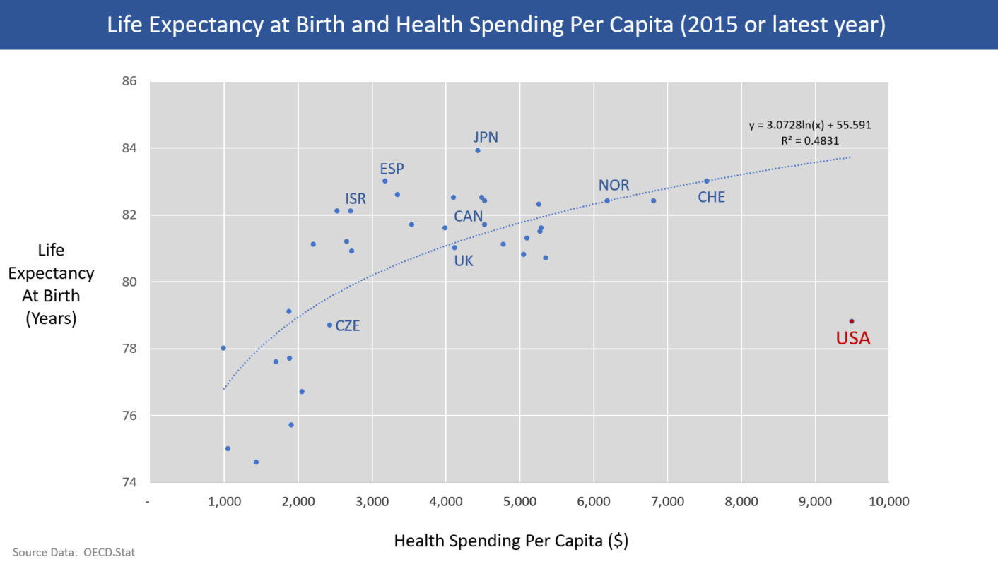
Notes:
Our health outcomes demonstrate that we are not getting value for what we pay for. Despite spending the most on health per capita, we are an outlier for how poor our life expectancy and infant mortality rates are. Across a number of health measures, the UThis begs the question – is this the right ratio of investment? Should we be spending as much as we do in health care for the things we pay for (end-stage complications of poorly managed chronic disease in the form of amputations, dialysis, and heart attacks) or should we be re-investing HEALTHcare dollars into HEALTH care and not disease care? If some of the funds spent to provide disease care were re-invested to health-promoting care perhaps we would have improved health outcomes and reduced healthcare costs as the literature suggests. Research would suggest that investing in medically-supportive food and nutrition and addressing food insecurity – a core social determinant of health – would improve health outcomes and save on healthcare costs.
S underperforms other developed nations.

Slide 5
CalAIM
California Advancing and Innovating Medi-Cal (CalAIM) is a multi-year initiative by DHCS to improve the quality of life and health outcomes of our population by implementing broad delivery system, program and payment reform across the MediCal program
Notes:
MediCal Healthier California for All is a multi-year initiative by DHCS to improve the quality of life and health outcomes of our population by implementing broad delivery system, program and payment reform across the MediCal program. Incorporating medically-supportive food and nutrition supports as part of medical care would address two of the three primary goals, namely by (1) addressing social determinants of health to manage member risk and (2) improving quality outcomes through value-based initiatives.
Food as medicine programs, are an example of value based initiatives, that could fall into a category of “In lieu of services” meaning they are cost-effective alternatives to current MediCal approved services that get paid for already.

Slide 6
Food as Medicine and CalAIM
The CalAIM proposal was released Oct 29, 2019 and details proposed improvements to MediCal drafted by DHCS
DHCS is conducting extensive stakeholder engagement through 2020 to receive feedback on their proposal
Final public comment closes 3/6/20
Notes:
CalAIM’s first proposal was released October 29, 2019. In the coming months, there are a number of meetings and workgroups that will be discussing what will go into the next MediCal waivers.

Slide 7
Governors Support
Governor Newsom's budget priorities include funding for CalAIM
Proposed $348 million from the General Fund (effective 1/1/21) for implementing the Medi-Cal changes. This totals a $695 million investment due to the Federal match.
The Budget Summary (page 33) explains the funding and notes it will support:
- Enhanced Care Management and ILOS (the subsection medically supportive food and nutrition would be in)
- Infrastructure for Whole Person Care expansion statewide
- Building upon existing dental initiatives
Notes:
In past updates to MediCal provision the state portion of funding was primarily covered by counties and local hospitals. This move towards state level general fund support shows strong governmental interest in MediCal improvements.

Slide 8
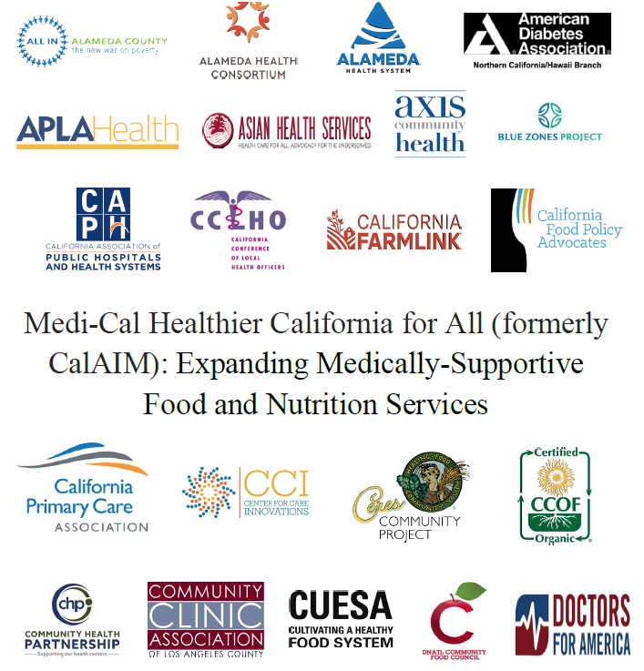
Our Strategy
Grassroots advocacy effort to gain support for including food supports in waiver
Meeting with key decision makers and stakeholders
Next phase: implementation work with local health plans
Notes:
In past updates to MediCal provision the state portion of funding was primarily covered by counties and local hospitals. This move towards state level general fund support shows strong governmental interest in MediCal improvements.

Slide 9
Questions? Comments?
Research, data, food as medicine interventions in healthcare settings: rita.nguyen@sfdph.org
CalAIM, Medicaid, policy change: kettman@spur.org

