Slide 1
Employee and Tuition Expense Reimbursement Using PeopleSoft
May 2019
DPH Finance

Slide 2
Table of Contents
Travel/Training Authorization (not done in FSP)............................... Slide 3
Create an Employee Expense Reimbursement.................................. Slide 6
Correct Errors in an Expense – “Send Back”.................................... Slide 20
Check the Status of an Expense Reimbursement............................... Slide 25
DHR Tuition Reimbursement........................................................ Slide 28
Monthly Employee Expense......................................................... Slide 32
Hotel Reimbursement Rates........................................................ Slide 38
Approve an Employee’s Expense Reimbursement – HR Supervisor......... Slide 40
Delete an Expense Report.......................................................... Slide 52
Create an Expense Report from an Existing Expense Report.............. Slide 54
Delegate Expense Data Entry to Another Person............................. Slide 59
Create Shortcuts/Favorites........................................................ Slide 61
Accounting Forms.................................................................... Slide 62

Slide 3
Travel/Training Authorization (TTA)
Travel and training authorization (TTA) is not done in FSP.
Complete TTA, gather supporting documentation, and get all necessary approvals.
  For PHD, Behavioral Health, Health Network or Admin: TTA is on-line and electronically signed using DocuSign.
  For grant, work order or project funded travel submit to the appropriate accounting unit for approval.
Attach TTA to expense reimbursement.
For airfare, Accounting will give you the authorization # for you to book airfare through a city travel agency.

Slide 4
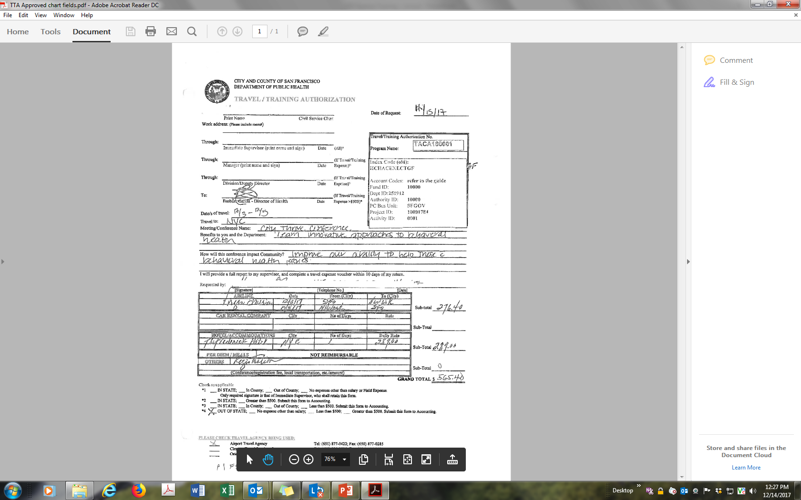
Paper Travel Authorization

Slide 5
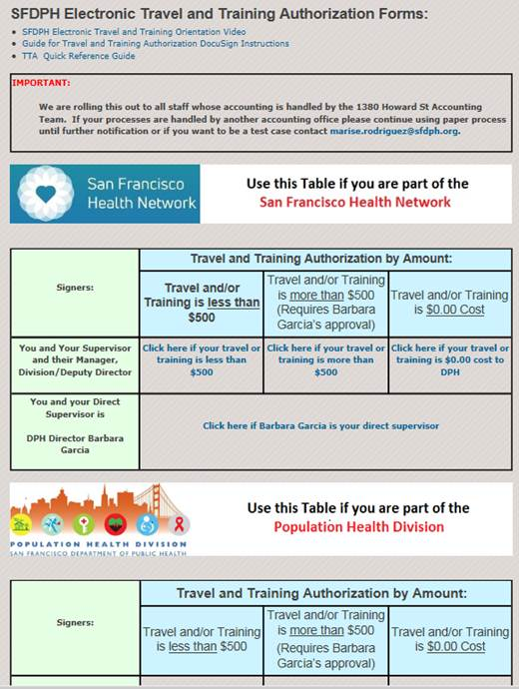
  For PHD, Behavioral Health, Health Network or Admin - on-line TTA

Slide 6
Create an Employee Expense Reimbursement
Step 1. Go to SF Employee Portal and create an employee reimbursement.
Step 2. Enter expense details and attach documentation (e.g. travel authorization, field expense report, travel expense voucher, receipts, proof of attendance at training/membership, etc.)
Step 3. Submit expense reimbursement. It will automatically route to your HR Supervisor (as defined by eMerge) and then Accounting.
Step 4. When approved, you will be paid by direct deposit on a non-payroll Tuesday.

Slide 7
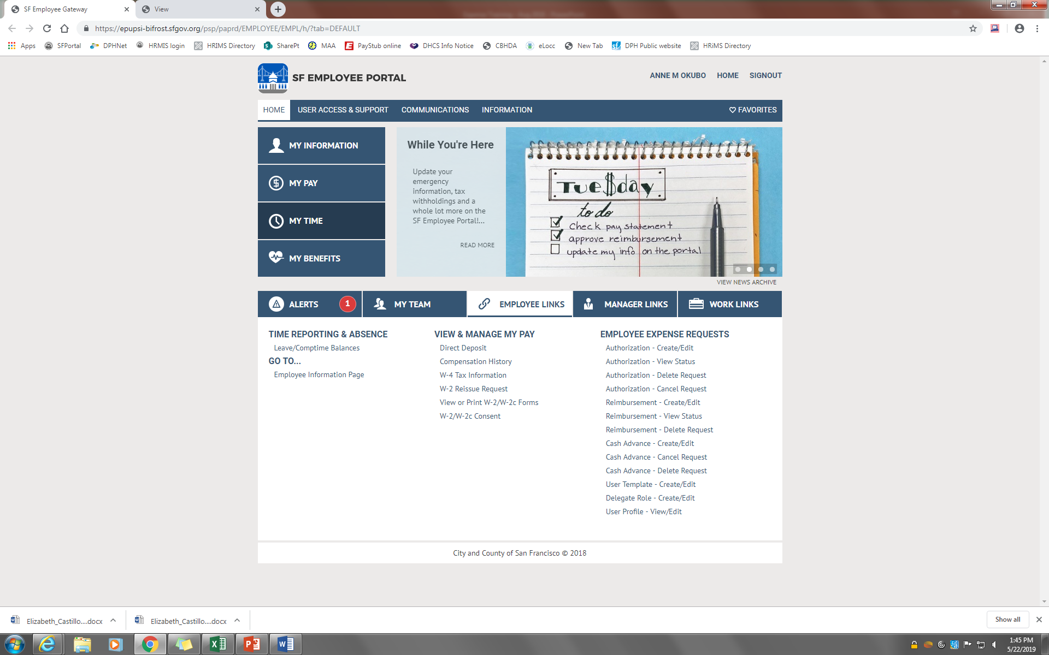
Go to SF Employee Portal
<- Reimbursement - Create/Edit

Slide 8
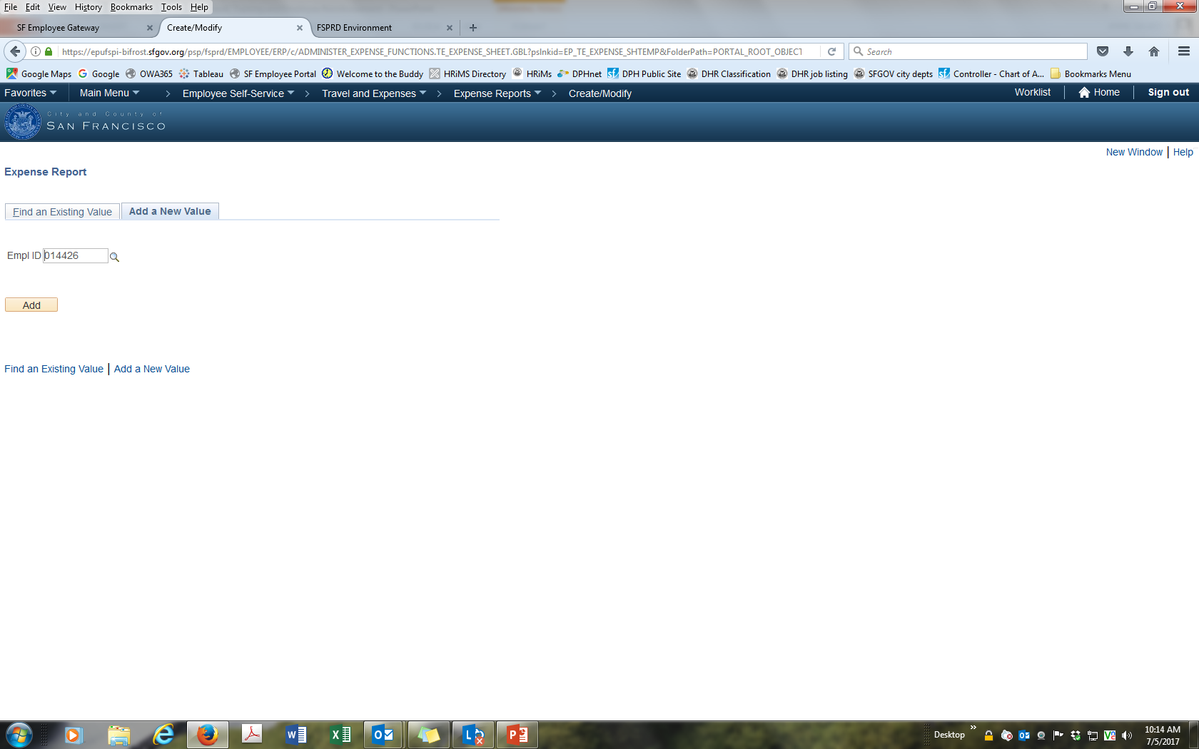
Enter Employee ID (DSW)
<- DSW is 6 digit (may contain leading zero)

Slide 9
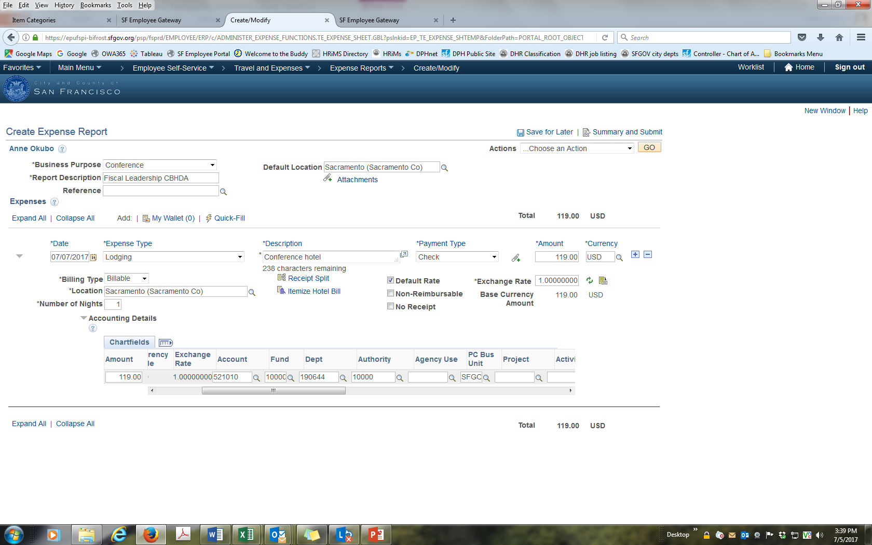
Enter Expense Details and Attach Documentation
<- Attach receipts, field expense report, travel authorization, proof of attendance, DHR approval, etc
<- Date = date expense was incurred.
Billing Type = billable.
Payment Type = check (always use this
even if you paid with credit card).

Slide 10
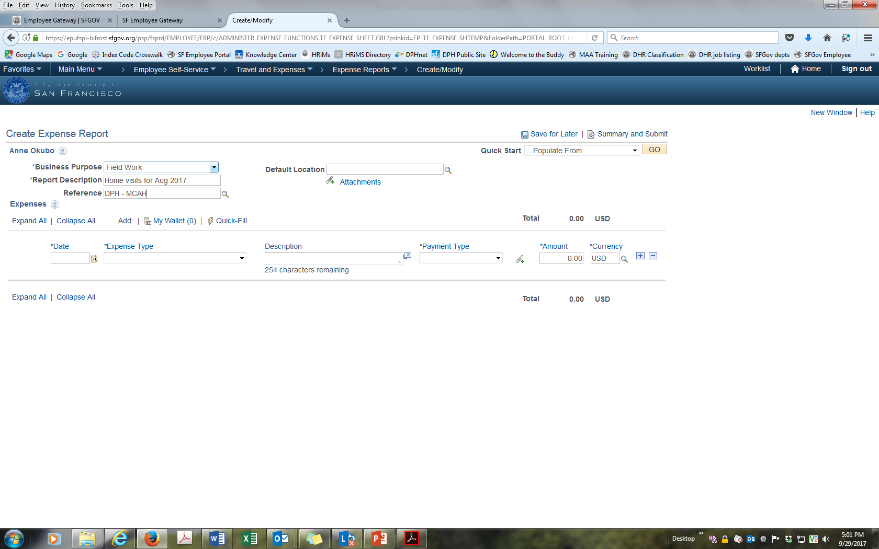
Business Purpose – DPH Standard Format
Business Purpose: select drop down purpose. Eg. Field work
Report Description: include month and year. Eg. Home Visits for October 2017
Reference: identify your DPH department and program. Eg. MCAH

Slide 11
Enter Chart Fields and Accounting Codes
<- Chart Fields and Accounting codes

Slide 12
Account Codes – Travel and Training
Account Code/Description | Expense Type | Applicable to
521030 – Air Travel Employees | Airfare | Airfares, baggage fees
522010 – Training Costs Paid to Employees | Registration fees | Registration fees paid related to the trainings/conferences/seminars attended
522010 – Training Costs Paid to Employees | Educational Reimbursement | Tuition fees paid related to courses or classes attended (DHR pre-approval is required)***
521050 – Non-Air Travel Employees | Lodging, Mileage, Rental Car, Public Transit, Taxis, Telecom, Per Diem, Meals/Food, Other Employee Reimbursement (whichever is applicable) | Hotel bills/Airbnb/public transportation/ mileage/taxis/ridesharing/rental car/per diem meals/parking/toll fees/ telephone/internet/gratuities
Account Code/Description | Expense Type | Applicable to
523010 – Auto Mileage | Mileage | Mileage only
523020 – Local Field Expense | Auto Expense, Public Transit, Taxis, Telecom, Other Employee Reimbursement (whichever is applicable) | Parking meters/garage parking/toll fees/ telephone/public transportation/taxis/ ridesharing (pre-approval from supervisor required)
523020 – Local Field Expense | Auto Expense | Parking citations and claims due to vehicle damages as allowed per MOU
535610 - Postage | Other Employee Reimbursement | Postage/stamps
552210 – Fees Licenses Permits | Membership | Professional Licenses renewal

Slide 13
Account Codes – Field Expense
Account Code/Description | Expense Type | Applicable to
523010 – Auto Mileage | Mileage | Mileage only
523020 – Local Field Expense | Auto Expense, Public Transit, Taxis, Telecom, Other Employee Reimbursement (whichever is applicable) | Parking meters/garage parking/toll fees/ telephone/public transportation/taxis/ ridesharing (pre-approval from supervisor required)
523020 – Local Field Expense | Auto Expense | Parking citations and claims due to vehicle damages as allowed per MOU
535610 - Postage | Other Employee Reimbursement | Postage/stamps
552210 – Fees Licenses Permits | Membership | Professional Licenses renewal, membership, subscription

Slide 14
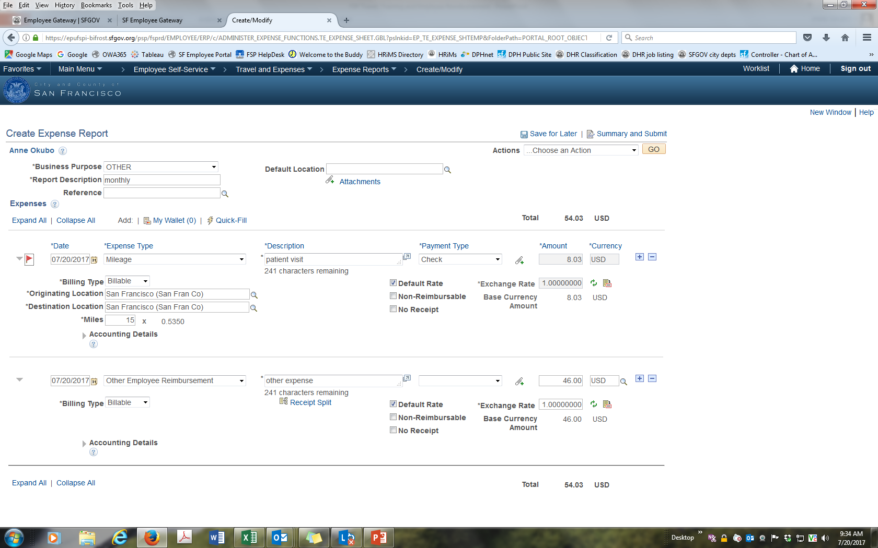
Create Multiple Expense Categories
<- Click + to add multiple
expense categories

Slide 15
Submit (or Save for Later)

Slide 16
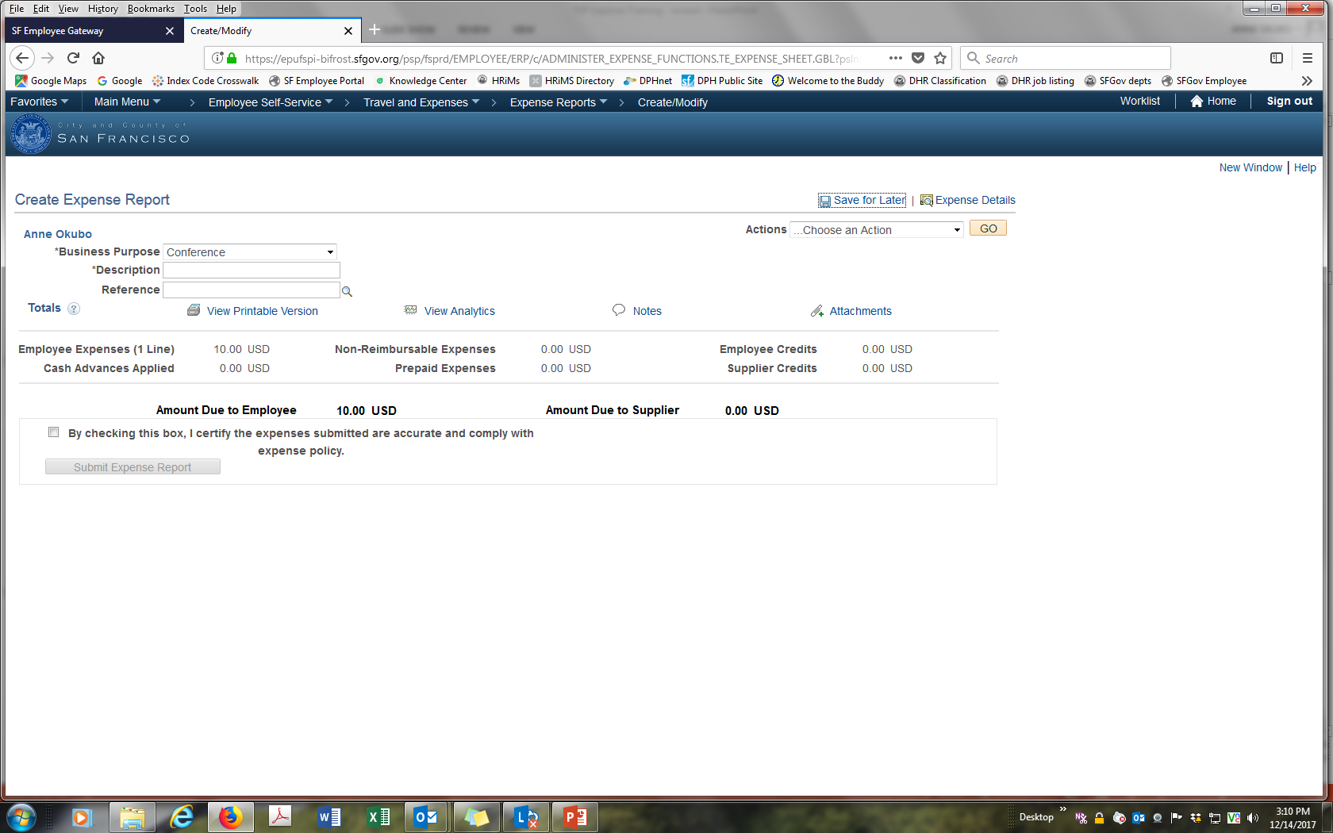
Certify and Submit
<- Click certification and submit

Slide 17
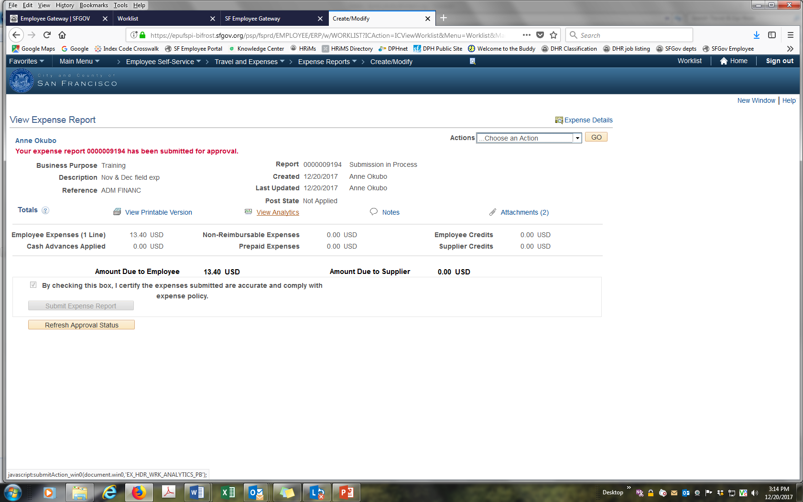
Verification of Submission
<- Verification of your submission

Slide 18
Common Error: Request Created but Not Submitted
<- If certification box is blank, then request is not
complete. If box is grey and you cannot enter
data, follow instructions to modify a request

Slide 19
Common Error: SFGOV In Red
<- If SFGOV is red, PS Chart Fields
are not correct

Slide 20
Correct Errors in an Expense – “Send Back”
  If there is an error or missing documentation you will receive a “Send Back”.
  Go to SF Employee Portal and modify your existing expense.
  Check the reason for the “Send Back”.
  Make corrections and resubmit Expense.

Slide 21
Modify Existing Expense Report
<- Reimbursement - Create/Edit

Slide 22
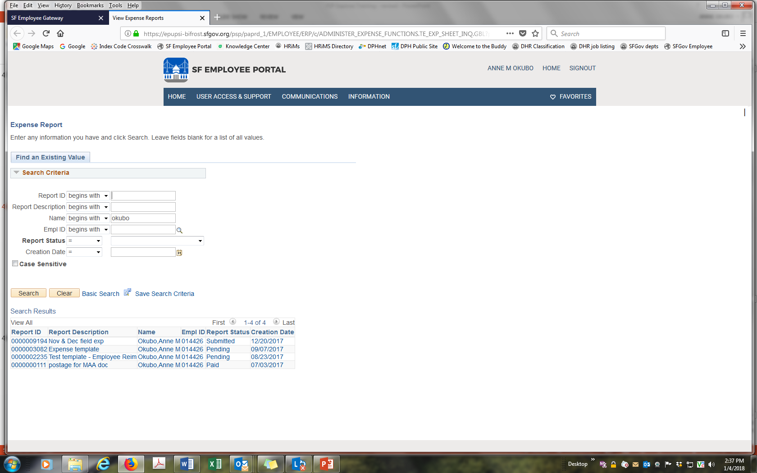
Search for Existing Expense Report
<-Search by last name or DSW
<- Select your Expense Report

Slide 23
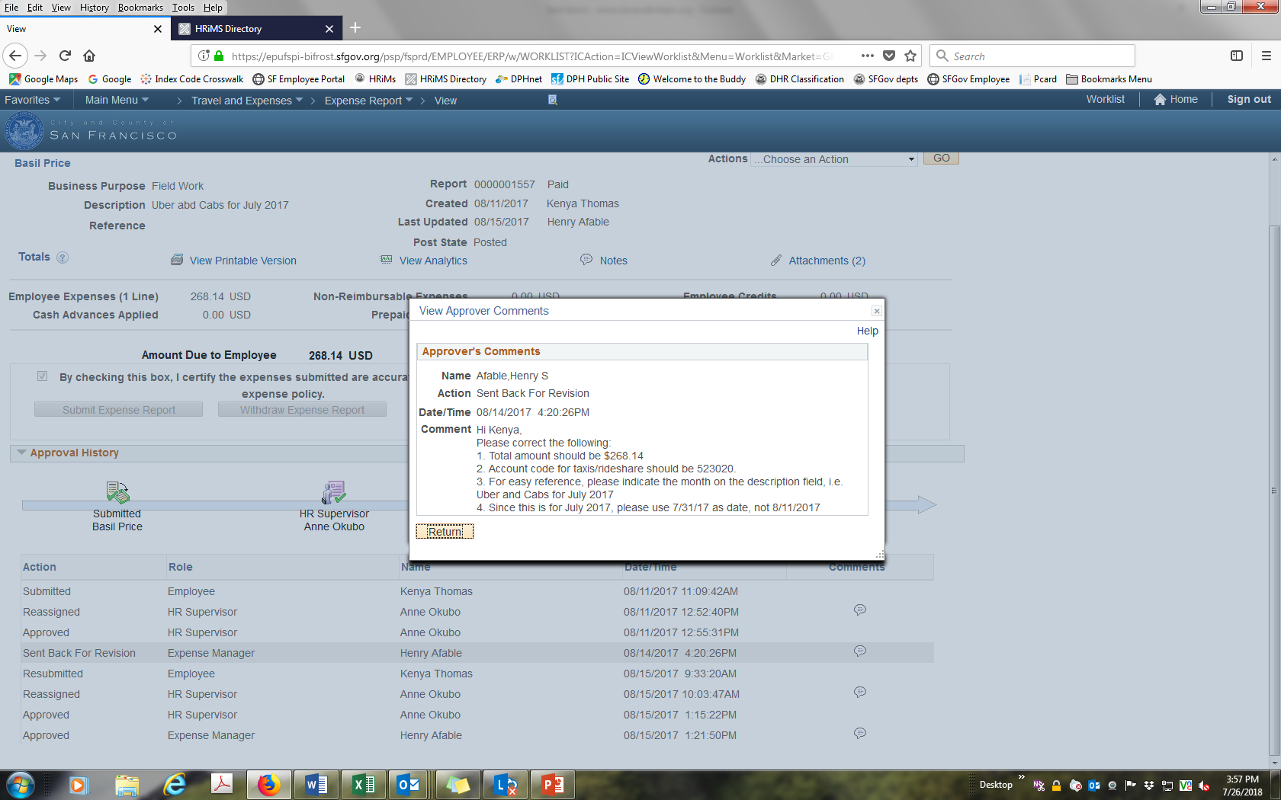
Reason for the “Send Back”
<-Reason for “Send Back”
(e.g. attach receipt, proof of payment,
DHR approval, etc)
<-Click on bubble

Slide 24
Resubmit Expense and Certify

Slide 25
Check the Status of an Expense Reimbursement
<-Reimbursement - View Status

Slide 26
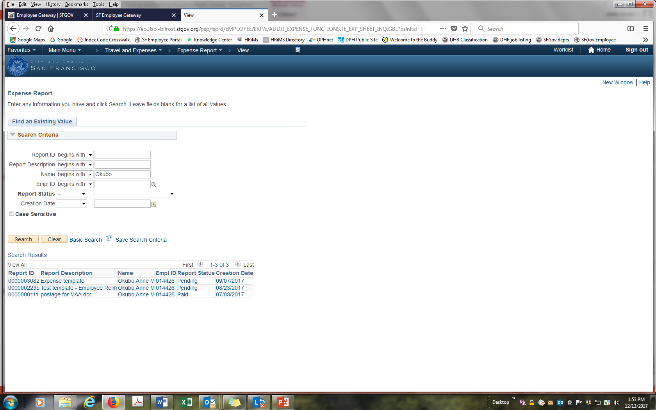
Look Up Expense
<- Type last name or DSW # (DSW is 6 digit with
leading zero)
<- Select report

Slide 27
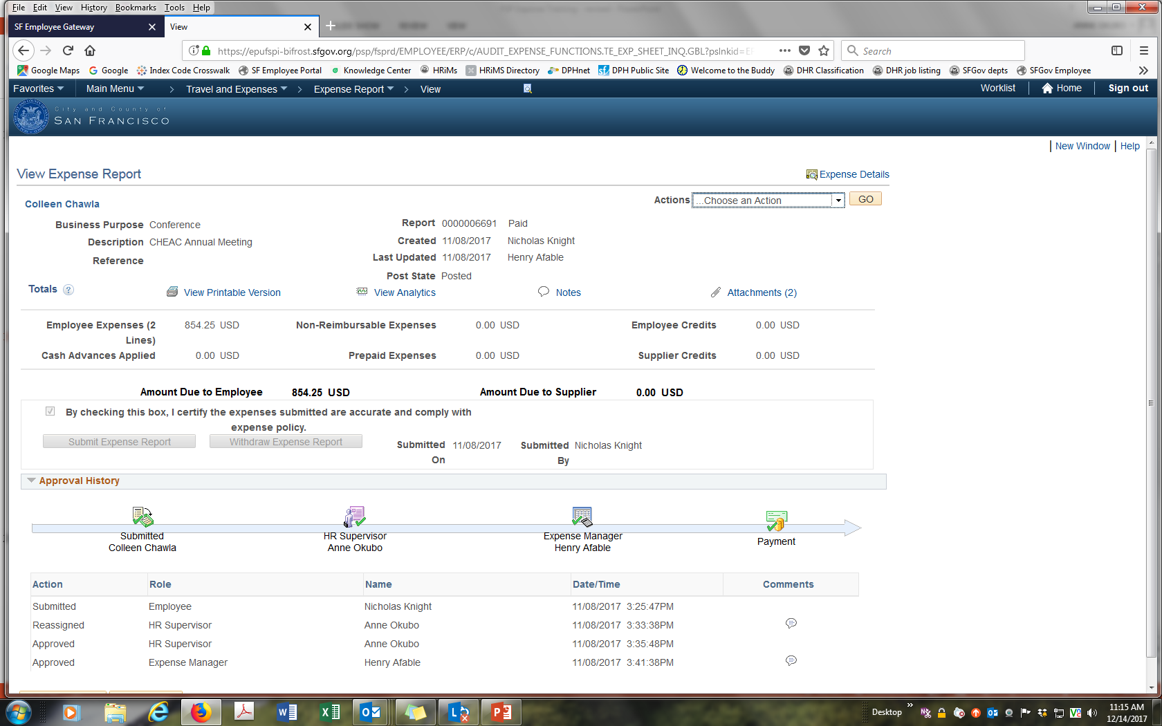
Expense Work Flow
Expense >$2,000 is approved by
Controller after Expense Manager

Slide 28
DHR Tuition Reimbursement
Step 1. Go the DHR website and submit a request for reimbursement.
Step 2. When DHR approves reimbursement, download DHR approval with amount and account codes.
Step 3. Create Expense reimbursement.
Step 4. Attach 1) DHR approval with account codes; 2) proof of payment; and 3) proof of attendance or membership.

Slide 29
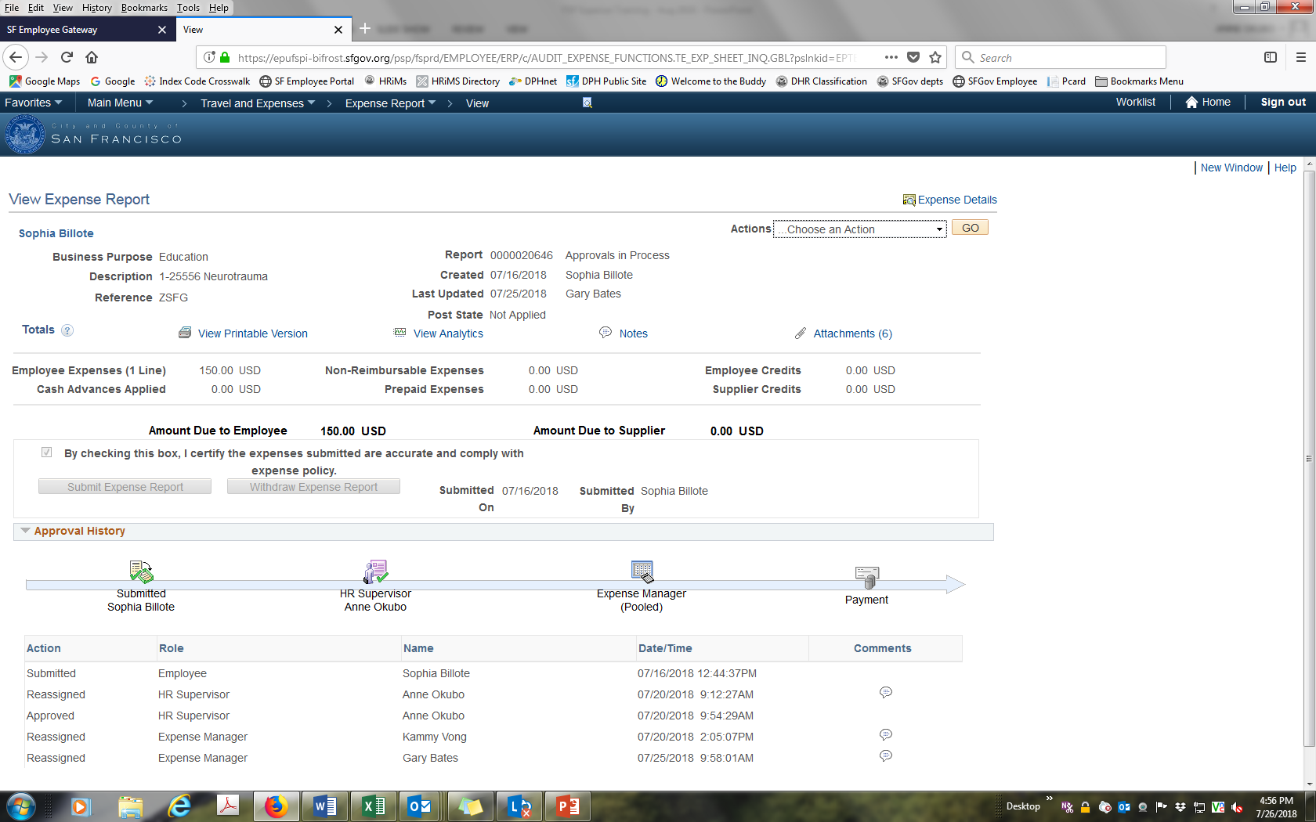
Business Purpose, Description, Reference
<-Business Purpose = Education
Description = DHR approval #
Reference = DPH Division

Slide 30
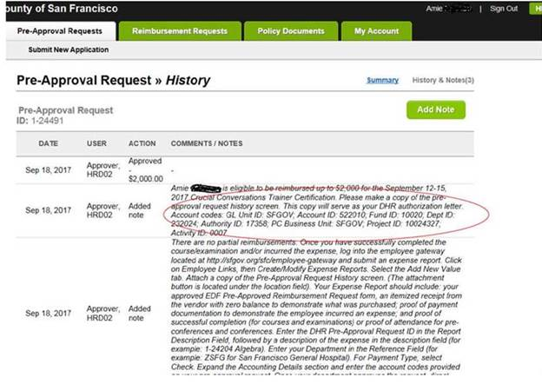
Attach DHR Approval with Amount and Accounting Codes
<- Amount and accounting codes

Slide 31
Professional License
DPH Human Resources
DPH Human Resources approves professional licenses.
Attach DPH approval to expense reimbursement.

Slide 32
Monthly Employee Expense
Step 1. Submit employee reimbursement monthly.
Step 2. Use a Field Expense Report (FER) to list all your monthly expenses. Include dates, amounts, car make, model and license # for mileage.
Step 3. Create multiple expense categories by account (e.g. mileage, registration - See slide #12 -13 for account codes).
Step 4. Attach receipt, credit card/bank statement (redacted), email confirmation from vendor (e.g. registration), etc. If hotel bill does not show a $0 balance submit credit card statement confirming full payment.

Slide 33
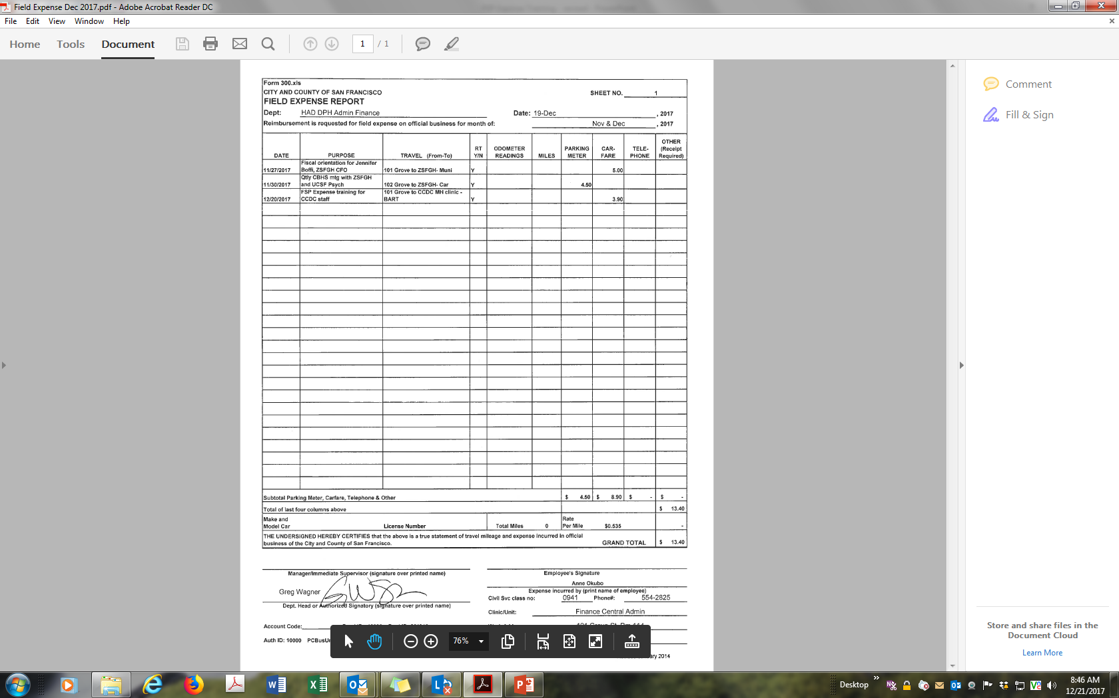
Use a Field Expense Report (FER) for Monthly Expense

Slide 34
Mileage
Report monthly mileage (not daily) using a Field Expense Report (FER).
Include “From” and “To” location, car model, make and license number.
Add odometer reading or attach Google map with mileage.
If actual travel is 2 miles (one-way) or 4 miles (round trip) more than Google map, Fiscal will approve this.
  Any miles greater than this must be justified to be approved (e.g. traffic was re-routed due to road construction).

Slide 35
Field Expense Report – attach to Expense
<- Mileage Detail
<- Monthly mileage = 61 miles
<- Include Car model, make and license number

Slide 36
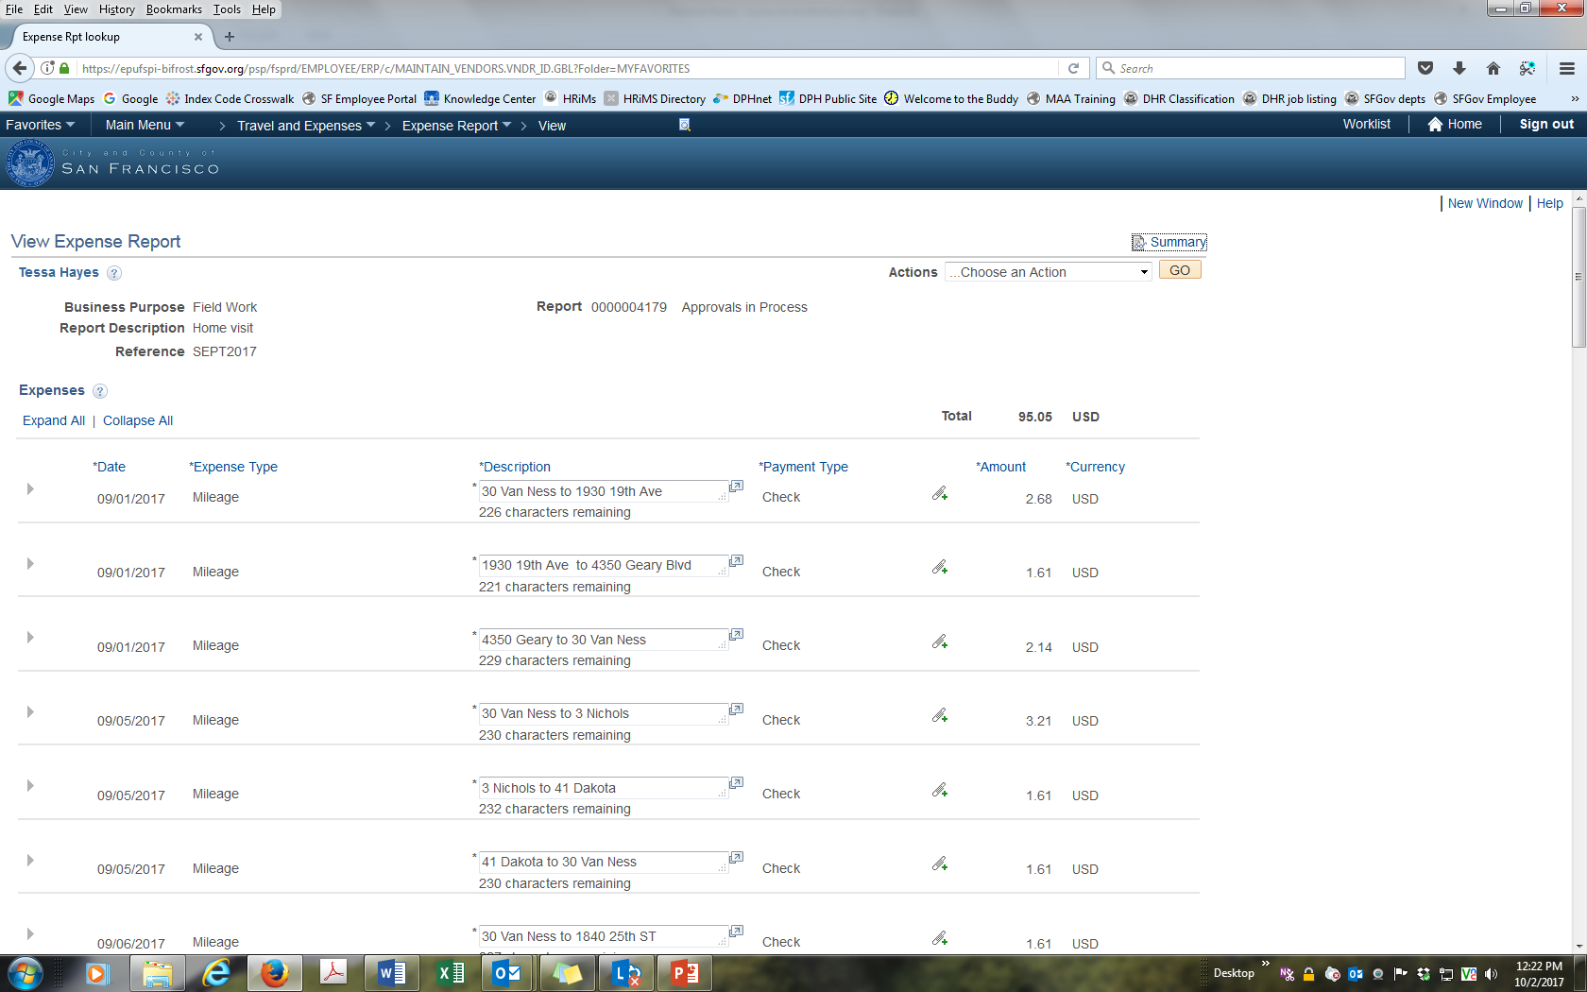
Do Not Create Daily Mileage
<- Don’t create mileage
for every day

Slide 37
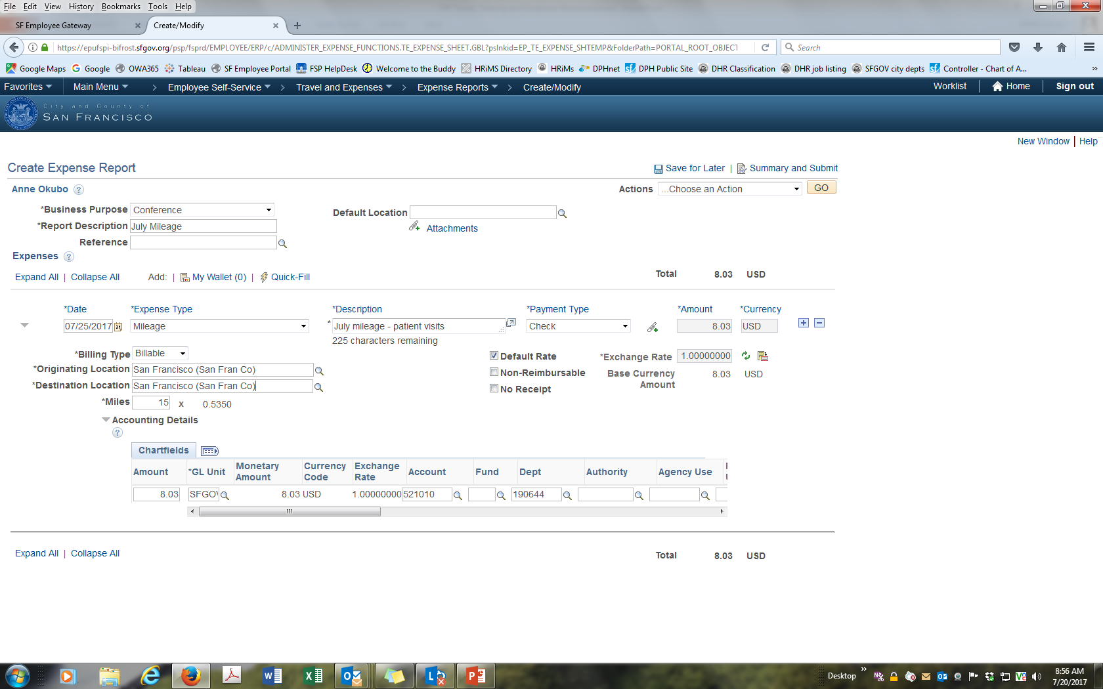
Monthly Mileage
<- One line for mileage for month
<- Originating and destination location: both are
San Francisco (FER has daily mileage locations).
Miles: 61 (PS calculates $0.535 per mile)

Slide 38
Hotel Reimbursement Rates
PeopleSoft checks the hotel rate using the federal GSA rate for a particular location.
  Eg. GSA rate for Sacramento is $119/night. Rate for San Francisco is $267/night.
City rules allow you to exceed the GSA rate if you stay at the conference hotel or the overflow hotel.
If hotel rate is greater than the GSA rate for a given location, PS will not allow you to do this unless you add a comment justifying amount (e.g. conference hotel).

Slide 39
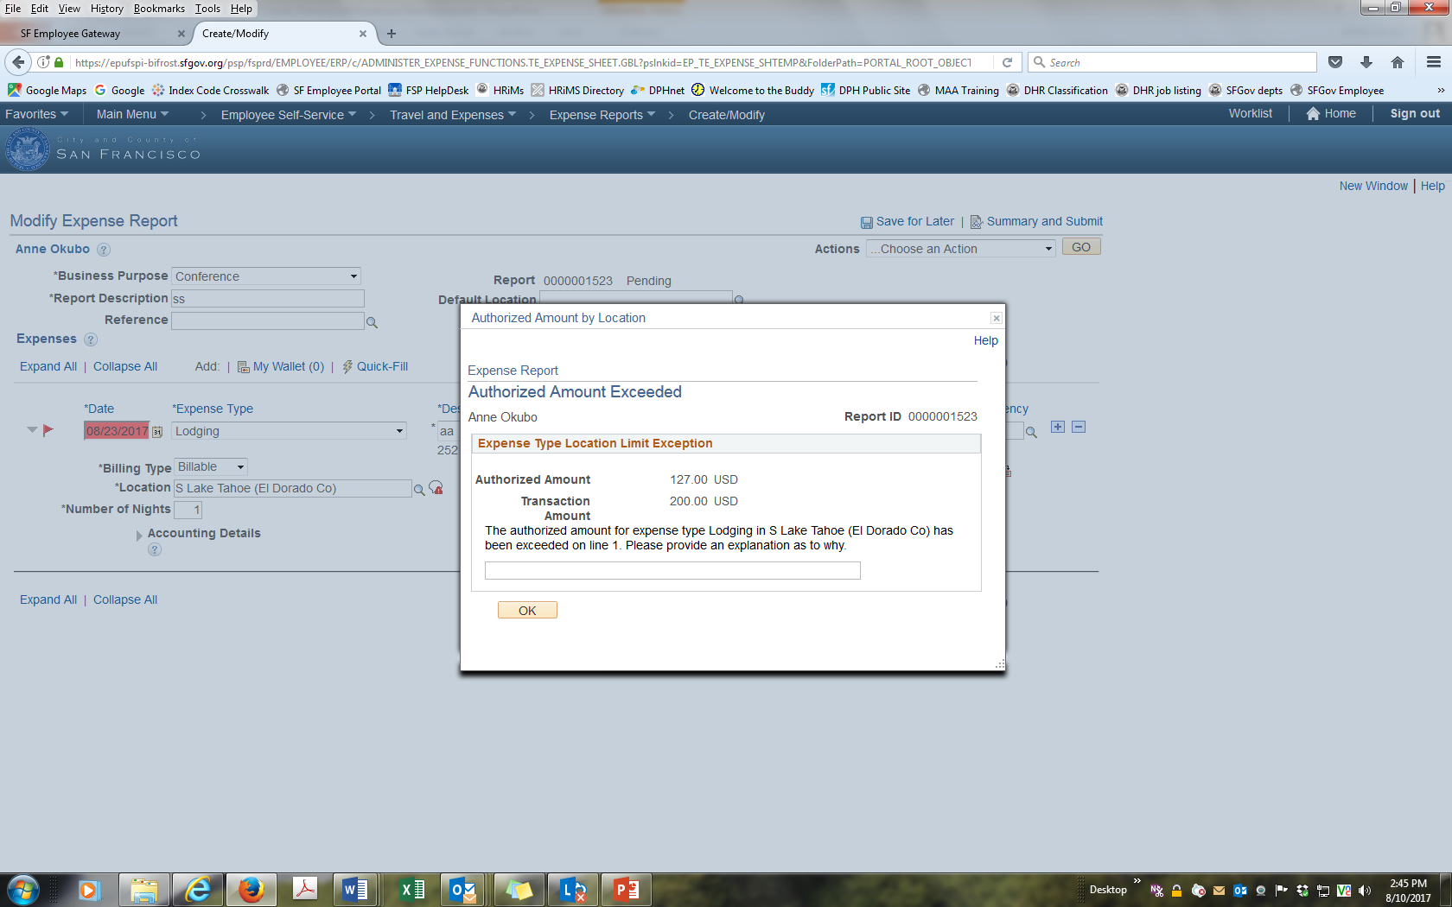
Error: Lodging Rate Exceeds Government Rate
<- Error - red comment boxes
<- Error message: amount for lodging
has been exceeded. Enter justification
(e.g. conference hotel)

Slide 40
Approve an Employee’s Expense Reimbursement - HR Supervisor
HR Supervisor is determined by DPH HR and entered into the eMerge module.
Go into the SF Employee Portal to approve your employee’s reimbursement request.
If you are on leave, you can reassign approval to another person.

Slide 41
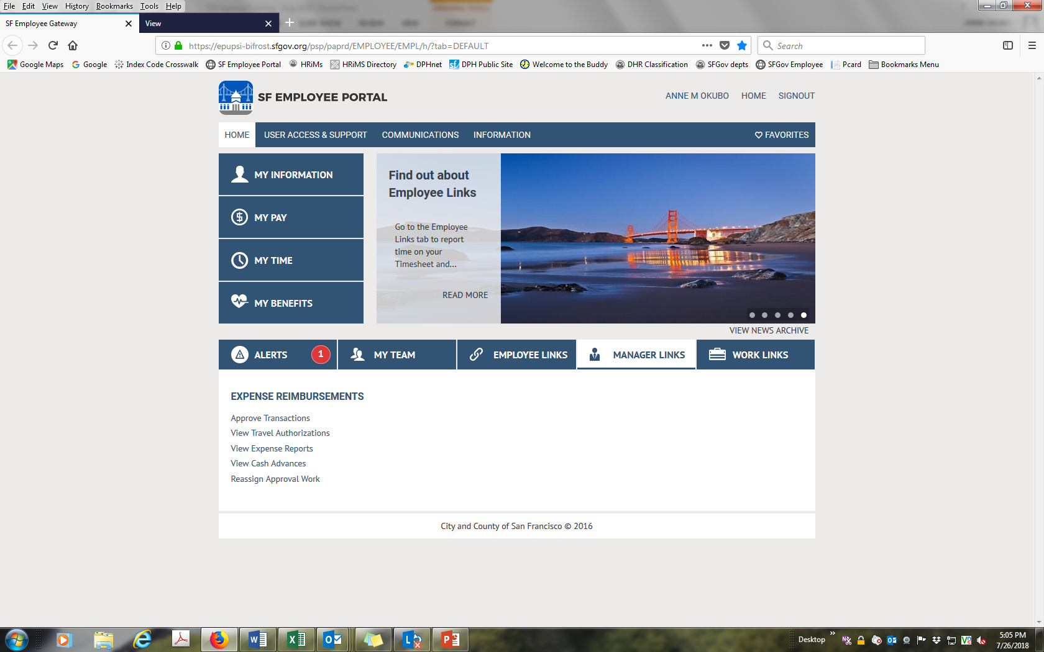
Approve Employee’s Expense
<- Approve Transactions

Slide 42
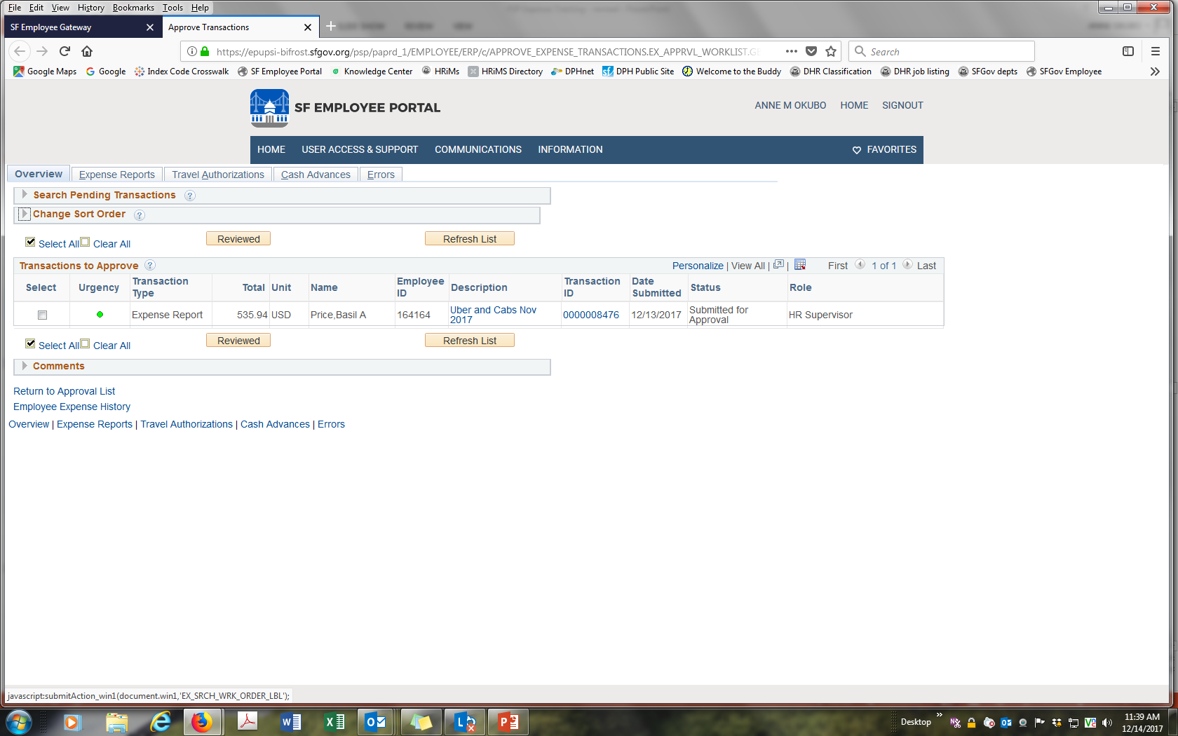
Select Transaction to Approve
<- Click on transaction
Do Not click on Select

Slide 43
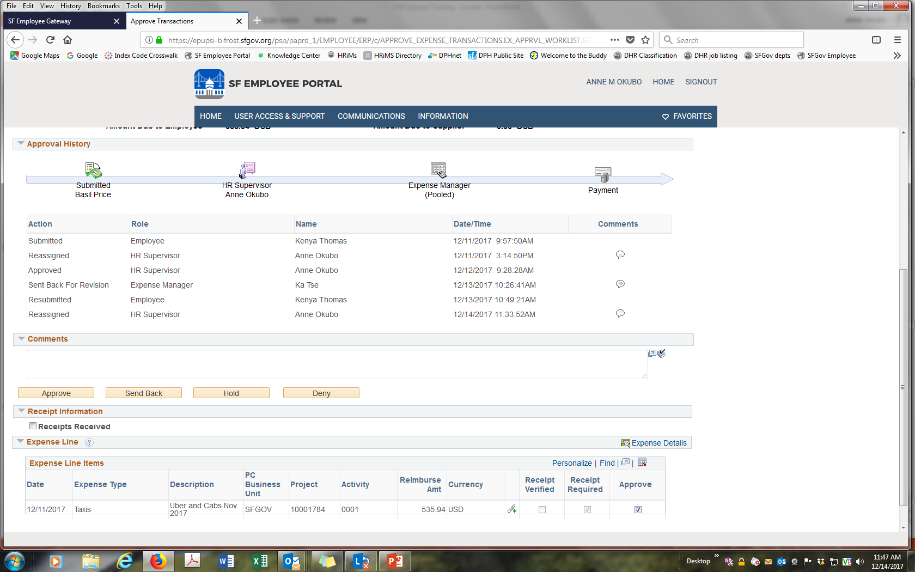
Approve Request
<- Click on Approve (or Send back).
Don’t Deny. This will delete request.

Slide 44
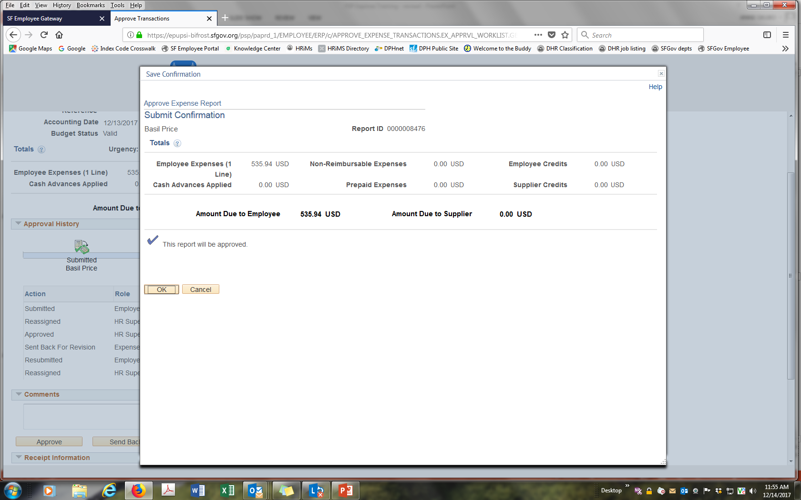
Request Approved
<- Click ok

Slide 45
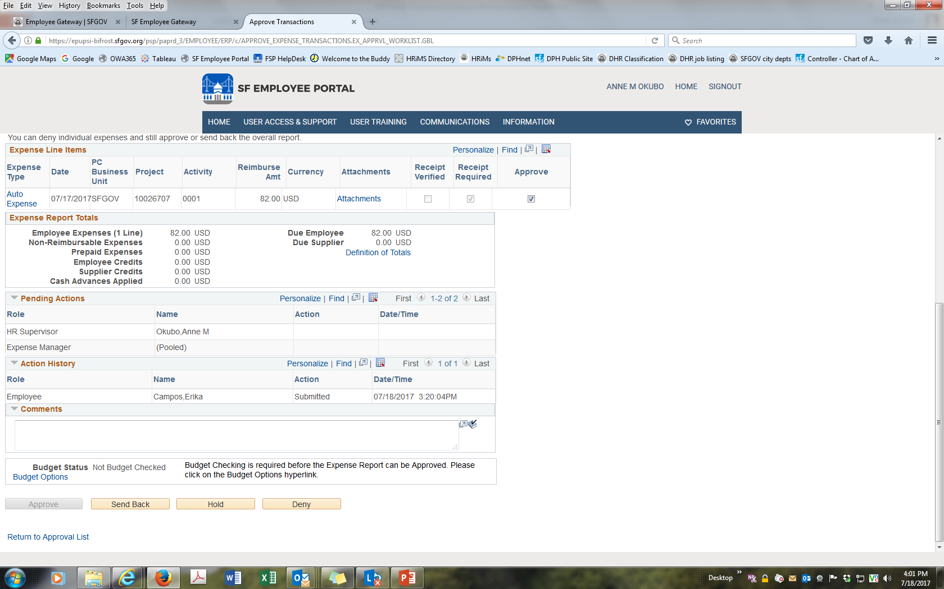
Error: Approve is Disabled/Greyed Out

Slide 46
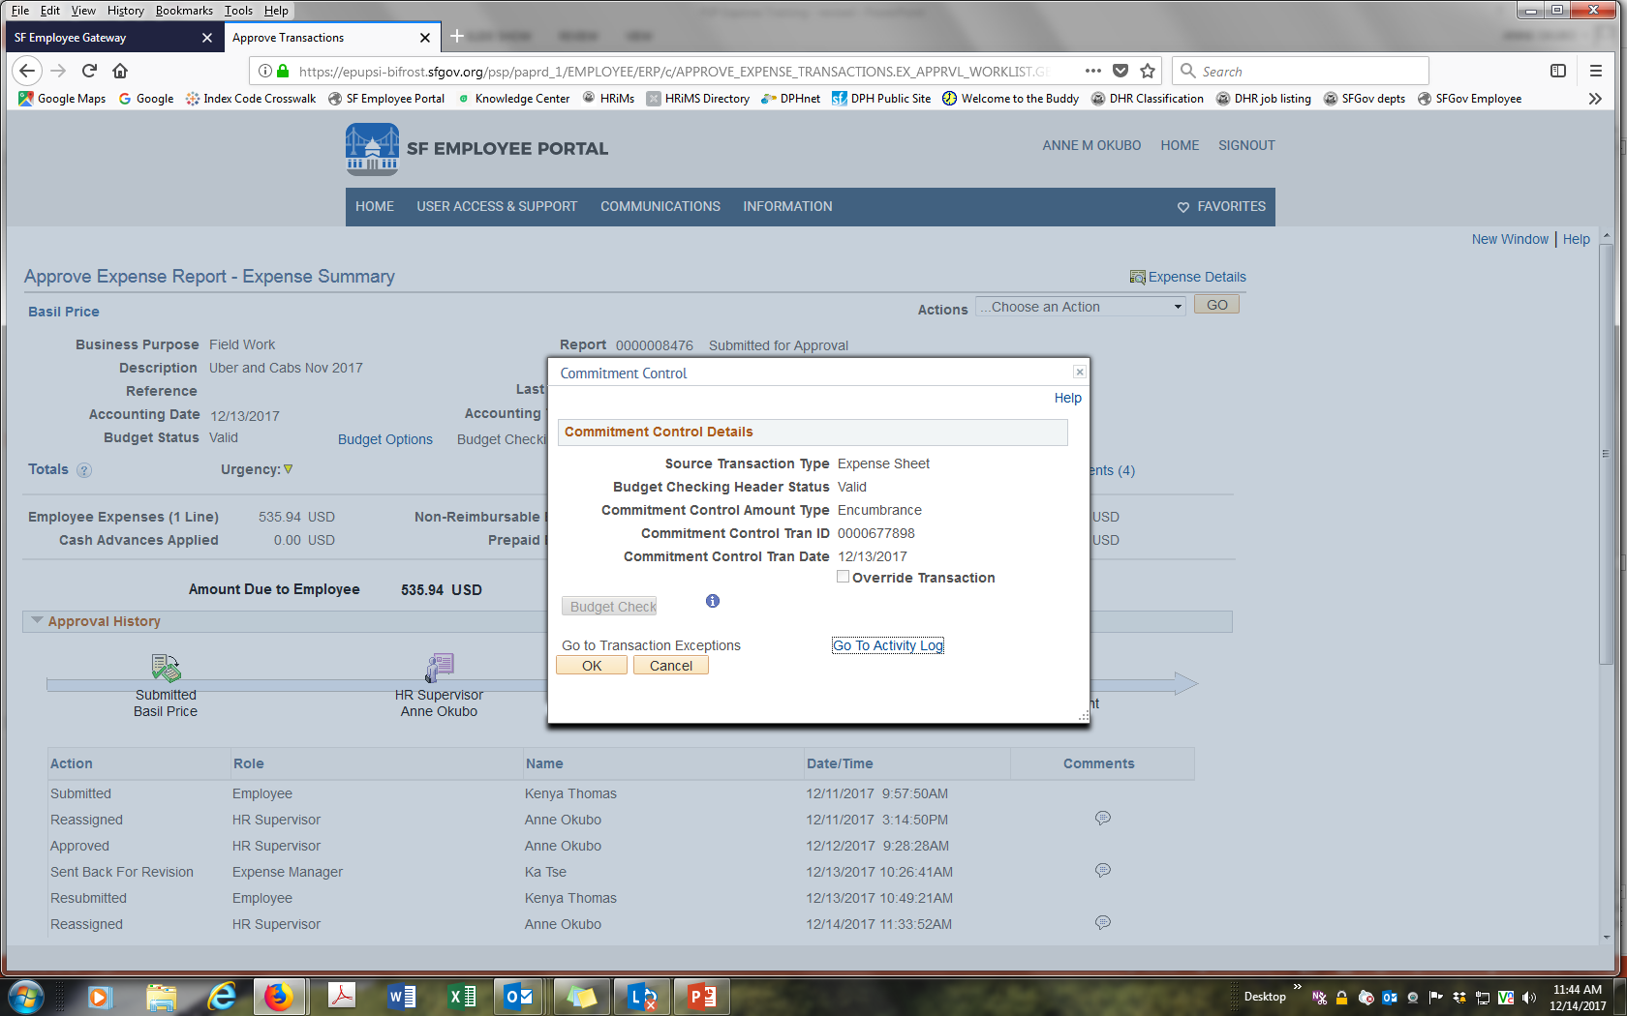
Manual Budget Check
<- click Budget Check. When complete “Approve”
should be enabled

Slide 47
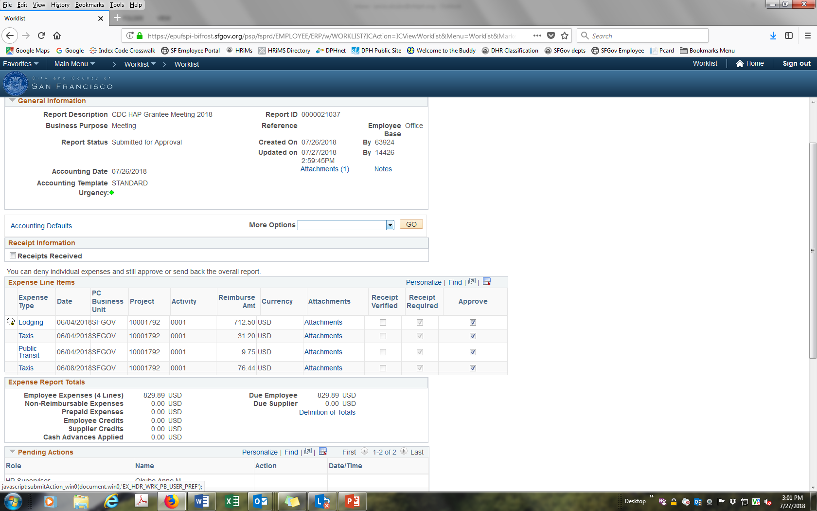
Error: Budget Check Failed – Edit Chart fields
<- Select Expense types

Slide 48
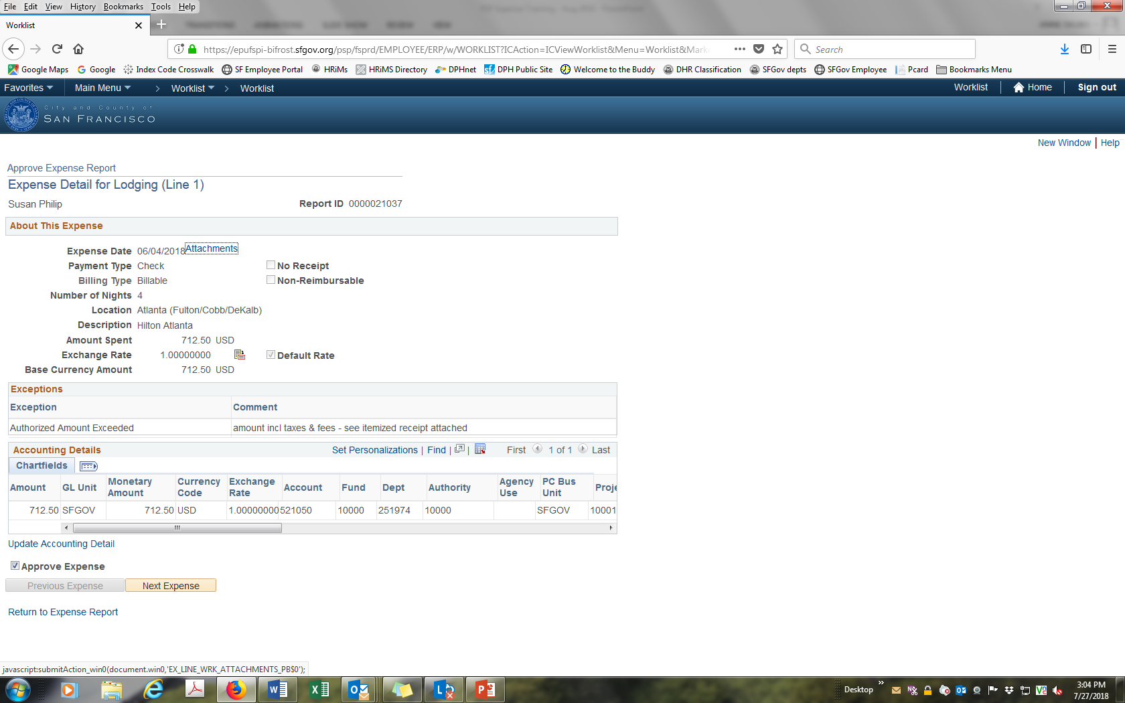
Edit Chart Fields - Select Update Accounting Detail

Slide 49
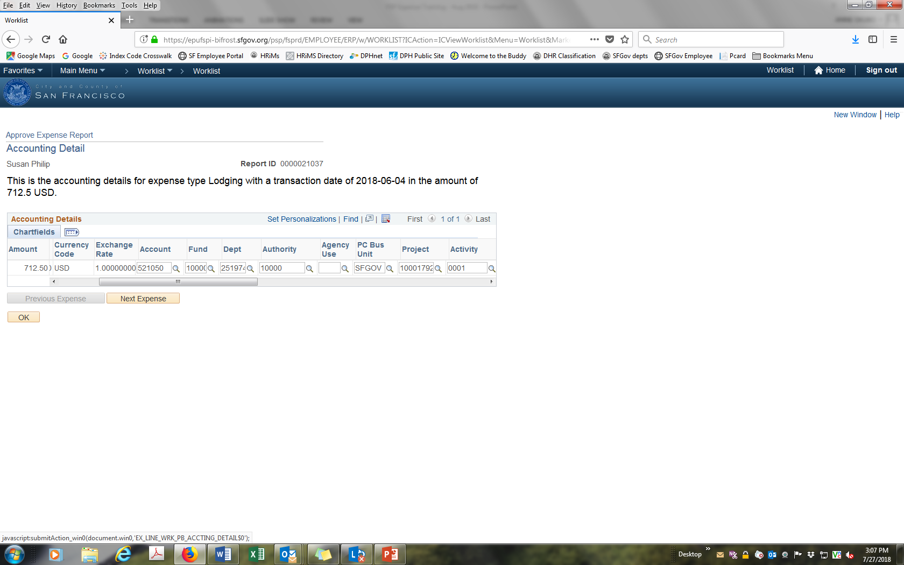
Correct Errors in Chart fields
<- Edit chart field (e.g. from DHR approval) or
send back. Employee can contact Accounting
for correct chart fields.

Slide 50
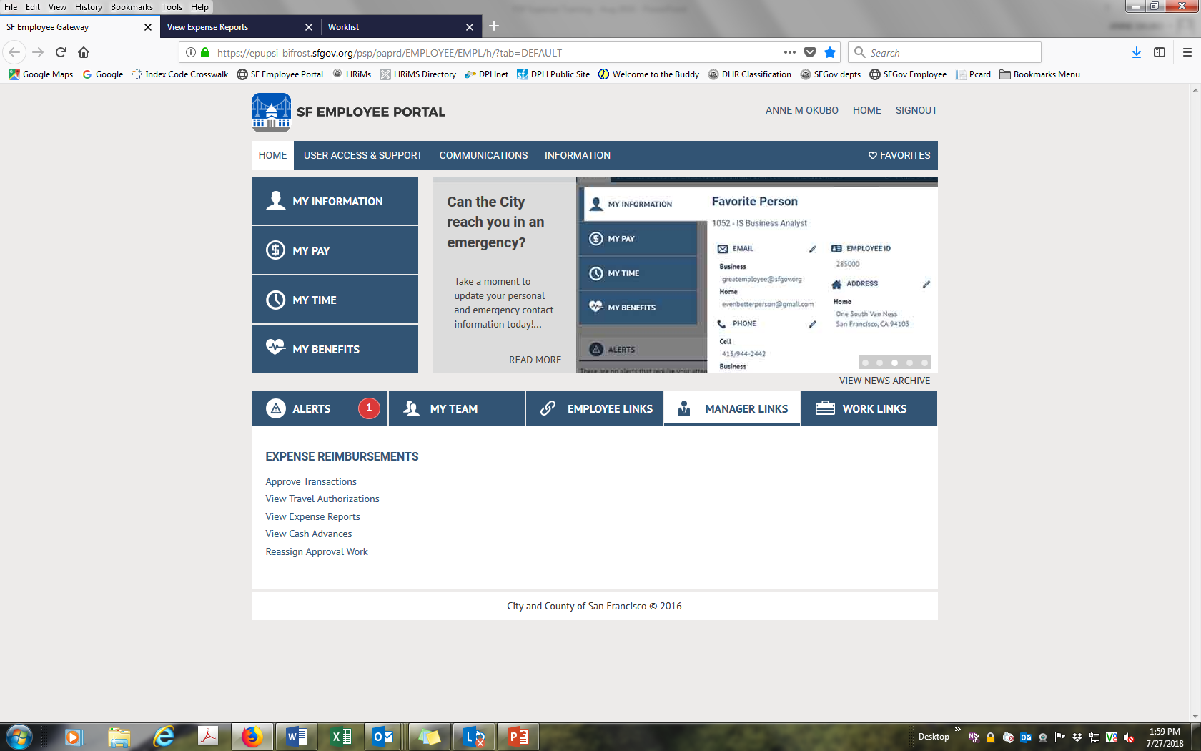
Reassign Approval to Another Person
<- Reassign approval work

Slide 51
Wrong HR Supervisor or No HR Supervisor
  If the HR Supervisor is wrong
    1) Have “wrong” HR Supervisor approve, or contact Fiscal to temporarily reassign to another person; then
    2) Contact HR to permanently assign the correct HR Supervisor.
  If there is no HR Supervisor
    1) Controller’s Office will reassigned to DPH; then
    2) Contact HR to permanently assign the correct HR Supervisor.

Slide 52
Delete Expense Report
<- Reimbursement - Delete Request

Slide 53
Duplicate Reimbursement Requests
Duplicate submissions create duplicate FSP reimbursements which result in duplicate payments.
To avoid duplicate reimbursements, modify existing FSP Expense. Don’t create a new one.
If you accidentally create a duplicate reimbursements, delete it.

Slide 54
Create an Expense Report from an Existing Expense
You can create a new Expense Report from an existing expense.
This may save time because the PS chart fields (accounting codes) are copied.

Slide 55
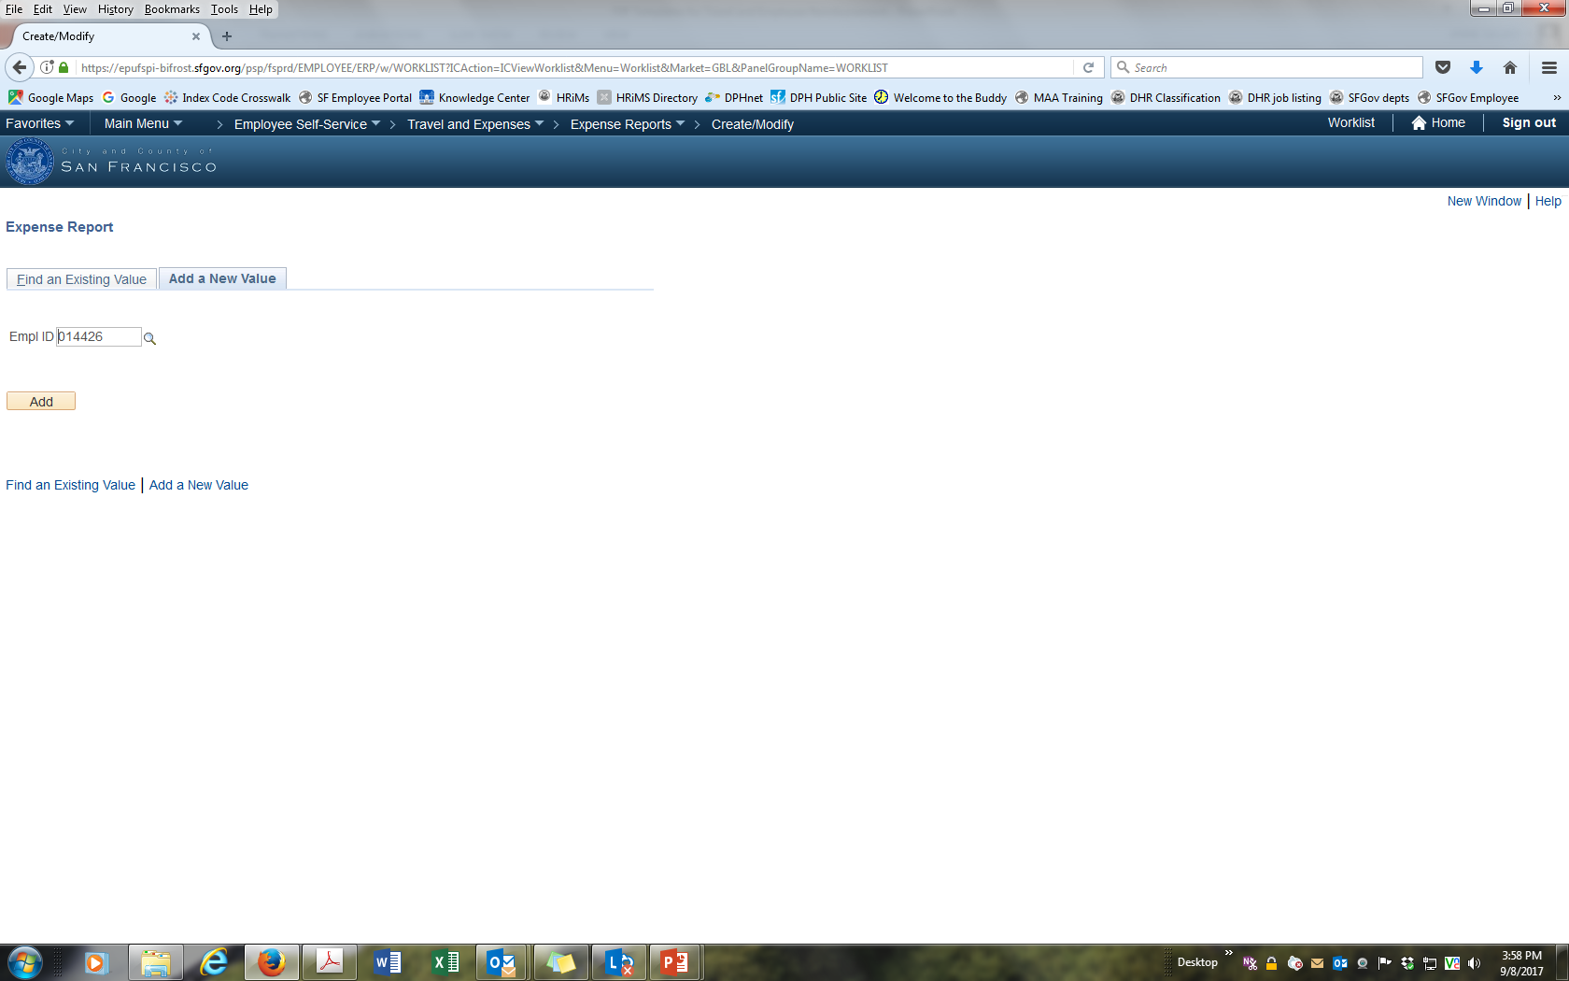
Create New Expense

Slide 56
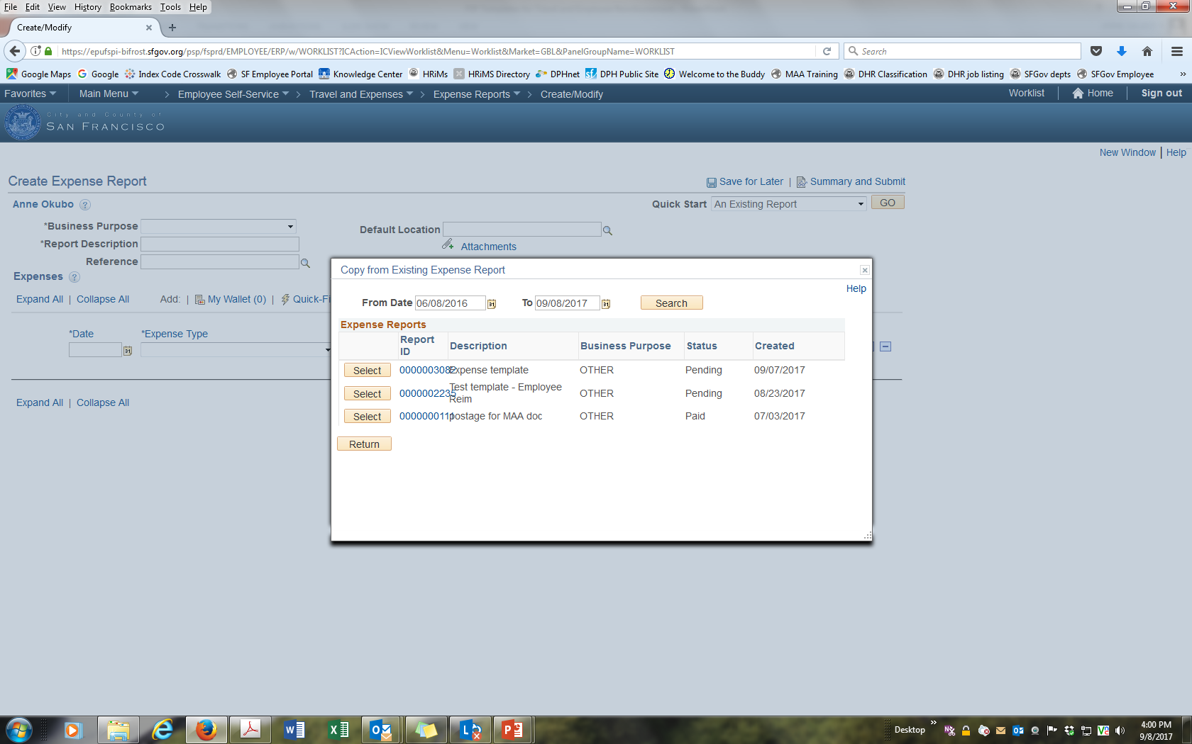
Create from An Existing Report
<- Populate from “An Existing Report”
Do not select “A Template”
<- Select expense to copy from

Slide 57
Revise Descriptions, Amount, Destination, etc.
<- Revise amount and other details

Slide 58
Change or Verify Accounting Codes
<- Change PS Account to real expense category (eg.
mileage, hotel, etc).
Confirm that all other PS chart fields are correct

Slide 59
Delegate Expense Data Entry to Another Person
You can delegate Expense data entry to your assistant or another person.
  They can create and submit your Expense request.

Slide 60
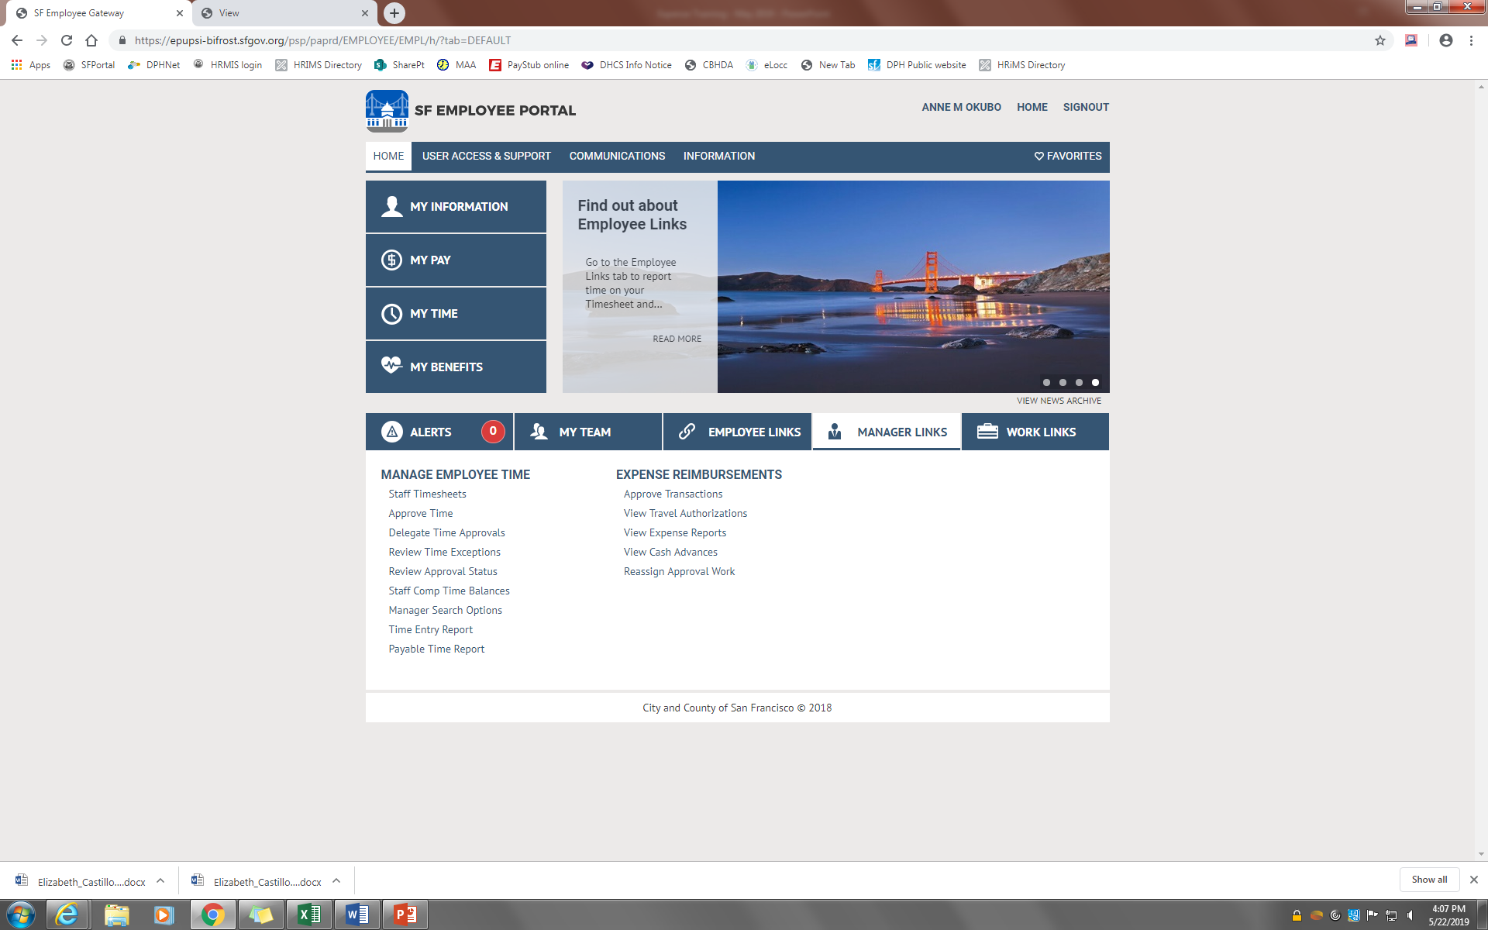
How to Delegate Expense Data Entry to Another Person
<- Reassign Approval Work

Slide 61
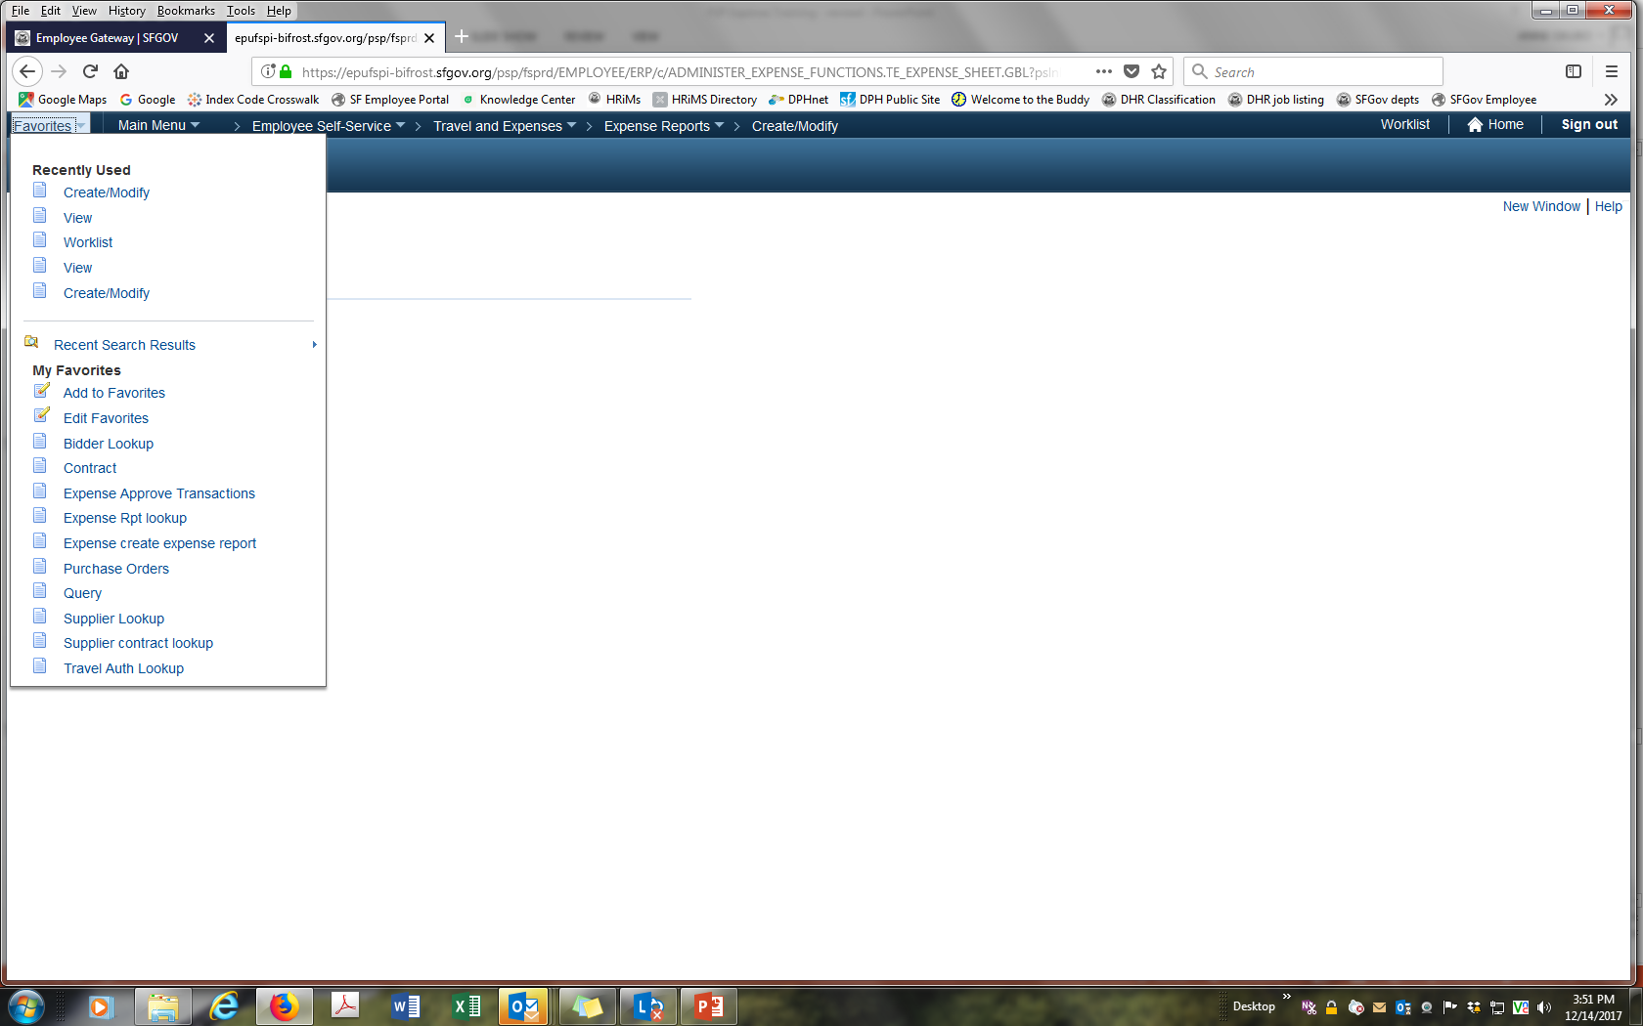
Create Shortcut/Favorites
<- On next screen create name for your Favorites

Slide 62
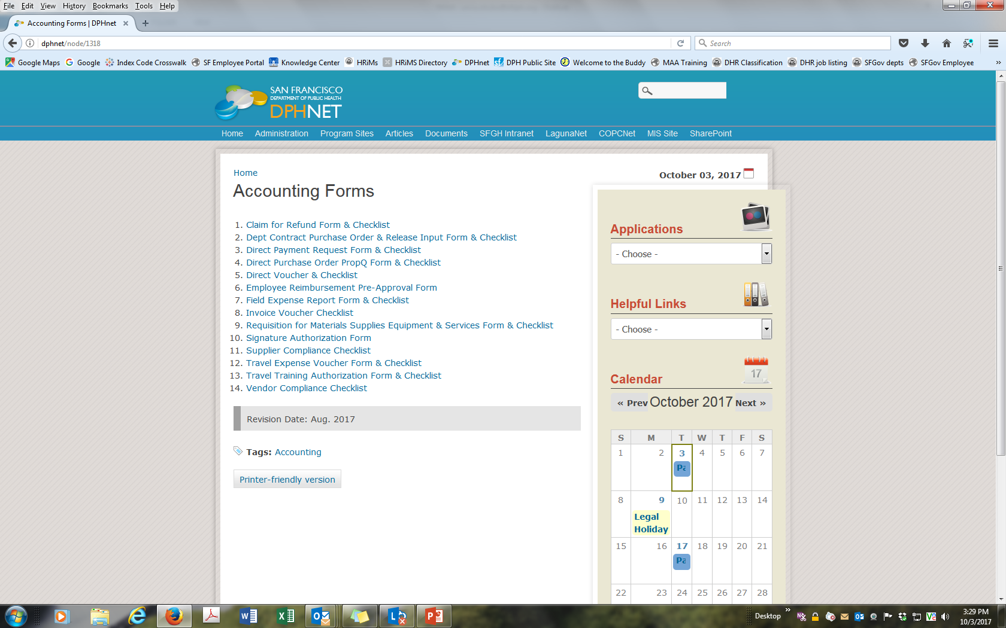
Accounting Forms
Use revised accounting forms with PS chart fields.
DPH Net, Helpful Links, Accounting Forms
http://dphnet/node/1318
<- Accounting Forms

