Slide 1
Cultural Competence Tracking System Training
September 7, 2017

Slide 2
In This Presentation
Overview
Accessing the System
Home Page
Staff Registrations
Reports
Interactive Maps
Interactive Charts
File Upload

Slide 3
Overview
Purpose of CCTS
Help Programs in maintenance management, tracking, and reporting.
Helps users to effectively submit staff information and to generate charts and reports.
Note: For best user experience please use Firefox or Internet Explorer 11

Slide 4
Who are the Users
General Users:
  Tied to a Program
  Access all the functionalities of the system
  Edit the information about their Program
  Submit staff registrations and forms
Read Only Users:
  Tied to a Program
  View all information
  Cannot edit any information or submit forms
Admins:
  Can access, add, edit all information about all Programs and users
  Can also add other users

Slide 5
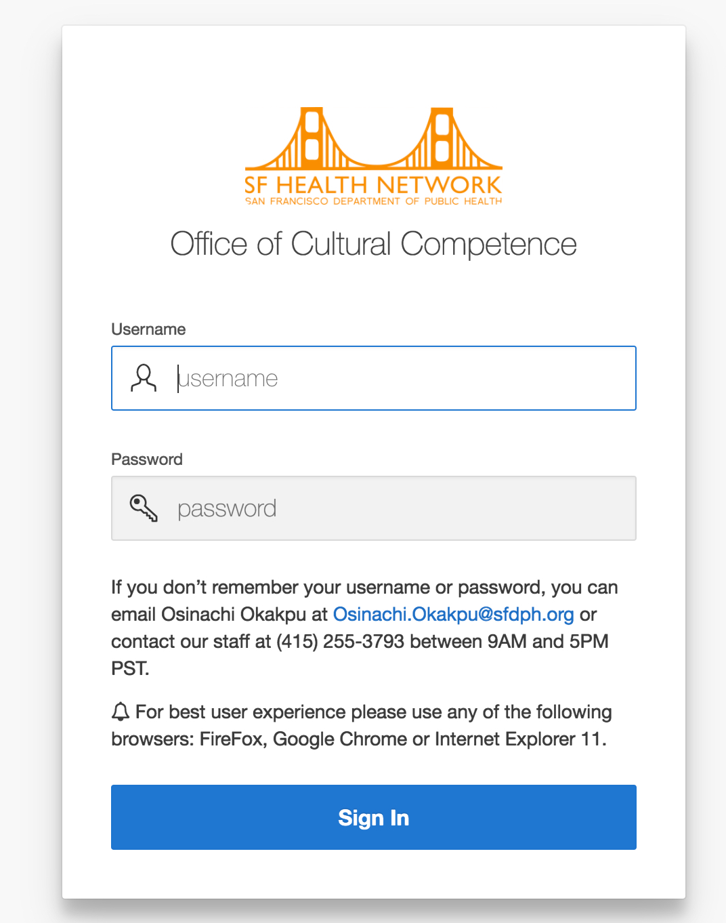
Accessing the System
Login URL: https://101g-xnet.sfdph.org:8443/ords/cmsp/f?p=106
Enter the username and password

Slide 6
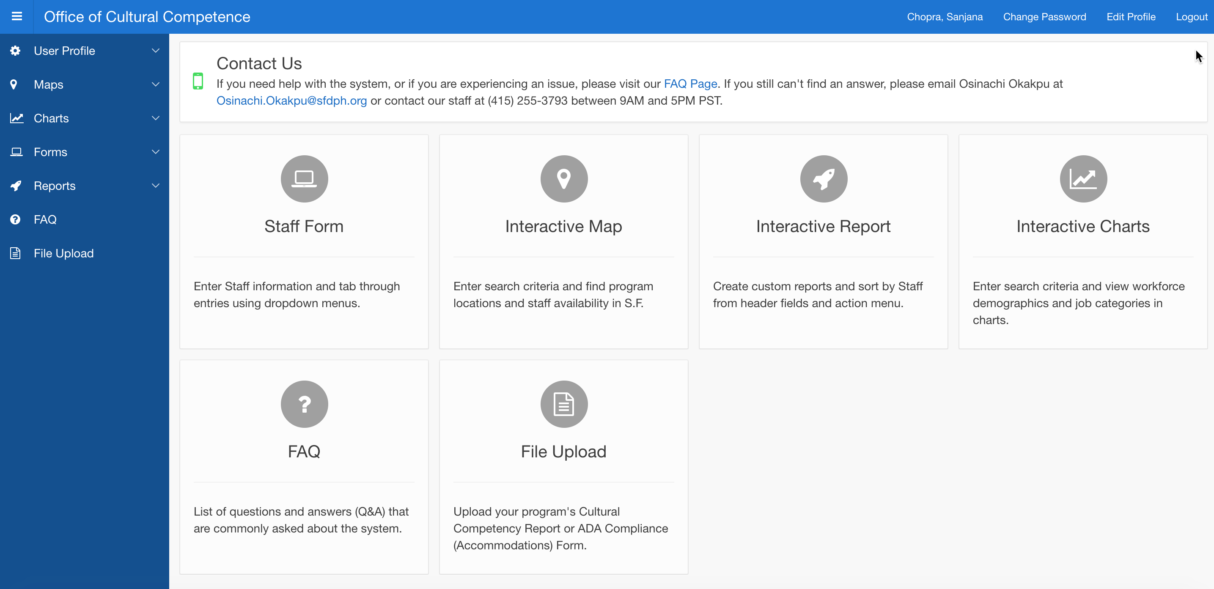
Home Page
Link to return to home page
Links to system functionalities

Slide 7
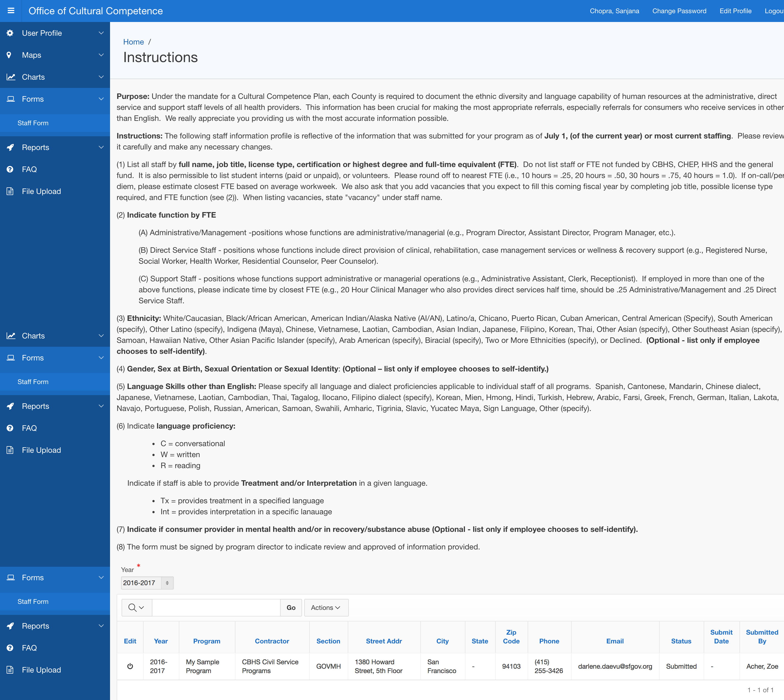
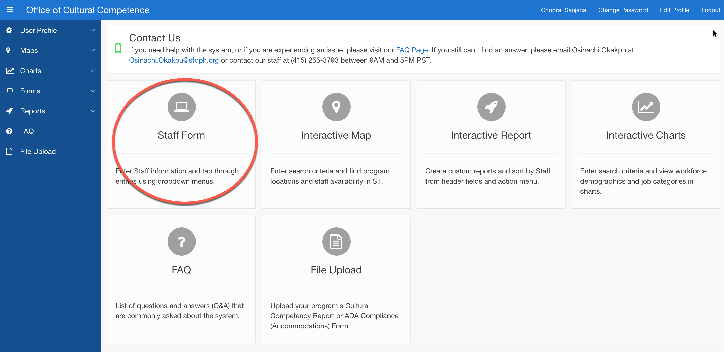
Staff Registrations
Staff Form Home Page
2. Read Instructions on Staff Home Page
1. Click Staff Form

Slide 8
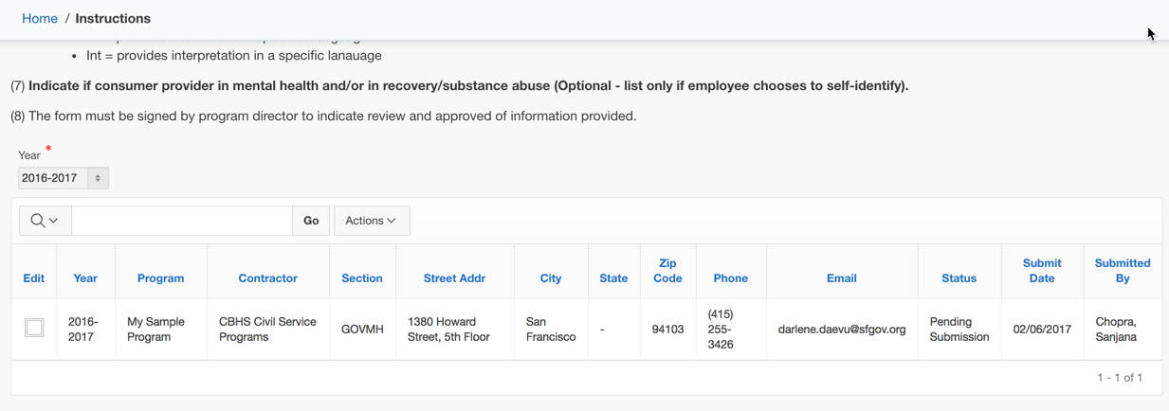
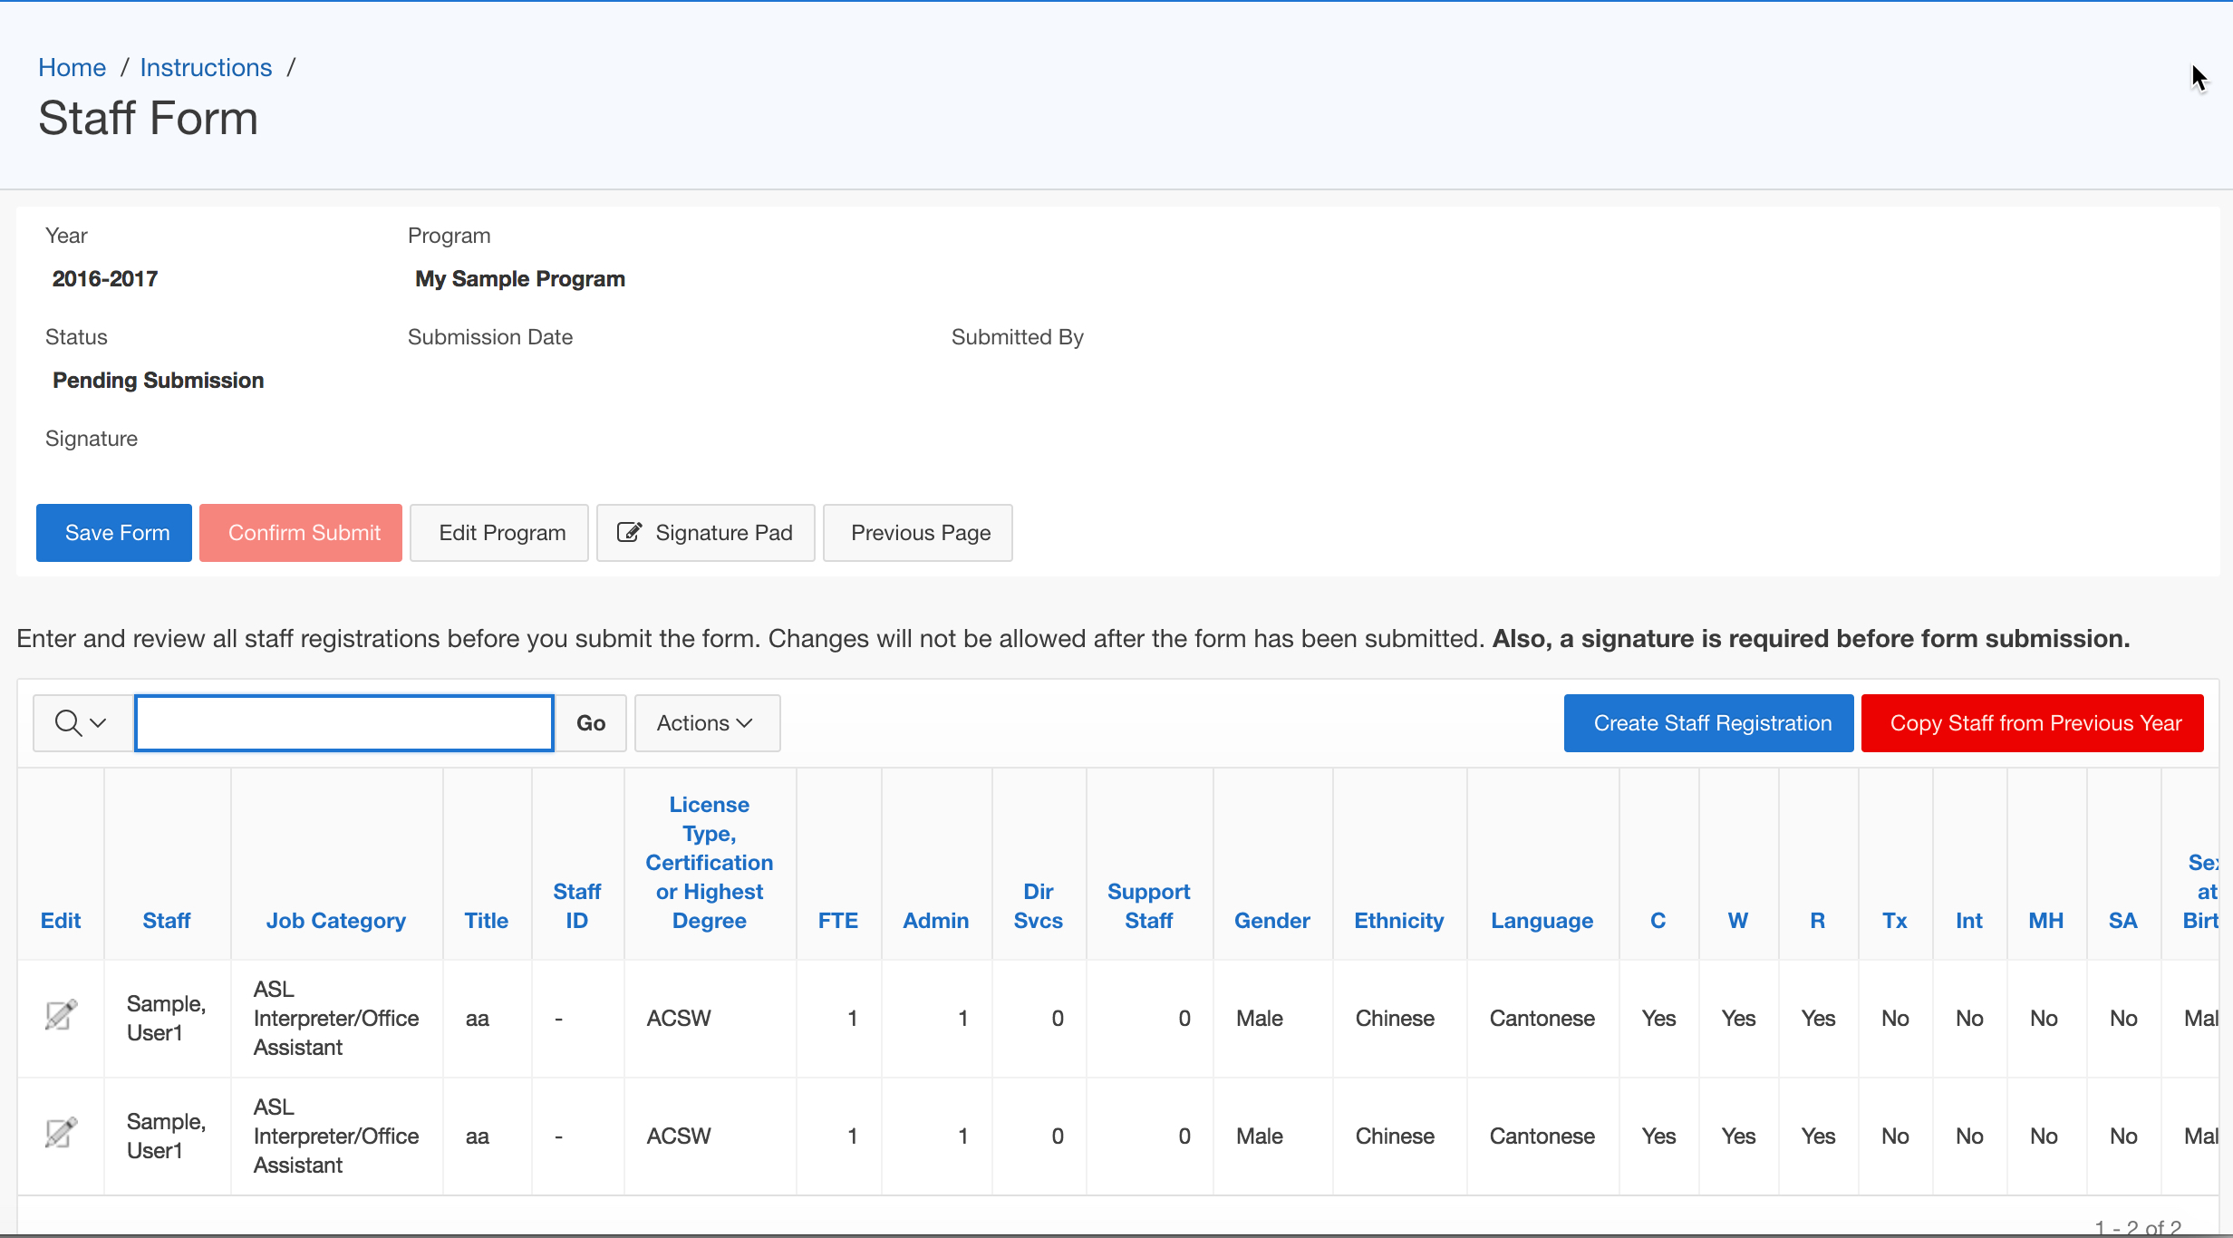
Staff Registrations - Add New Staff
1. Click Edit
Staff Form opens
1.
2. Click Create Staff Registration
2.

Slide 9
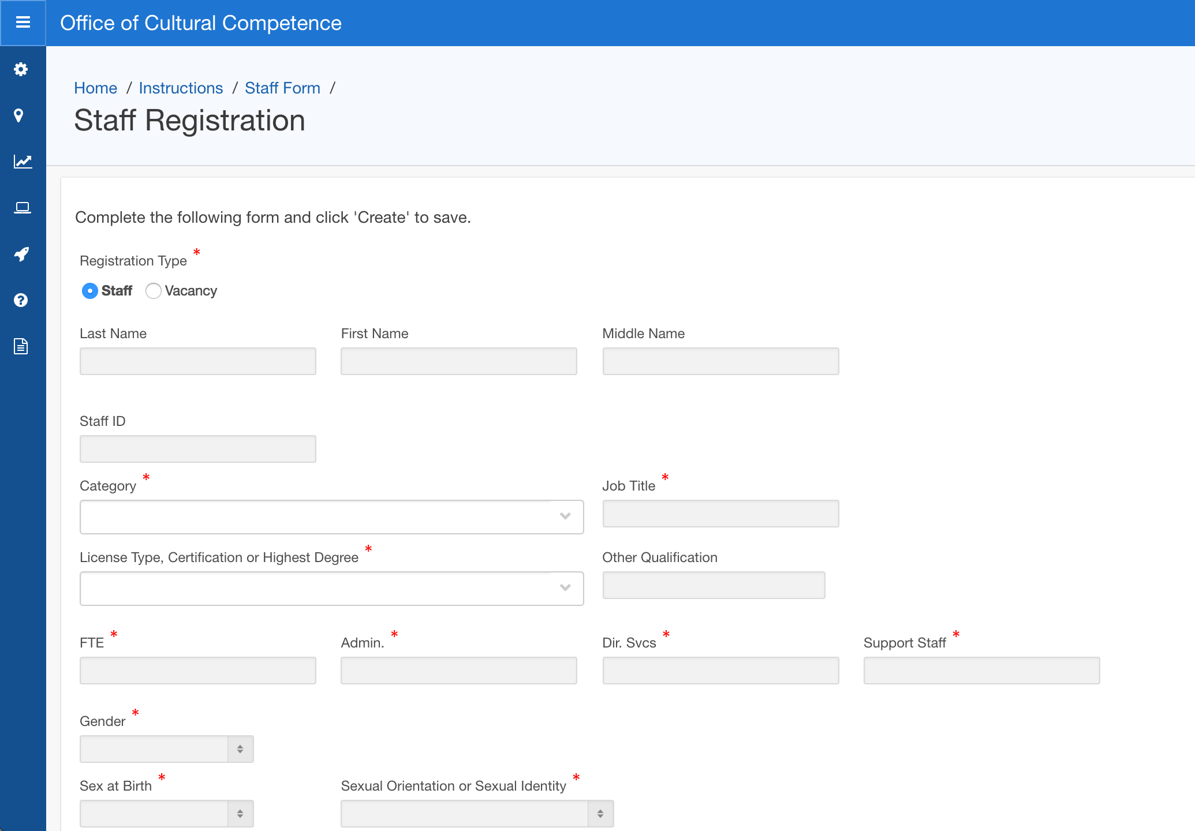
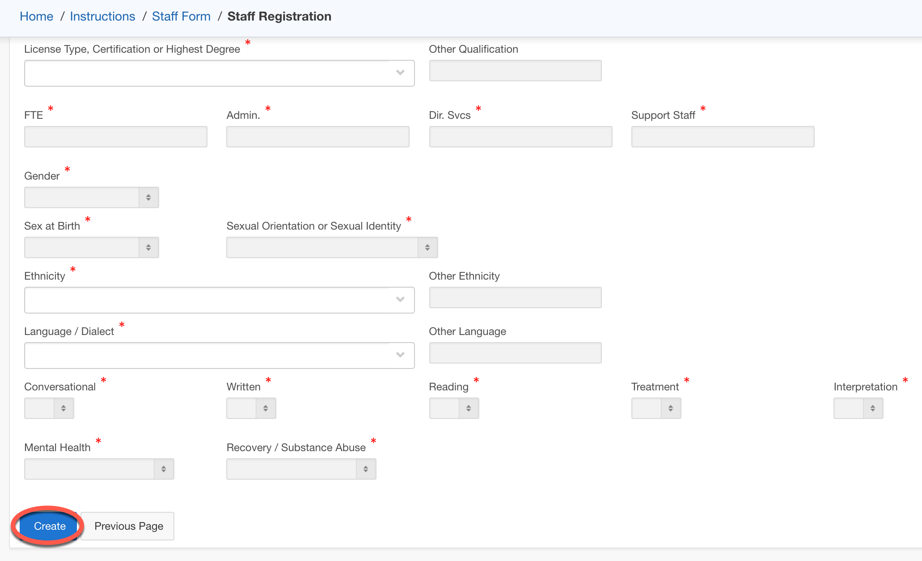
Staff Registrations - Add New Staff
3. Fill the Staff Registration form
4. Click Create

Slide 10
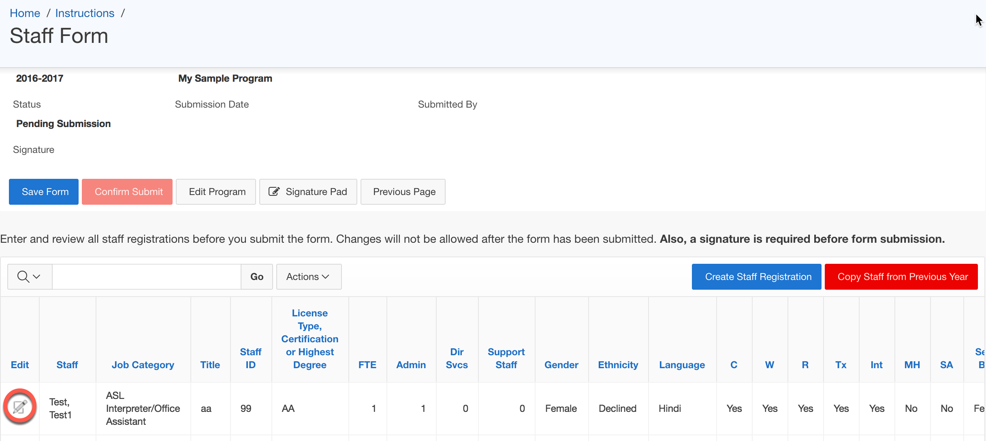
Staff Registrations – Edit Staff
1. Click Edit
Staff Form opens
1.
2. Click Edit
2.

Slide 11
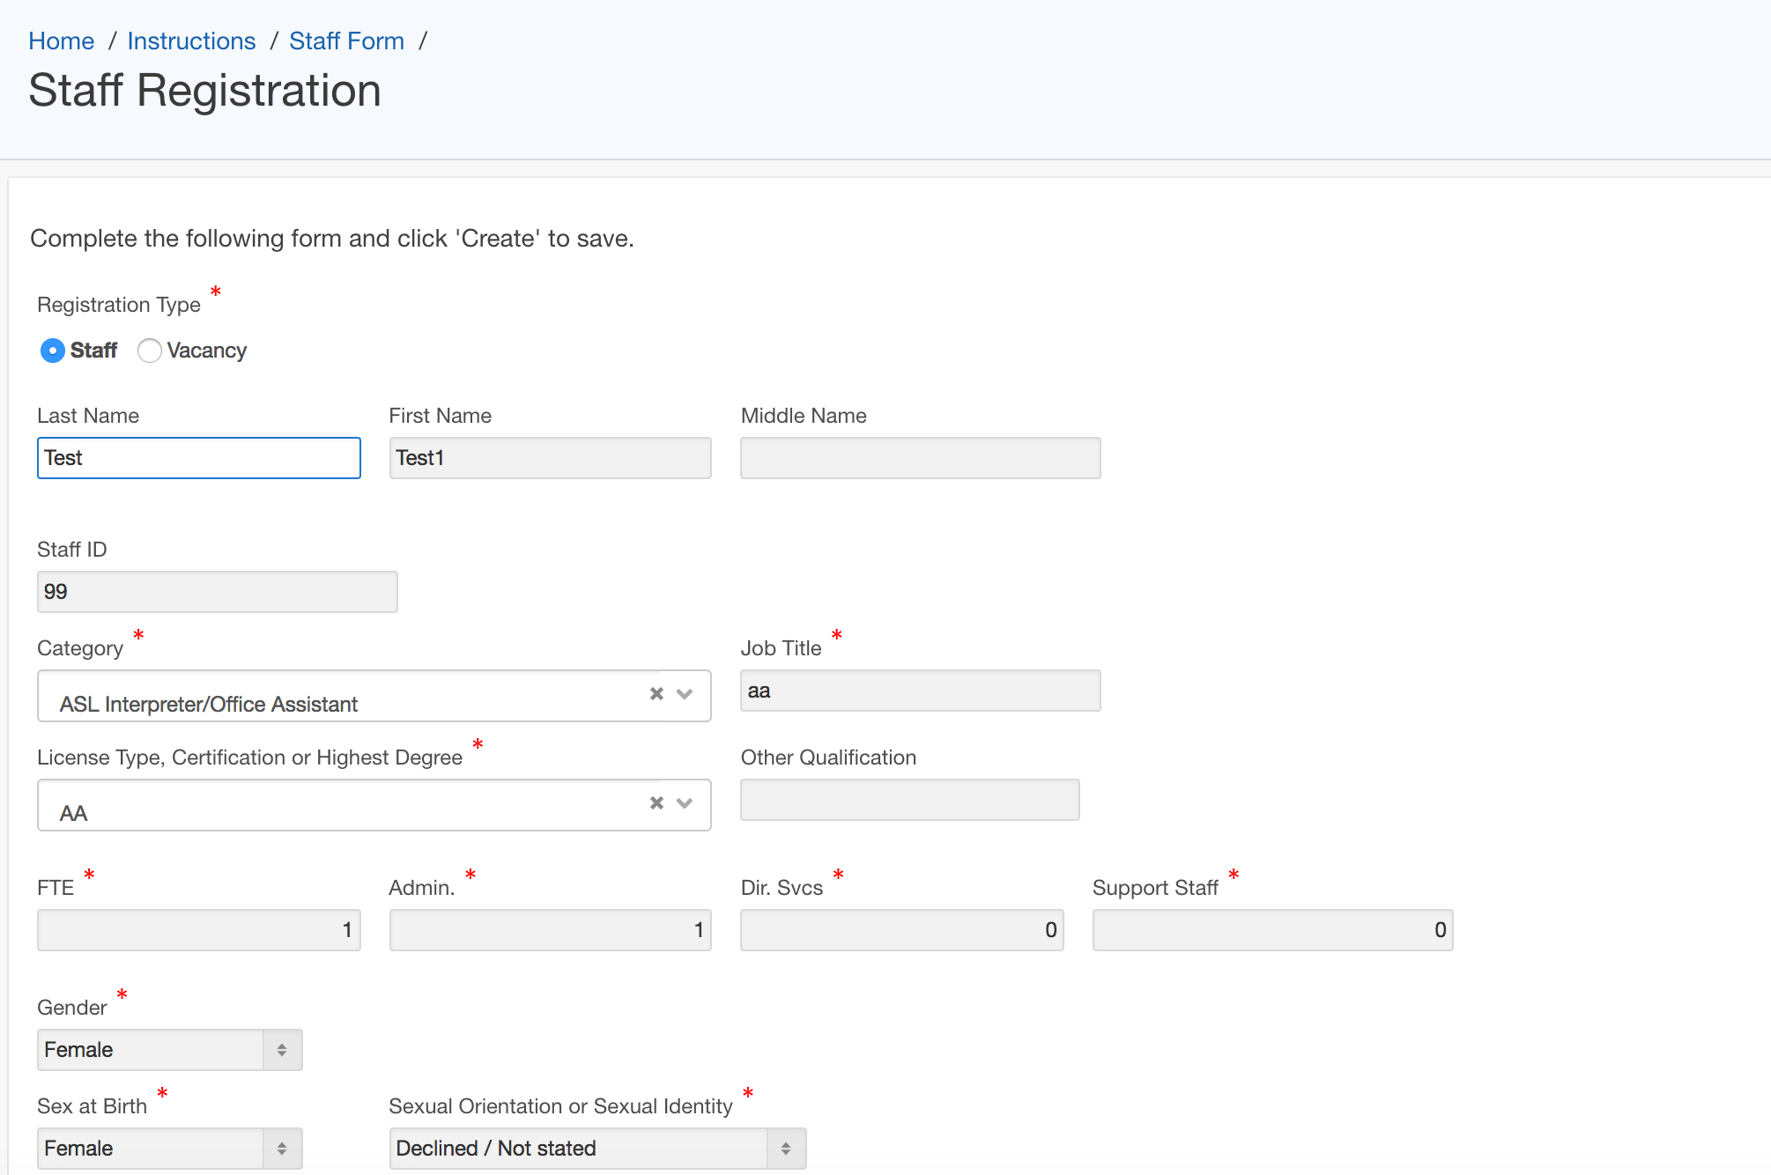
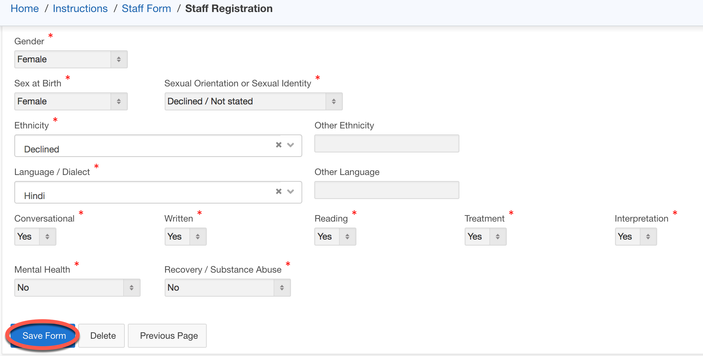
Staff Registrations – Edit Staff
3.
3.
3. Make the required changes
4.
4. Click Save Form

Slide 12
Staff Registrations – delete Staff
1. Click Edit
Staff Form opens
1.
2. Click Edit
2.

Slide 13
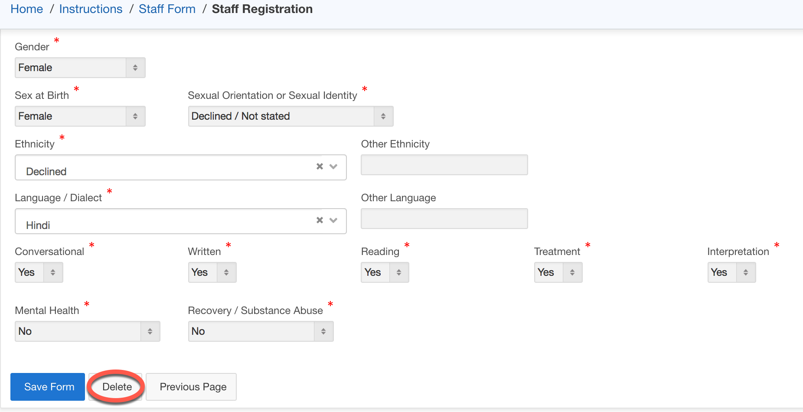
Staff Registrations – delete Staff
Staff Registration Page Opens
3.
3. Click Delete

Slide 14
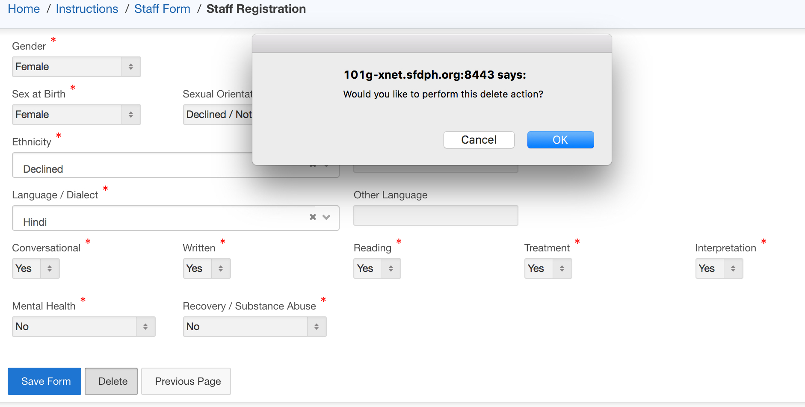
Staff Registrations – delete Staff
4.
4. Click OK

Slide 15
Staff Registrations – Copy Staff
From Previous Years
1. Click Edit
Staff Form opens
1.
2.
2. Click Copy Staff From Previous Year

Slide 16
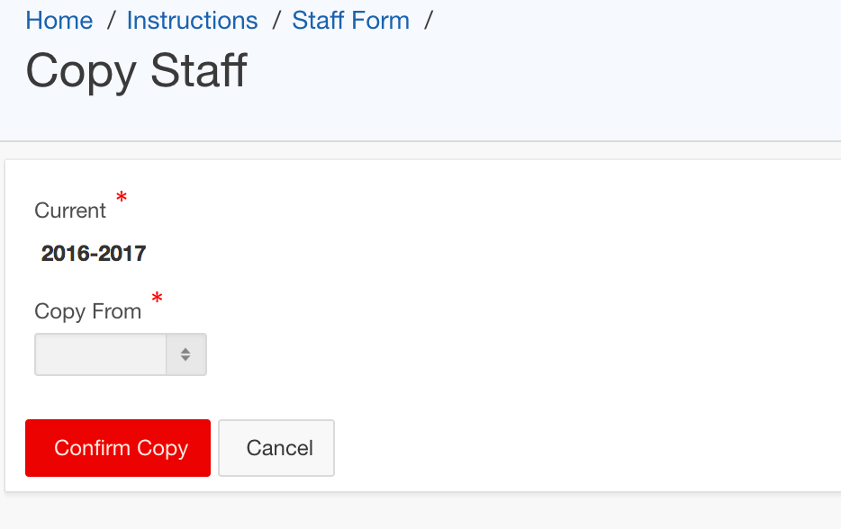
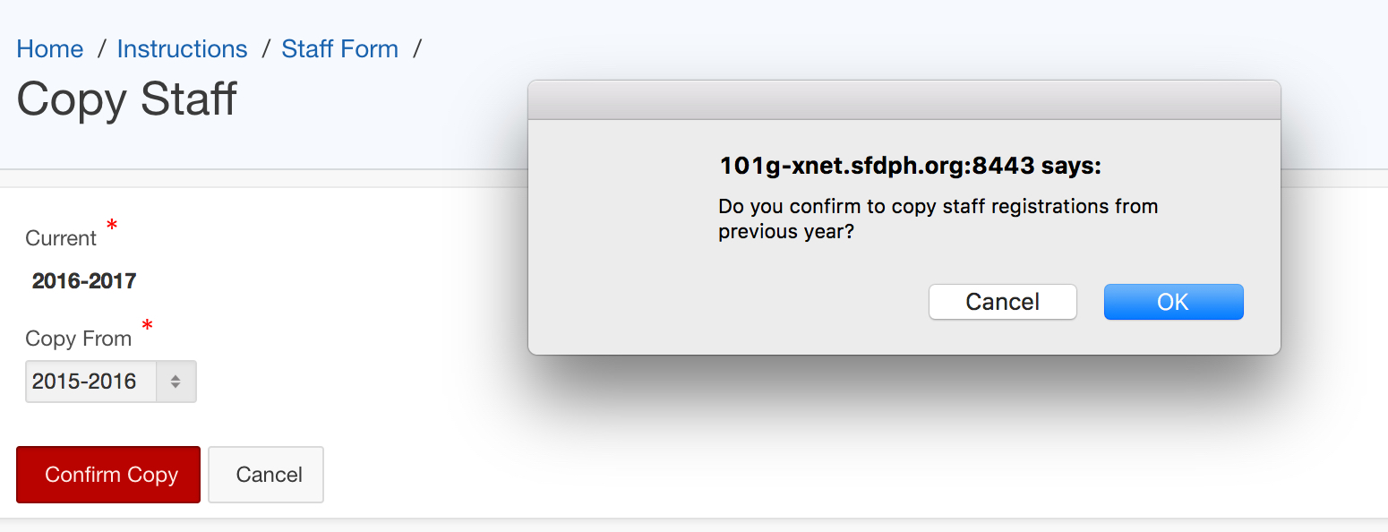
Staff Registrations – Copy Staff
3. Select Year
4. Click Confirm Copy
3.
4.
5. Click OK
5.

Slide 17
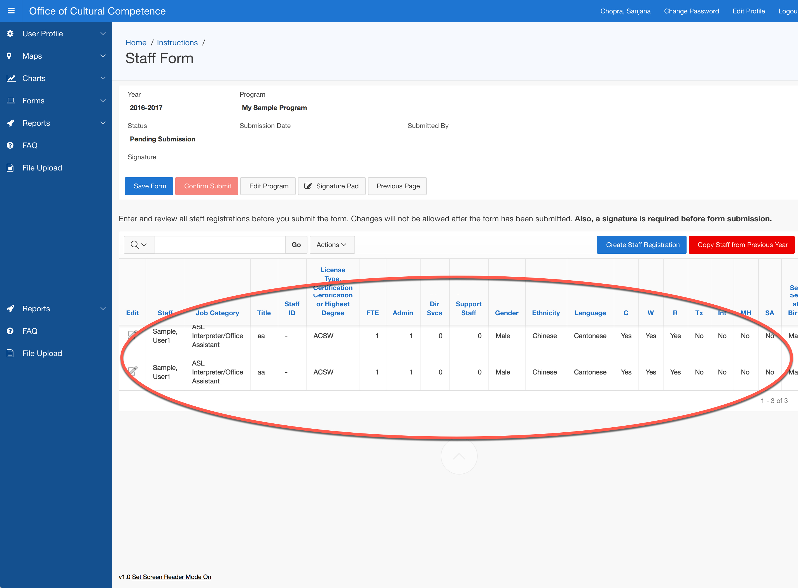
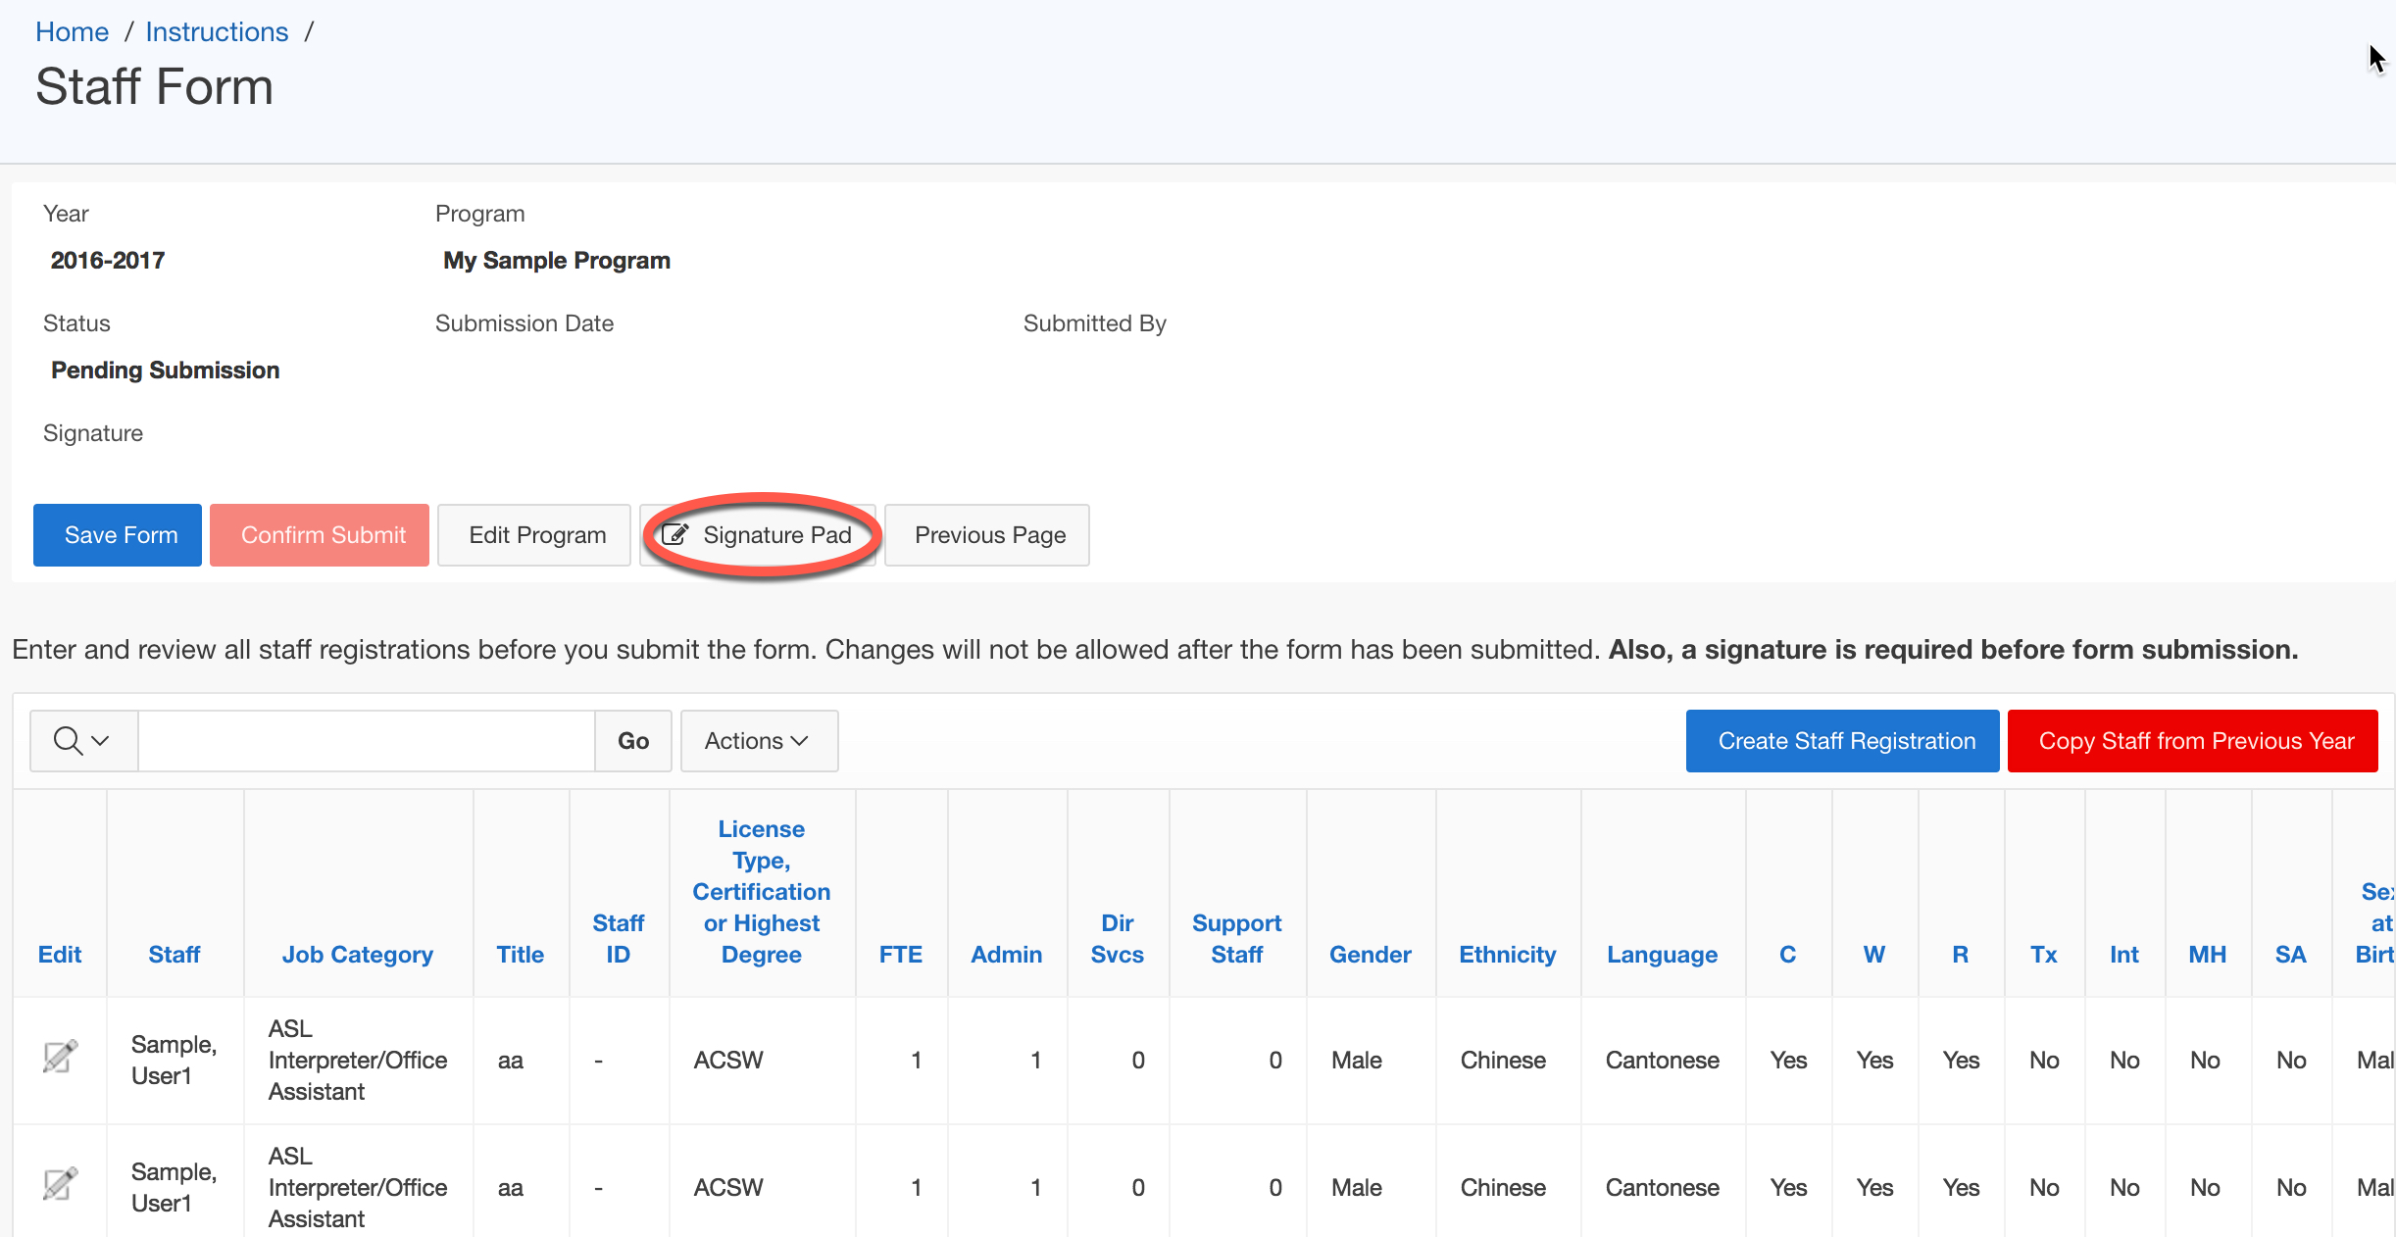
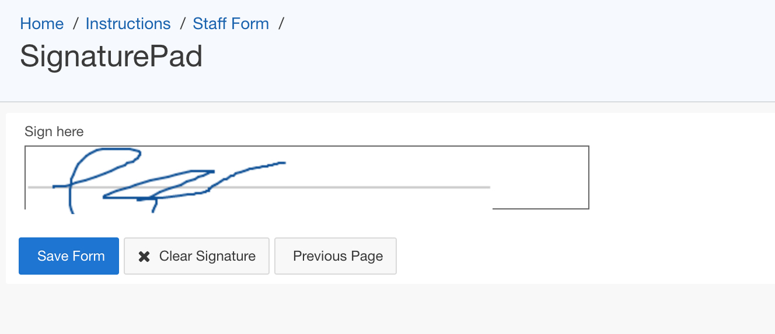
Staff Registrations – Sign and Submit
1. Review Staff Registrations
2. Click Signature Pad
1.
2.
3.
3. Sign in the Sign Here field
4. Click Save Form
4.

Slide 18
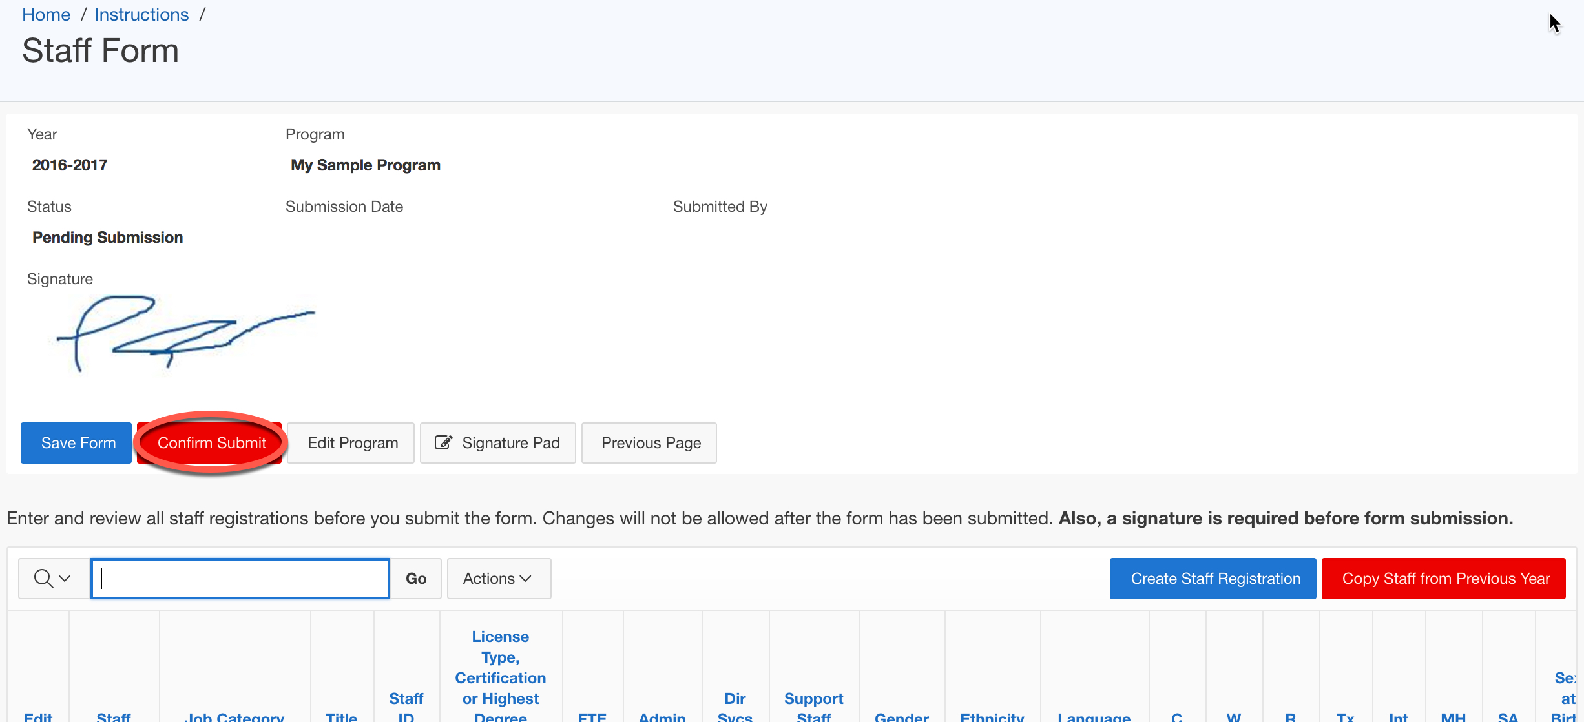
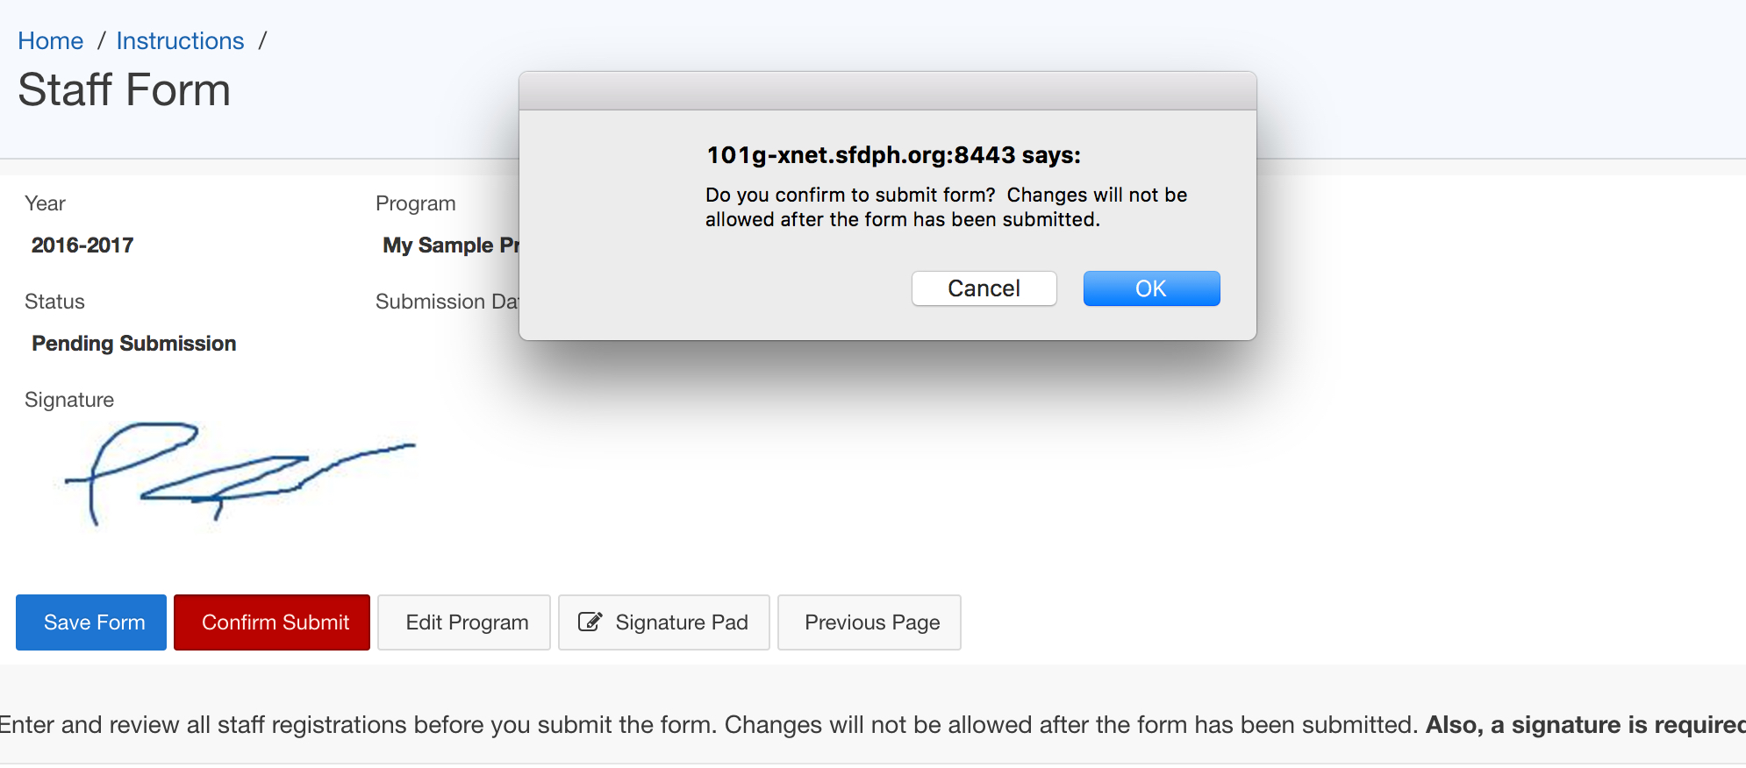
Staff Registrations – Sign and Submit
5. Click Confirm Submit
5.
6.
6. Click OK

Slide 19
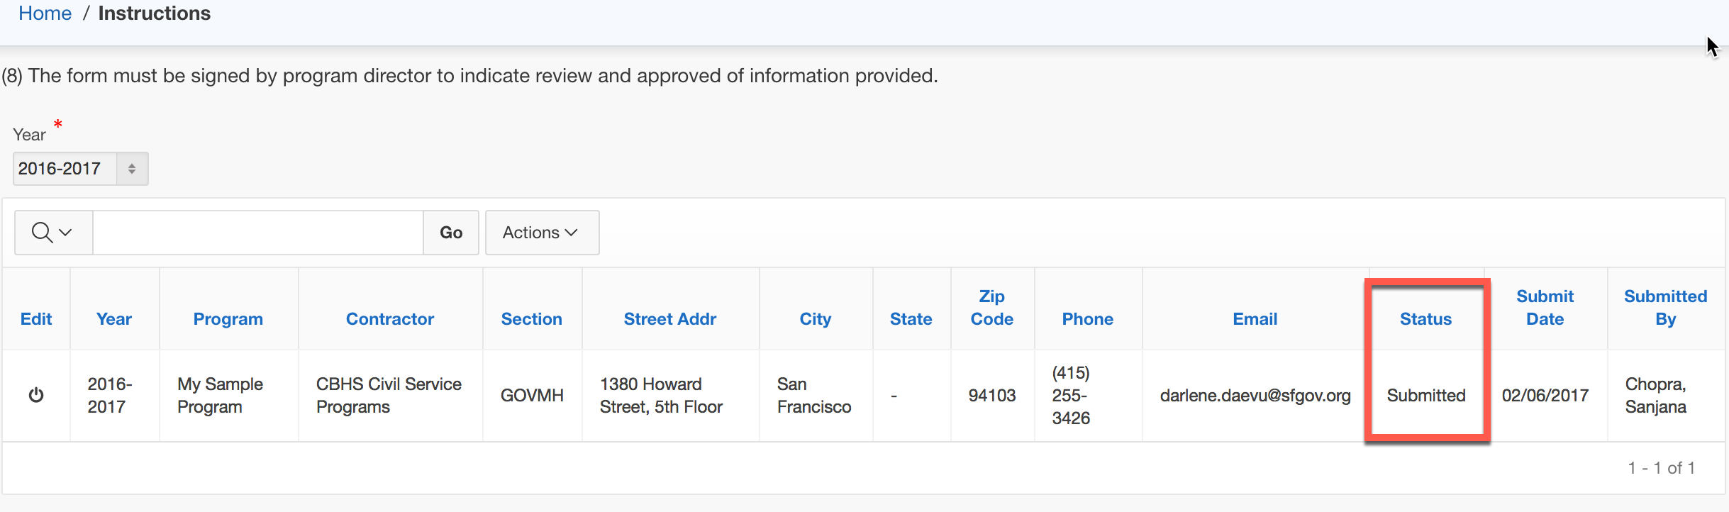
Staff Registrations – Sign and Submit
The form will not be updatable
The status of the Program will show as “Submitted”

Slide 20
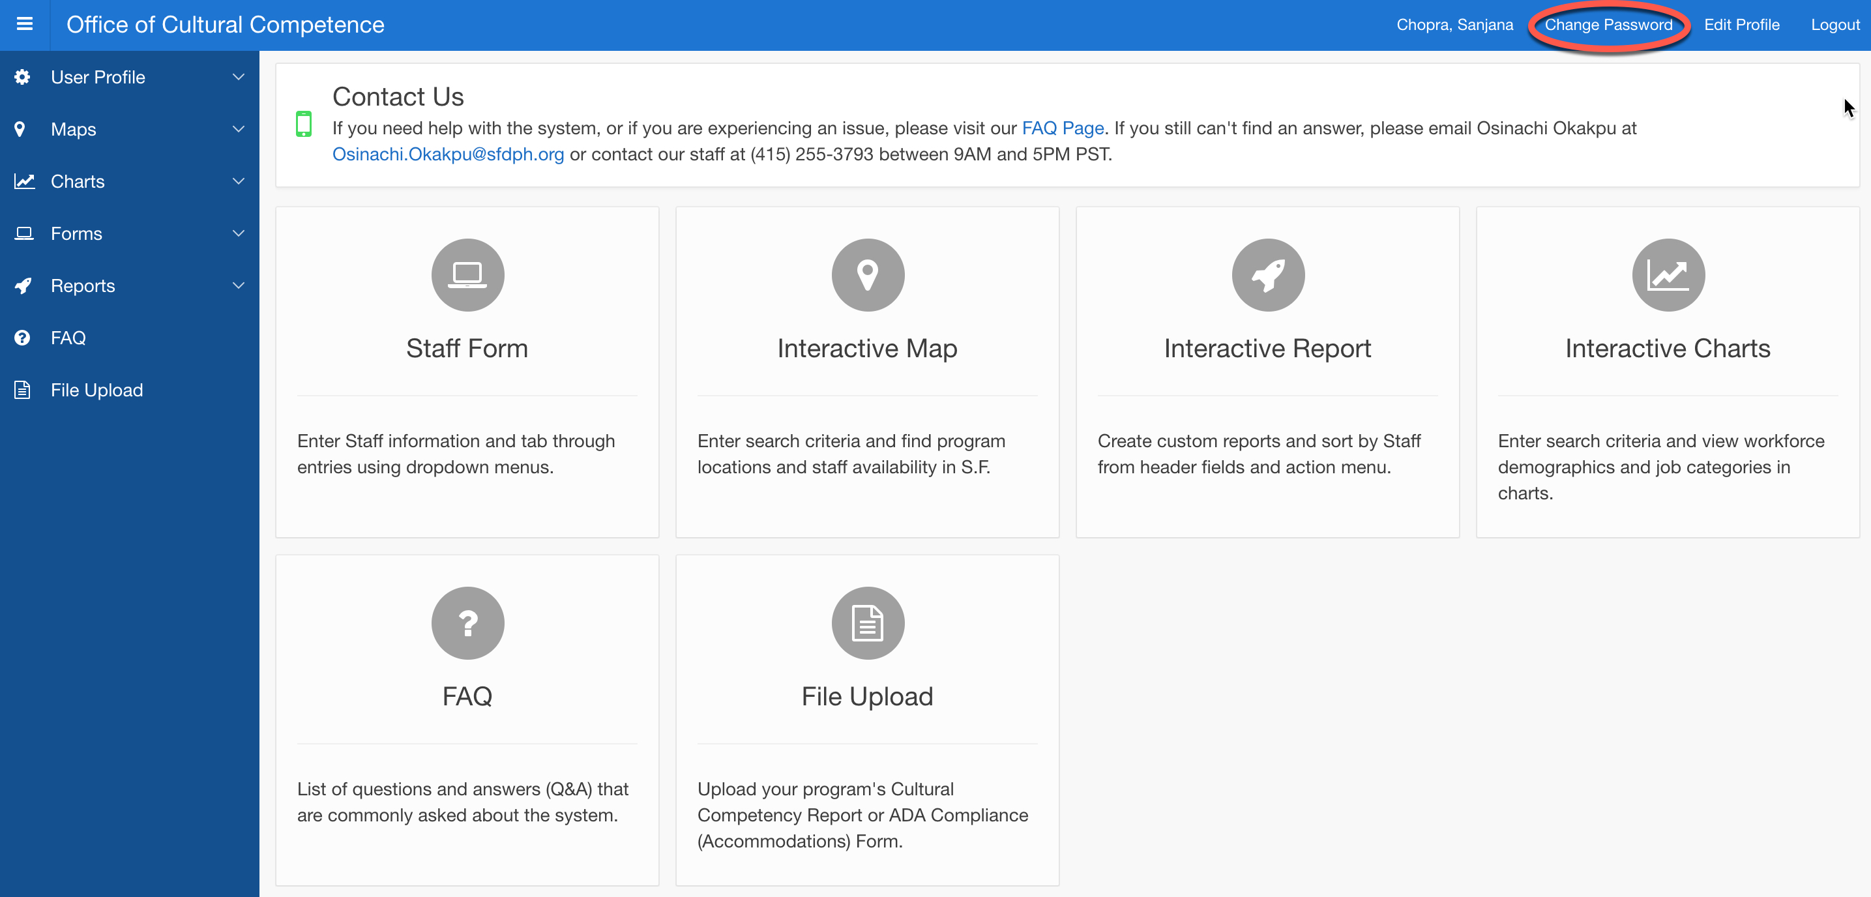
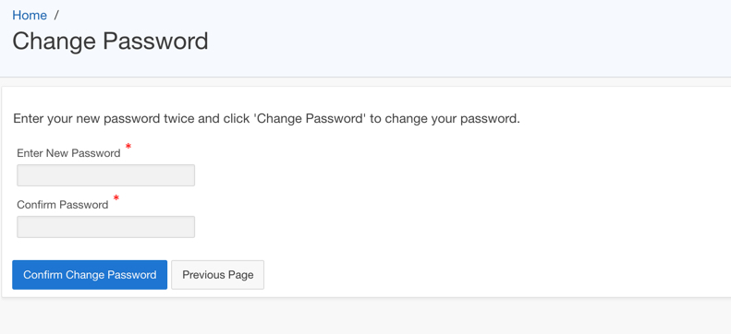
Changing the password
Step 1. Click the “Change Password” button on the top menu bar of the homepage.
Step 2. Users will be taken to the Change Password Screen where they will enter a new password on the first field and confirm it on the second. Clicking the “Confirm Change Password” will validate the change.
Upon logging onto the system for the first time, users will need to replace the default password they were initially given with a password of their own.

Slide 21
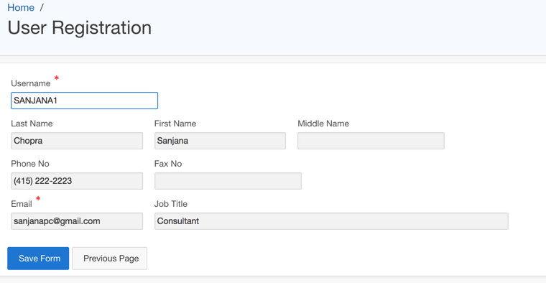
Edit Profile
Users can update their information through the “Edit Profile” link.
Step 1. Click the “Edit Profile” button at the top menu bar of the home page. The User Registration page will open.
Step 2. Update the information in at least the required fields. Clicking “Save Form” will save the changes.

Slide 22
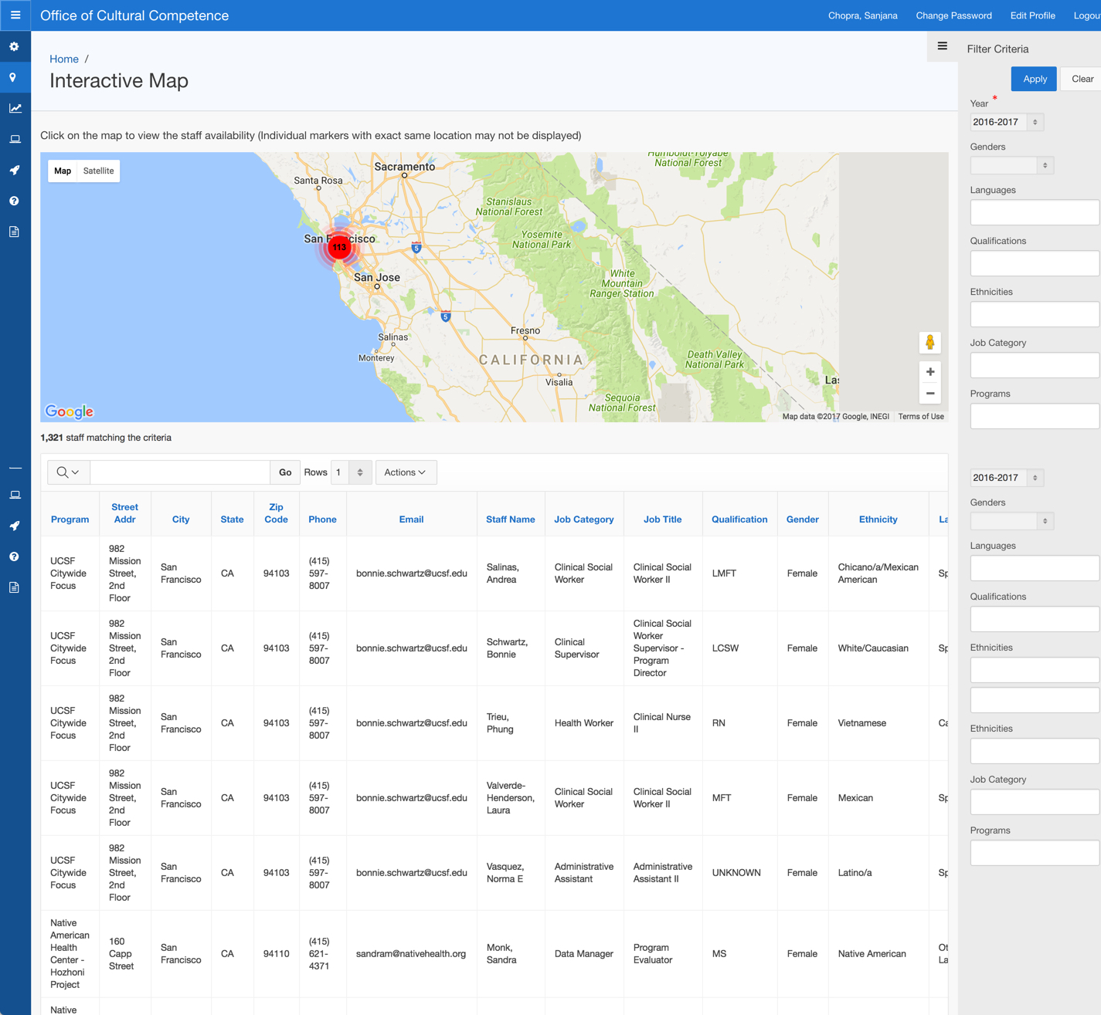
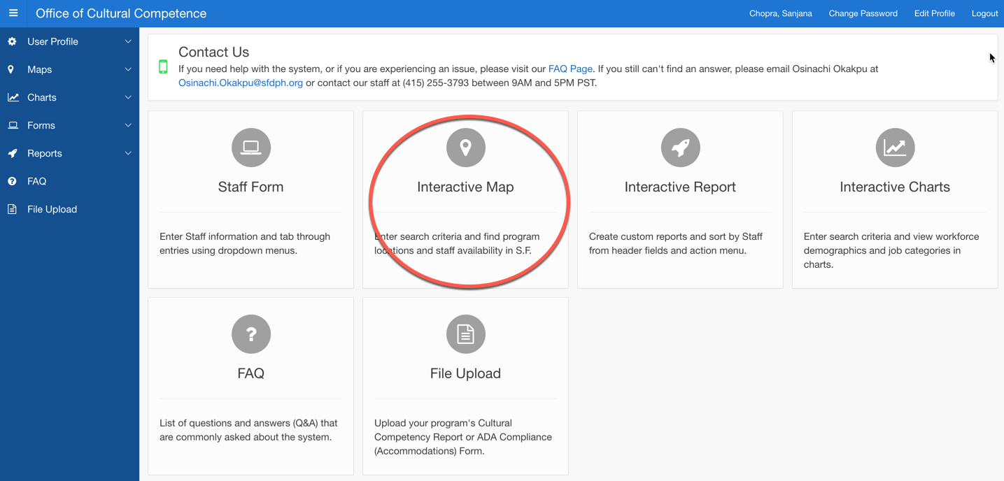
Interactive Map
The Interactive Map allows users to view staff availability and program locations on a map. It also provides filters for fields that a user desires.
The Interactive Map has an icon on the homepage. Clicking will take users to the its page, where there is a zoomed-out map and a chart with all the programs listed out (default).

Slide 23
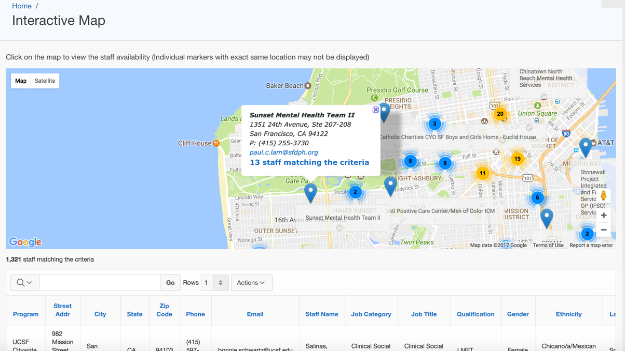
Interactive Map
Step 2. Clicking on a single arrow marker will pull up a small information window for the program.
Step 3. Clicking on the hyperlink for matching staff will reset the filter so that the chart below is filtered for only the staff of said program.
Step 1. When zoomed in, numbered circle icons will indicate areas where there is a cluster of programs close to each other. Clicking on the circle icon will zoom even further to reveal boxes with the names of specific programs and a corresponding arrow marker.

Slide 24
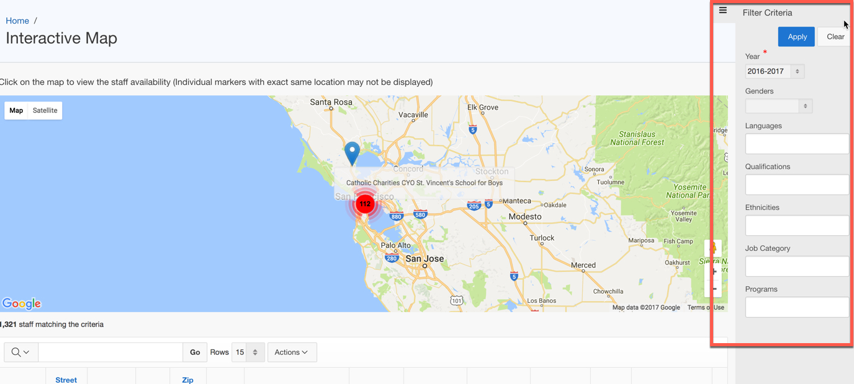
Interactive Map – Filter Criteria
Step 1. The Filter Criteria button is located at the upper right portion of the screen, indicated by three horizontal lines. Clicking will open up the filters.
Step 2. Entering the filters will reveal the relevant providers, listing them in the table below and placing markers for them on the map itself.
Clicking on the “Clear” button will remove all of the filters and reset the map and table to their default views.

Slide 25
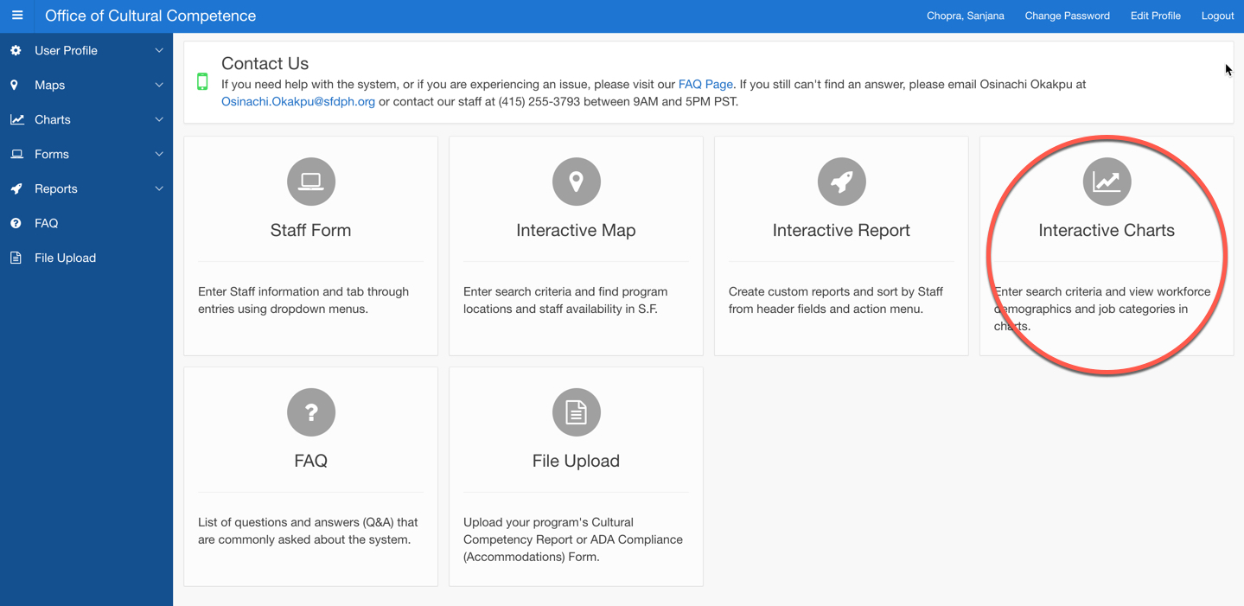
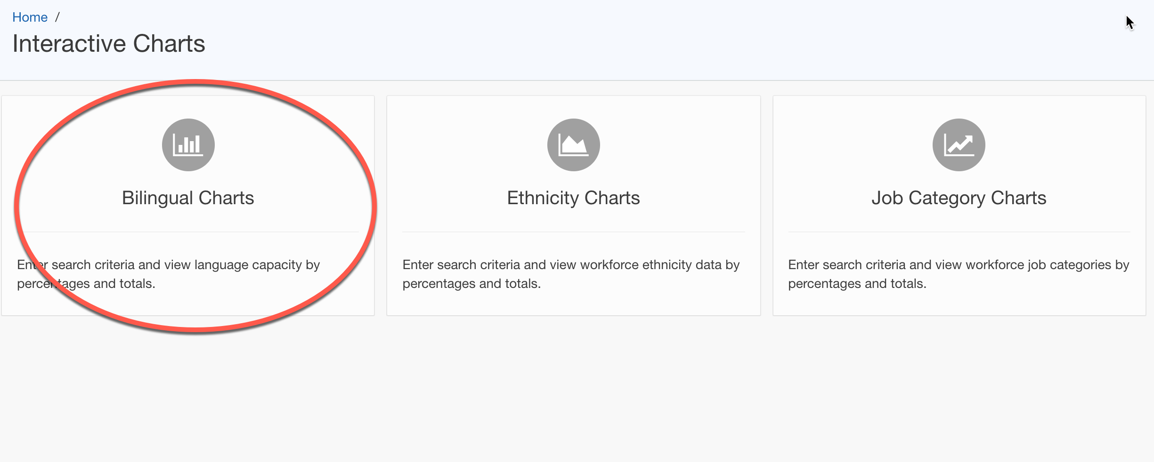
Interactive Charts
Bilingual charts: view the language capacity by percentages and totals
Ethnicity charts: view workforce ethnicities by percentages and totals
Job Category charts: view workforce job categories by percentages and totals
The system can create charts from the reports that a user generates. Three pre-created charts are accessible through the Interactive Charts: Bilingual Charts, Ethnicity Charts and Job Category Charts. These are shown on the Interactive Charts homepage (right).
Step 1: Click on the desired chart icon on the Interactive Charts homepage. The page will show a pie chart, column chart, and report which illustrate percentages and totals of workforce ethnicities.

Slide 26
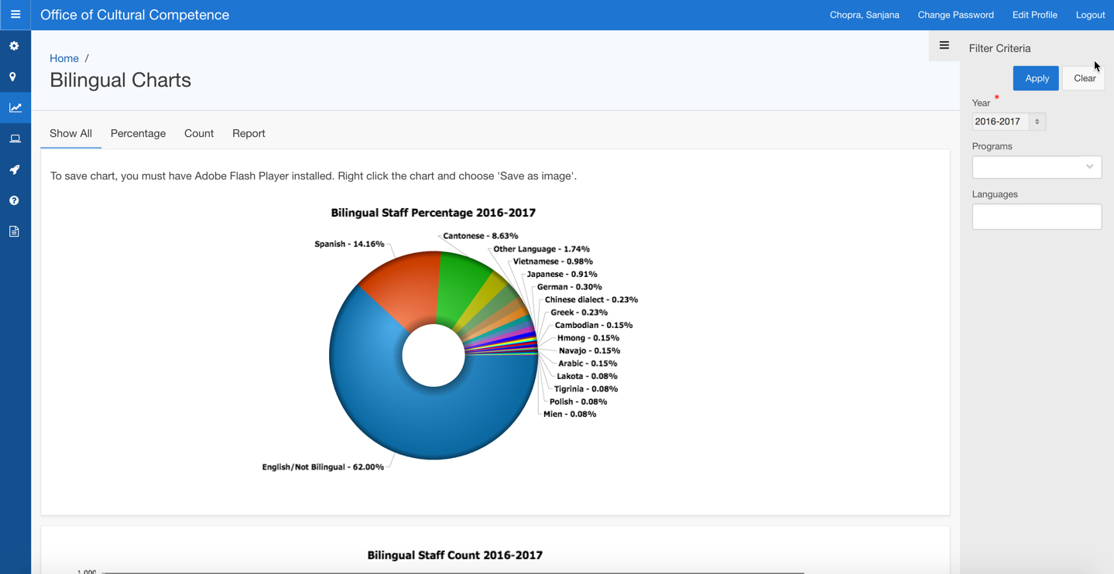
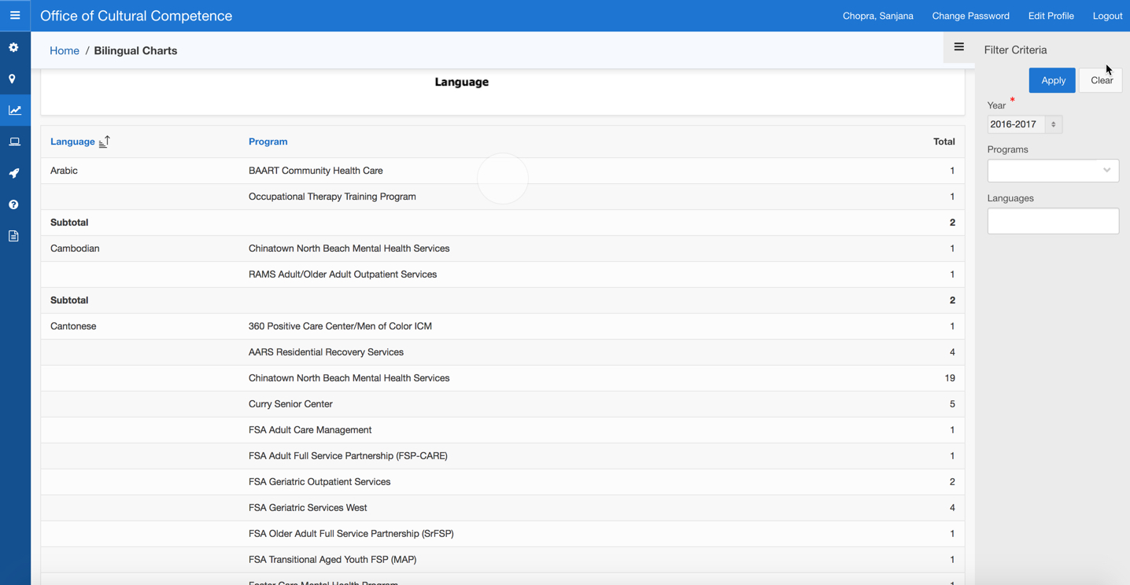
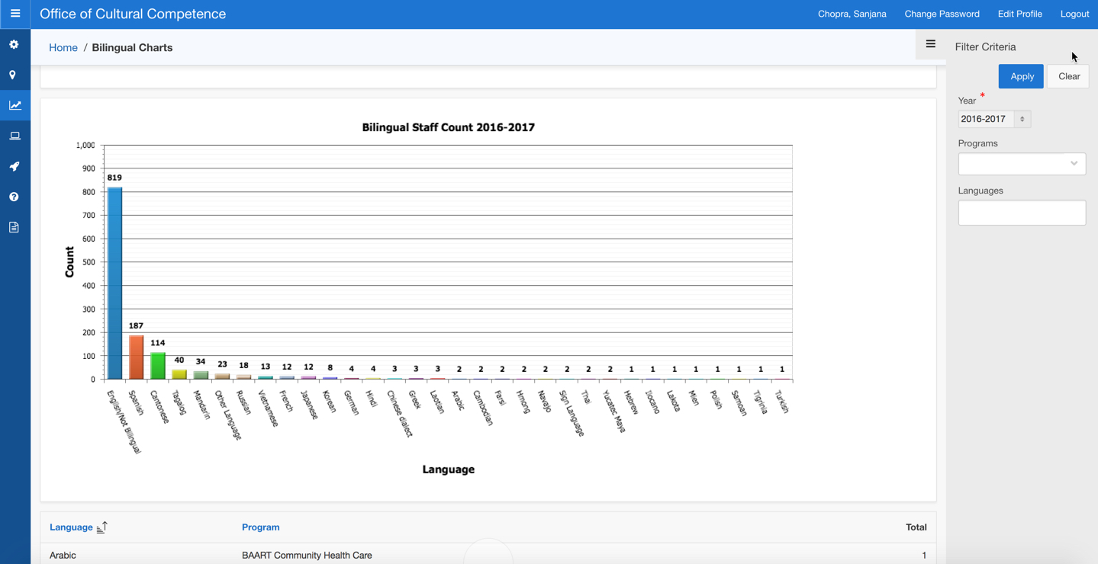
Interactive Charts
Step 2. Enter the filter criteria in the input fields on the right side of the screen. Then click “Apply” to run the query.
Step 3. The charts and report will show percentages and totals by program.
Step 4. Clicking “Clear” will remove the previous filters.

Slide 27
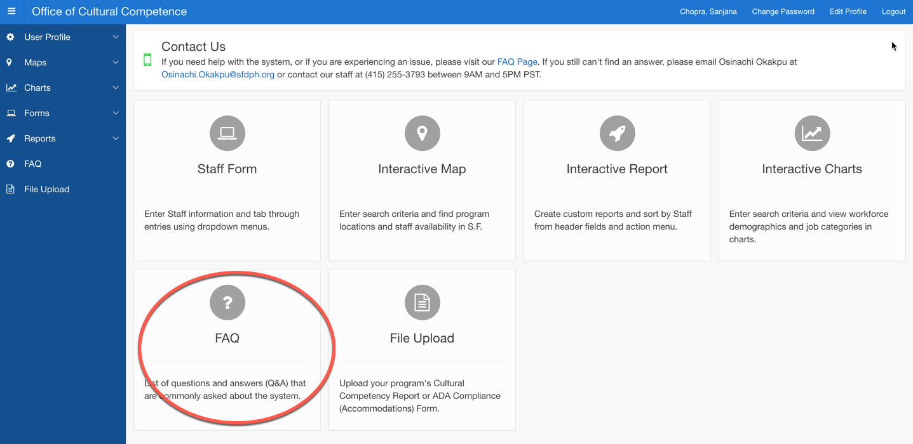
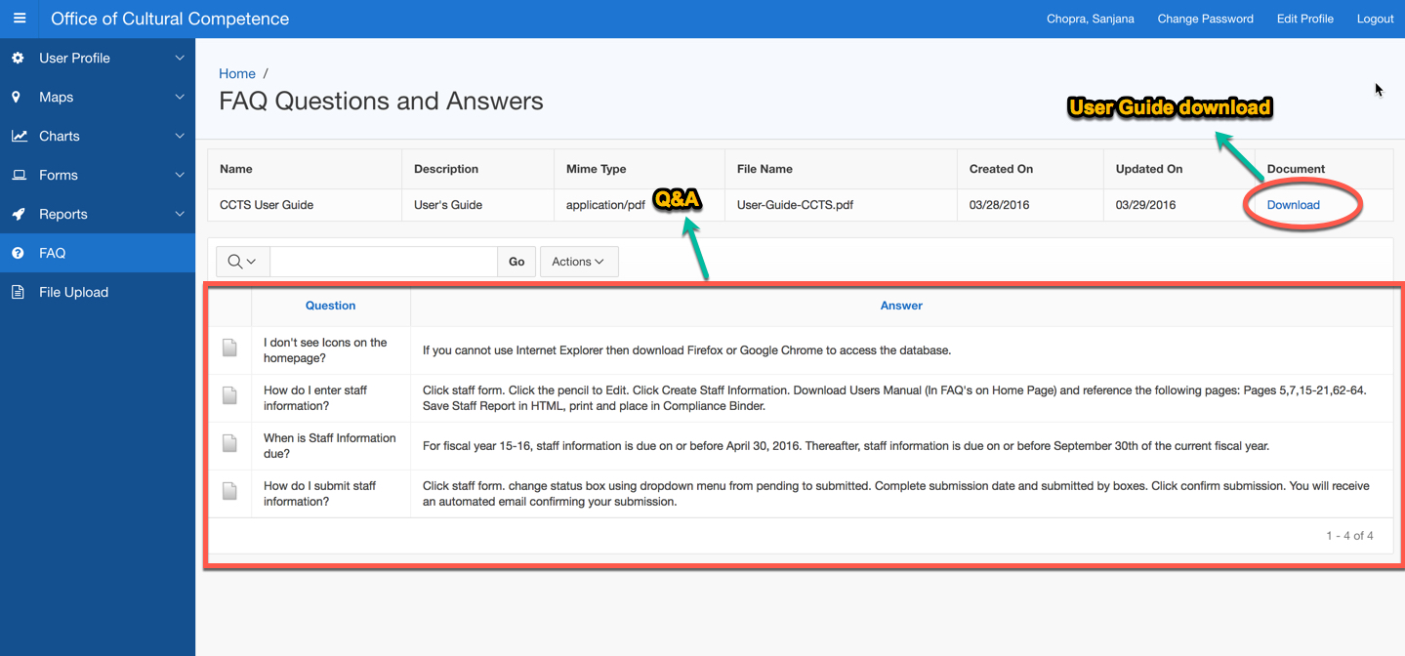
Frequently asked questions
The FAQ is a list of questions and answers (Q&A) that are commonly asked about the system. It helps users understand how to use the system effectively.
Step 1. Click the “FAQ” icon on the home page to go to the FAQ page.
The FAQ page also provides a link to download the User Guide.

Slide 28
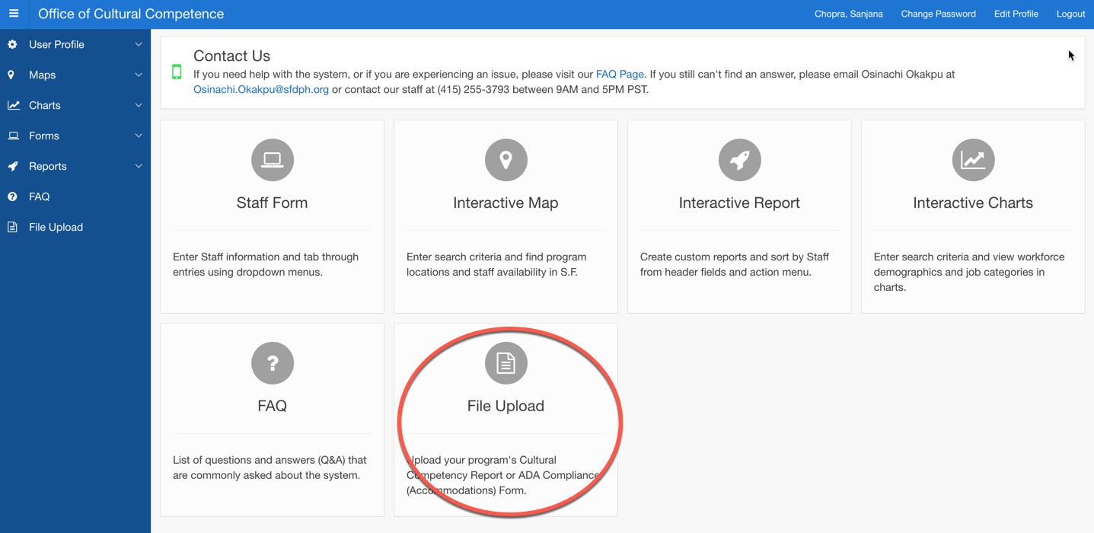
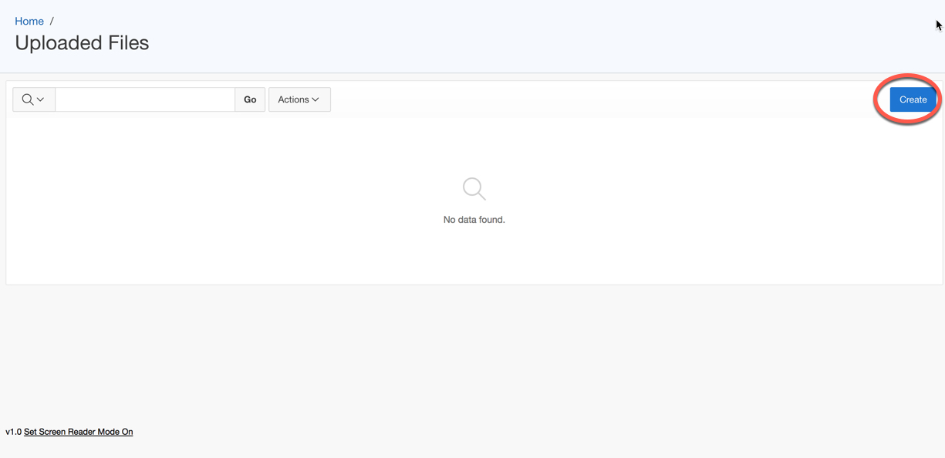
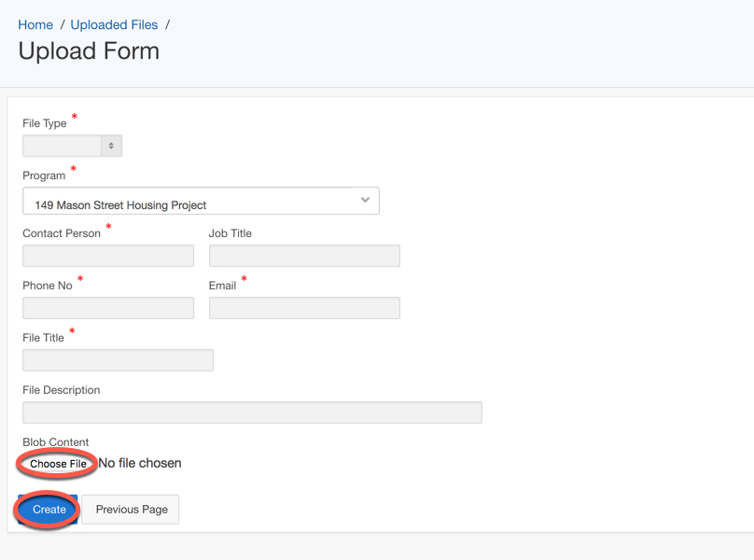
File Upload
Step 1. Click the “File Upload” icon on the home page to arrive at the Uploaded Files page
Step 2. Click “Create” to start the file upload process and arrive at the Upload Form page.
Step 3. Fill the required details about the file and select the file to be uploaded by clicking the “Choose File” link. Then click “Create” to upload the file. The file will appear in the list on the Files Uploaded page.

